Slide 1
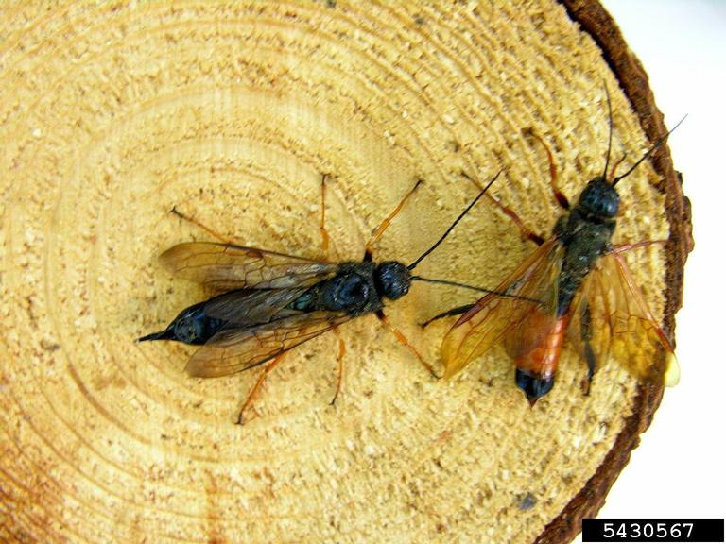
Sirex Woodwasp
Identifying Characteristics:
1 – 1 ½” long
Do not have narrow waists like many wasps
Metallic blue-black color
Females have orange legs
Males have orange in abdomen and black hind legs

Slide 2
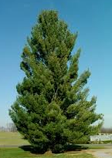
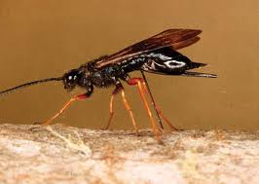
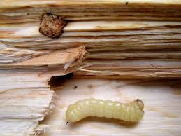
Sirex Woodwasp Relationship between Fungus and Wasp
Mucus kills tree cells and fungus eats dead cells
Wasp injects toxic mucus + fungus into tree while depositing eggs
Wasp eggs hatch and larvae feed on fungus
Mature wasp exits tree and carries mucus and fungus to another tree

Slide 3
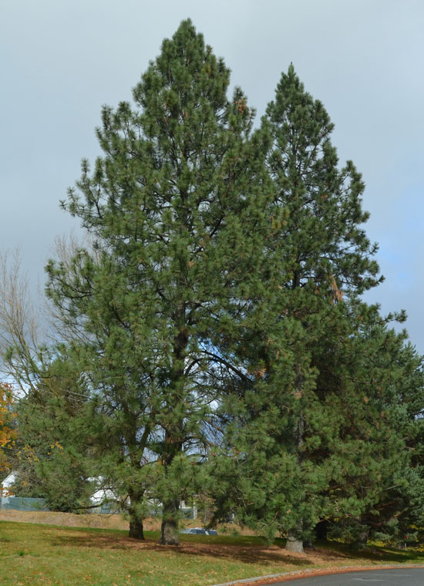
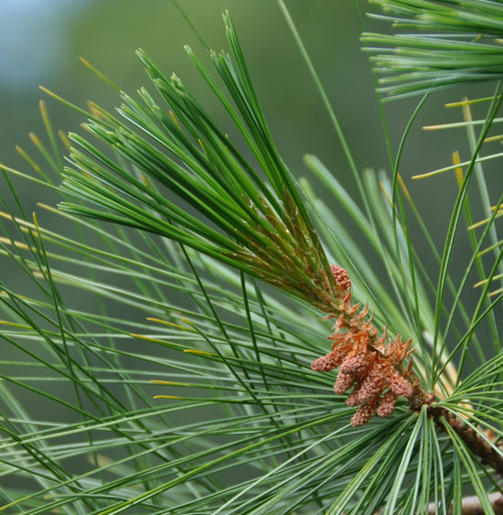
Sirex Woodwasp Common Host Trees
North American Pines
Scots Pine
White Pine
Notes:
Targets only one plant family (Pine)

Slide 4
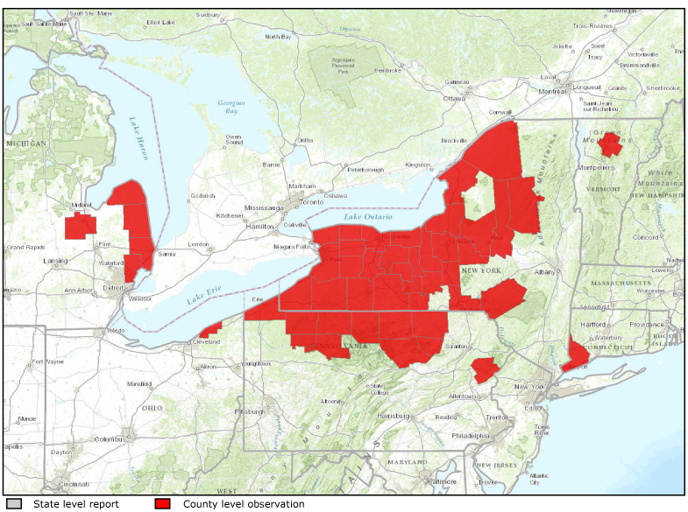
Sirex Woodwasp Map – Range of Sirex Woodwasp

Slide 5
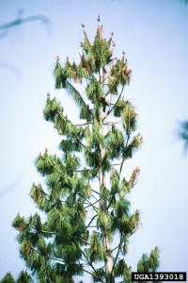
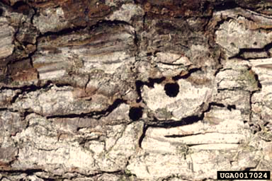
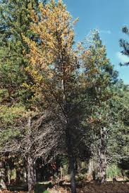
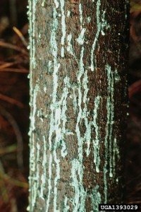
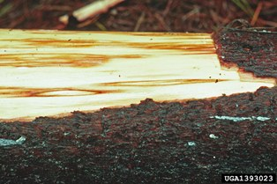
Sirex Woodwasp What to Look For
Small, round exit holes
Heavy needle fall and wilting
Progressive color changes at the top of the tree
Resin from egg-laying on branch and trunk
Brown fungal staining of sap wood
1
2
3
4
5

Slide 6
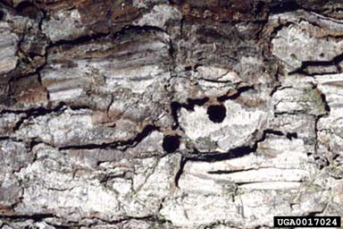
Sirex Woodwasp What to Look For
Small, round exit holes
Heavy needle fall and wilting
Progressive color changes at the top of the tree
Resin from egg-laying on branch and trunk
Brown fungal staining of sap wood
1
2
3
4
5

Slide 7
Sirex Woodwasp What to Look For
Small, round exit holes
Heavy needle fall and wilting
Progressive color changes at the top of the tree
Resin from egg-laying on branch and trunk
Brown fungal staining of sap wood
1
2
3
4
5

Slide 8
Sirex Woodwasp What to Look For
Small, round exit holes
Heavy needle fall and wilting
Progressive color changes at the top of the tree
Resin from egg-laying on branch and trunk
Brown fungal staining of sap wood
1
2
3
4
5

Slide 9
Sirex Woodwasp What to Look For
Small, round exit holes
Heavy needle fall and wilting
Progressive color changes at the top of the tree
Resin from egg-laying on branch and trunk
Brown fungal staining of sap wood
1
2
3
4
5

Slide 10
Sirex Woodwasp What to Look For (cont.)
LATE FALL/
EARLY WINTER:
Attacked trees have pale green, yellow or red needles at the top.
LATE SUMMER/
EARLY FALL:
Flight time for adults begins.
YEAR-ROUND: Heavy needle fall or wilting; Small, round exit holes.

Slide 11
Sirex Woodwasp Additional Resources
Southern Regional Extension Forestry
http://southernforesthealth.net/
USDA
http://www.na.fs.fed.us/spfo/pubs/pest_al/sirex_woodwasp/sirex_woodwasp.htm
Don’t Move Firewood
http://www.dontmovefirewood.org/gallery-of-pests/woodwasp.html
EDDMaps: Reporting App for Smartphones
http://www.eddmaps.org/

