Slide 1
Spotted lanternfly
Lycorma delicatula

Slide 2
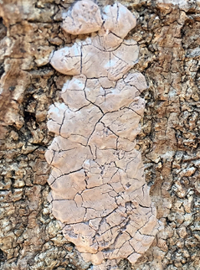
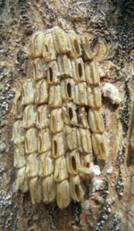
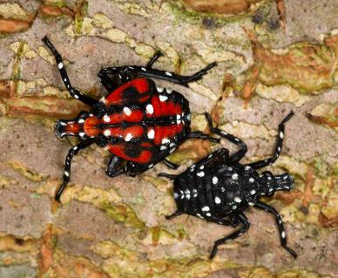
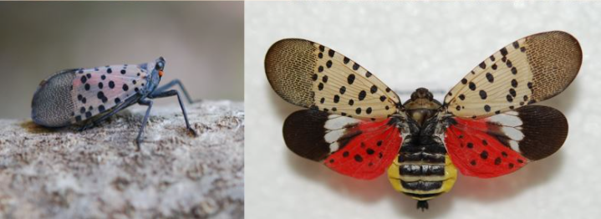
Spotted lanternfly Identifying characteristics
Early-stage nymphs have black bodies and legs and are covered in bright white spots. 1/8 – 1/4 inch long.
Late-stage nymphs are bright red with lateral black stripes and bright white spots. ~1/2 inch long.
Adults are ~1 inch long. When at rest, top wings are held tent-like and are gray with a pinkish tint and black spots. Underwings are bright red and may be seen in flight.
Egg masses are 1 to 1 1/2 inches long and covered in a grey putty-like substance, which cracks over time. Eggs are exposed in old egg masses after putty wears off completely.
Egg masses (new/old)
Nymphs (late/early)
Adult at rest
Adult in flight

Slide 3
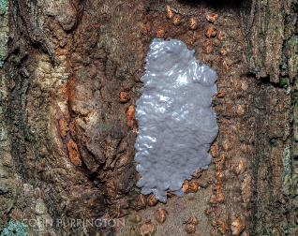
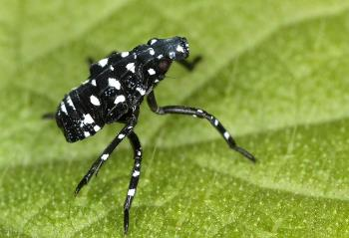
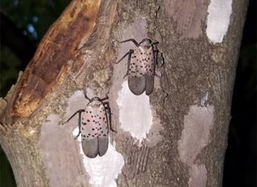
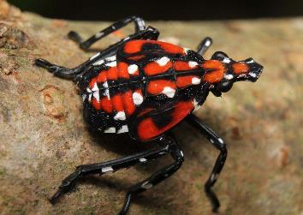
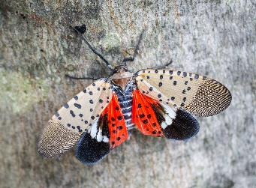
Spotted lanternfly Lifecycle
Adults mate in late summer. Females lay eggs on hard surfaces (trees, vehicles, furniture, etc.) in the fall.
Eggs overwinter, and egg masses are present from September to May.
Eggs hatch in early spring to early summer. Early-stage (black) nymphs are present from March to June.
Adults can be found from late summer to early winter.
Late-stage (red) nymphs appear in late summer to early fall.

Slide 4
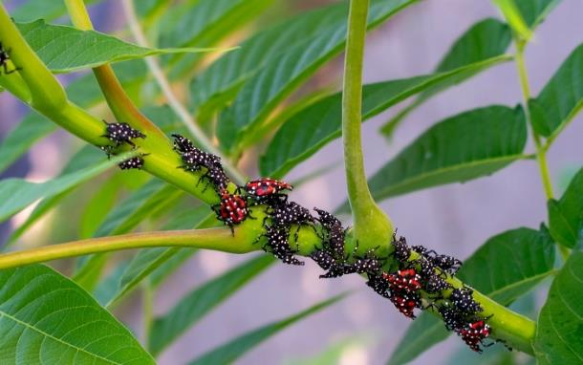
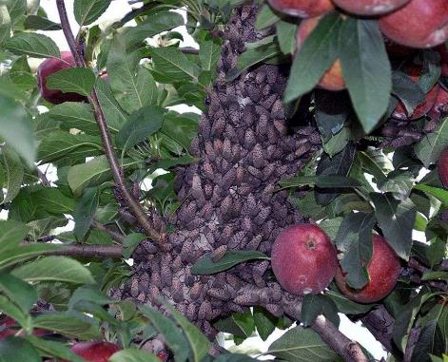
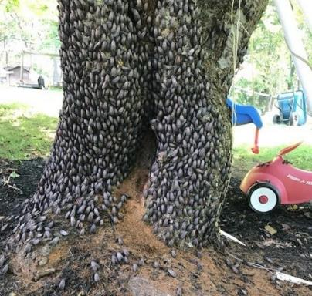
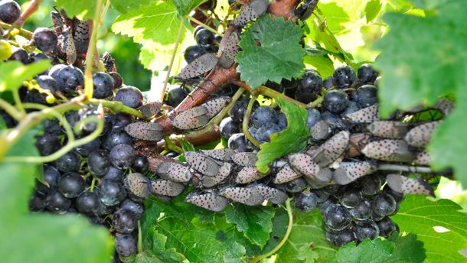
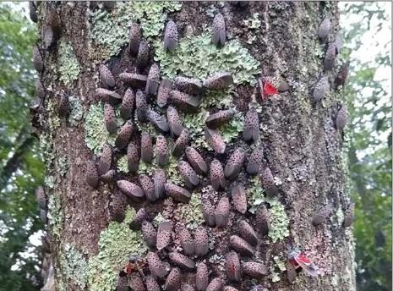
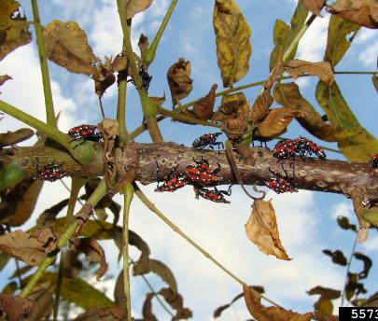
Spotted lanternfly Common hosts
Tree of heaven
Apple
Cherry
Grape
Maple
Walnut
Feeds on over 100 different plant species in North America (including grapevines, fruit tree, maple, black walnut, birch, willow, tree of heaven, and others).
Notes:
The spotted lanternfly uses its piercing-sucking mouthparts to feed on sap from over 100 different plant species. It has a strong preference for economically important plants including grapevines, maple trees, black walnut, birch, willow, and other trees. The feeding damage significantly stresses the plants which can lead to decreased health and potentially death.

Slide 5
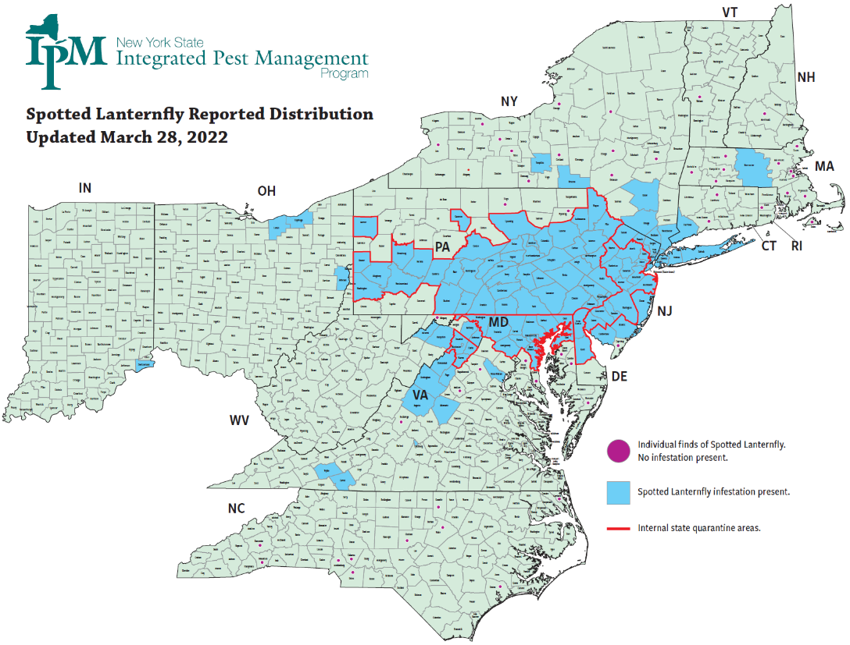
Spotted lanternfly Distribution
Notes:
Most recent map can be found at https://nysipm.cornell.edu/environment/invasive-species-exotic-pests/spotted-lanternfly/

Slide 6
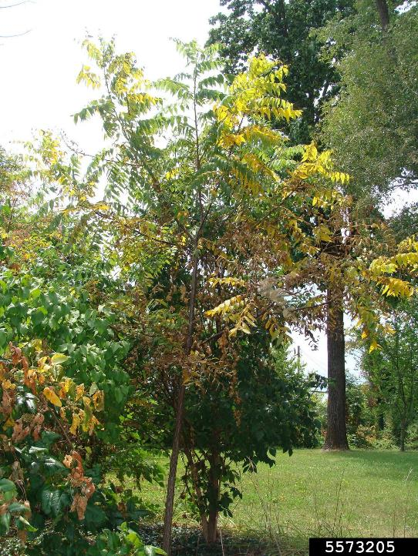
Spotted lanternfly What to look for
Both nymphs and adults cause damage when they feed, sucking sap from stems and branches.
Reduces photosynthesis
Weakens the plant
Can lead to death
Tree with damage from high population of spotted lanternfly. Photo: Eric R. Day, Virginia Polytechnic Institute and State University, Bugwood.org

Slide 7
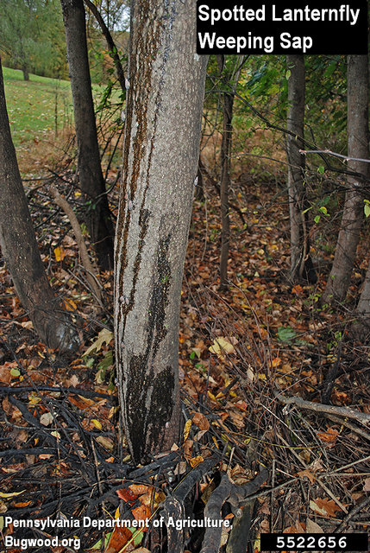
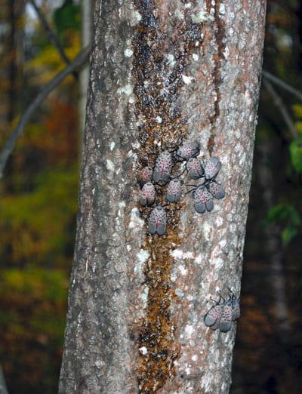
Spotted lanternfly What to look for
Both nymphs and adults cause damage when they feed, sucking sap from stems and branches.
Reduces photosynthesis
Weakens the plant
Can lead to death
Feeding on the phloem causes the plant to ooze or weep.
Spotted lanternfly feeding damage causes tree-of-heaven (Ailanthus altissima) to ooze sap. Photo: Pennsylvania Department of Agriculture , Bugwood.org .

Slide 8
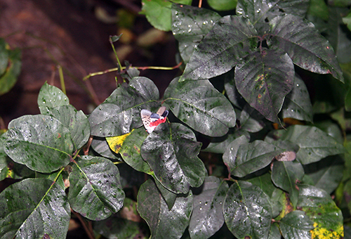
Spotted lanternfly What to look for
Both nymphs and adults cause damage when they feed, sucking sap from stems and branches.
Reduces photosynthesis
Weakens the plant
Can lead to death
Feeding on the phloem causes the plant to ooze or weep.
SLF excrete honeydew, which can cause sooty mold.
Honeydew produced by spotted lanternflies on foliage, with an adult spotted lanternfly. Photo: NYSIPM staff
Notes:
As SLF feeds, the insect excretes honeydew (a sugary substance) which can attract bees, wasps, and other insects. The honeydew also builds up and promotes the growth for sooty mold (fungi), which can cover the plant, forest understories, patio furniture, cars, and anything else found below SLF feeding.

Slide 9
Spotted lanternfly What to look for
SLF secretes honeydew
Honeydew is a sugar-rich, sticky liquid secreted by SLF.
Can attract bees, wasps, and other insects.
Honeydew produced by spotted lanternflies on foliage, with an adult spotted lanternfly. Photo: NYSIPM staff

Slide 10
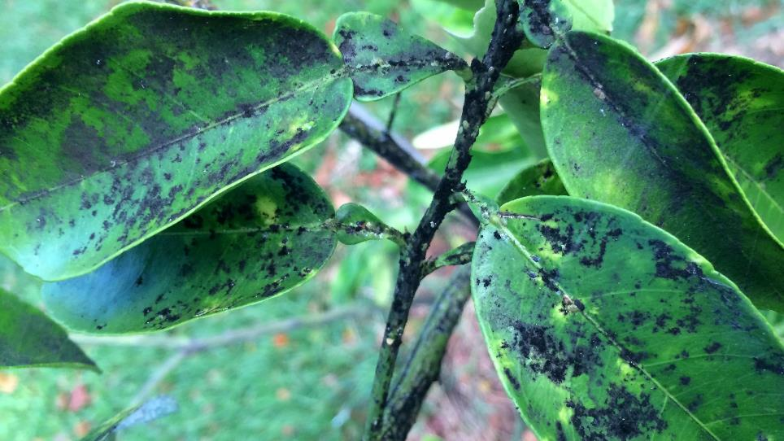
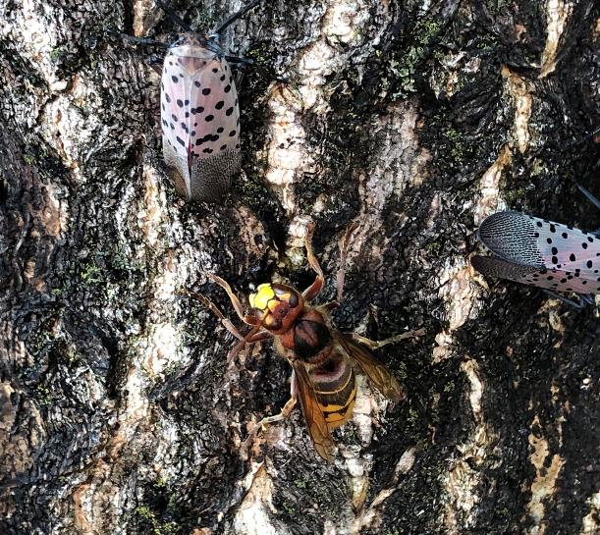
Spotted lanternfly What to look for
Honeydew can …
… cause sooty mold, which can cover the plant, forest understories, and anything else below the feeding site.
… attract bees, wasps, and other insects.

Slide 11
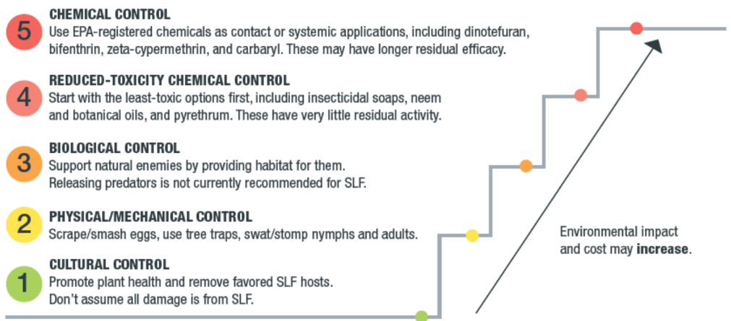
Spotted lanternfly Management
Chemical Control
Use EPA- registered chemicals as contact or systemic applications, including dinotefuran, bifenthrin, zeta-cypermethrin and carbaryl.
Reduced-Toxicity Chemical Control
Start with the least-toxic options first, including insecticidal soaps, neem, and botanical oils, pyrethrum. These have little residual activity.
Biological Control
Support natural enemies by providing habitat for them. Releasing predators is not currently recommended for SLF.
Physical/Mechanical Control
Scrape/smash eggs, use tree traps, sway/stomp nymphs and adults.
Cultural Control
Promote plant health and remove favored SLF hosts.
Use options in the lower steps before resorting to the careful use of chemical insecticides only when necessary. Photo and caption:
Penn State Extension (https://extension.psu.edu/spotted-lanternfly-management-guide)

Slide 12
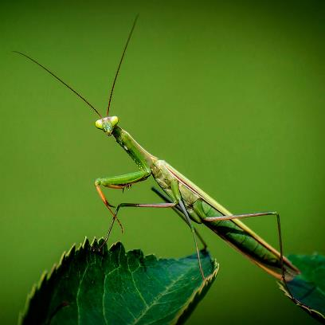
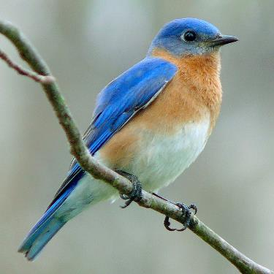
Spotted lanternfly Management
Chemical control: Control can be achieved by treating the affected host trees with a registered contact or systemic insecticide. Contact your local Extension agent for recommended products and applications.
Biological control: Support natural enemies by providing habitat for them. Releasing predators is not currently recommended for SLF.

Slide 13
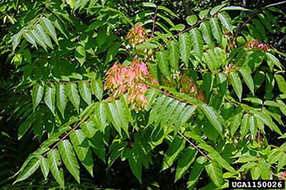
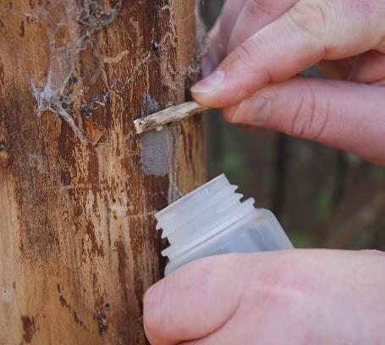
Spotted lanternfly Management
Mechanical control : Remove infested trees, find and destroy eggs, use traps (sticky bands, circle traps) to control nymphs and adults. cankerworm populations.
Cultural control: Remove infested trees and favored tree species, like tree of heaven (Ailanthus altissima).
The invasive Tree of heaven is a common
host for spotted lanternfly.
Photo: State of Michigan
Destroy SLF eggs by scraping them from the surface where they were laid into an alcohol solution.
Photo: Pennsylvania Department of Agriculture.

Slide 14
Spotted lanternfly Additional resources
Southern Regional Extension Forestry
http://southernforesthealth.net/
PennState
https://extension.psu.edu/spotted-lanternfly-management-resources
Entomological Society of America
https://www.entsoc.org/spotted-lanternfly-research-accelerates-effort-contain-invasive-pest
EDDMaps: Reporting App for Smartphones
http://www.eddmaps.org/

