Slide 1
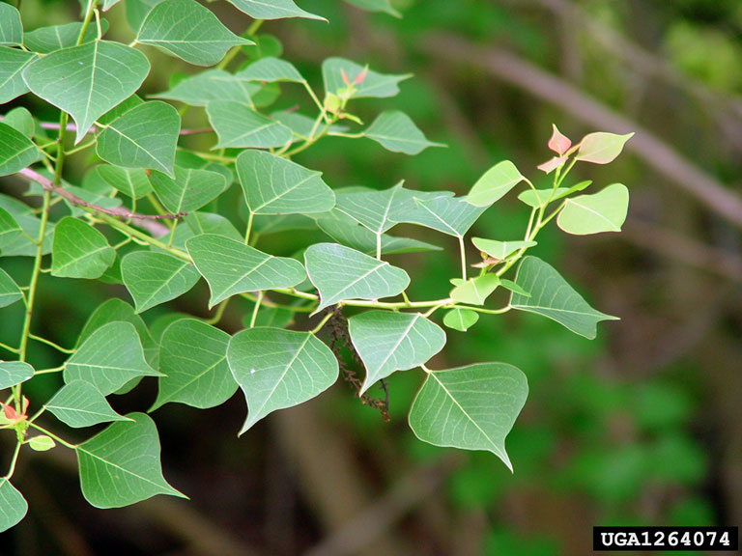
Chinese Tallow Tree
Triadica sebifera
Invasive, deciduous tree in the Euphorbiaceae (spurge) family
Commonly known as the popcorn tree
Chris Evans, University of Illinois, bugwood.org

Slide 2
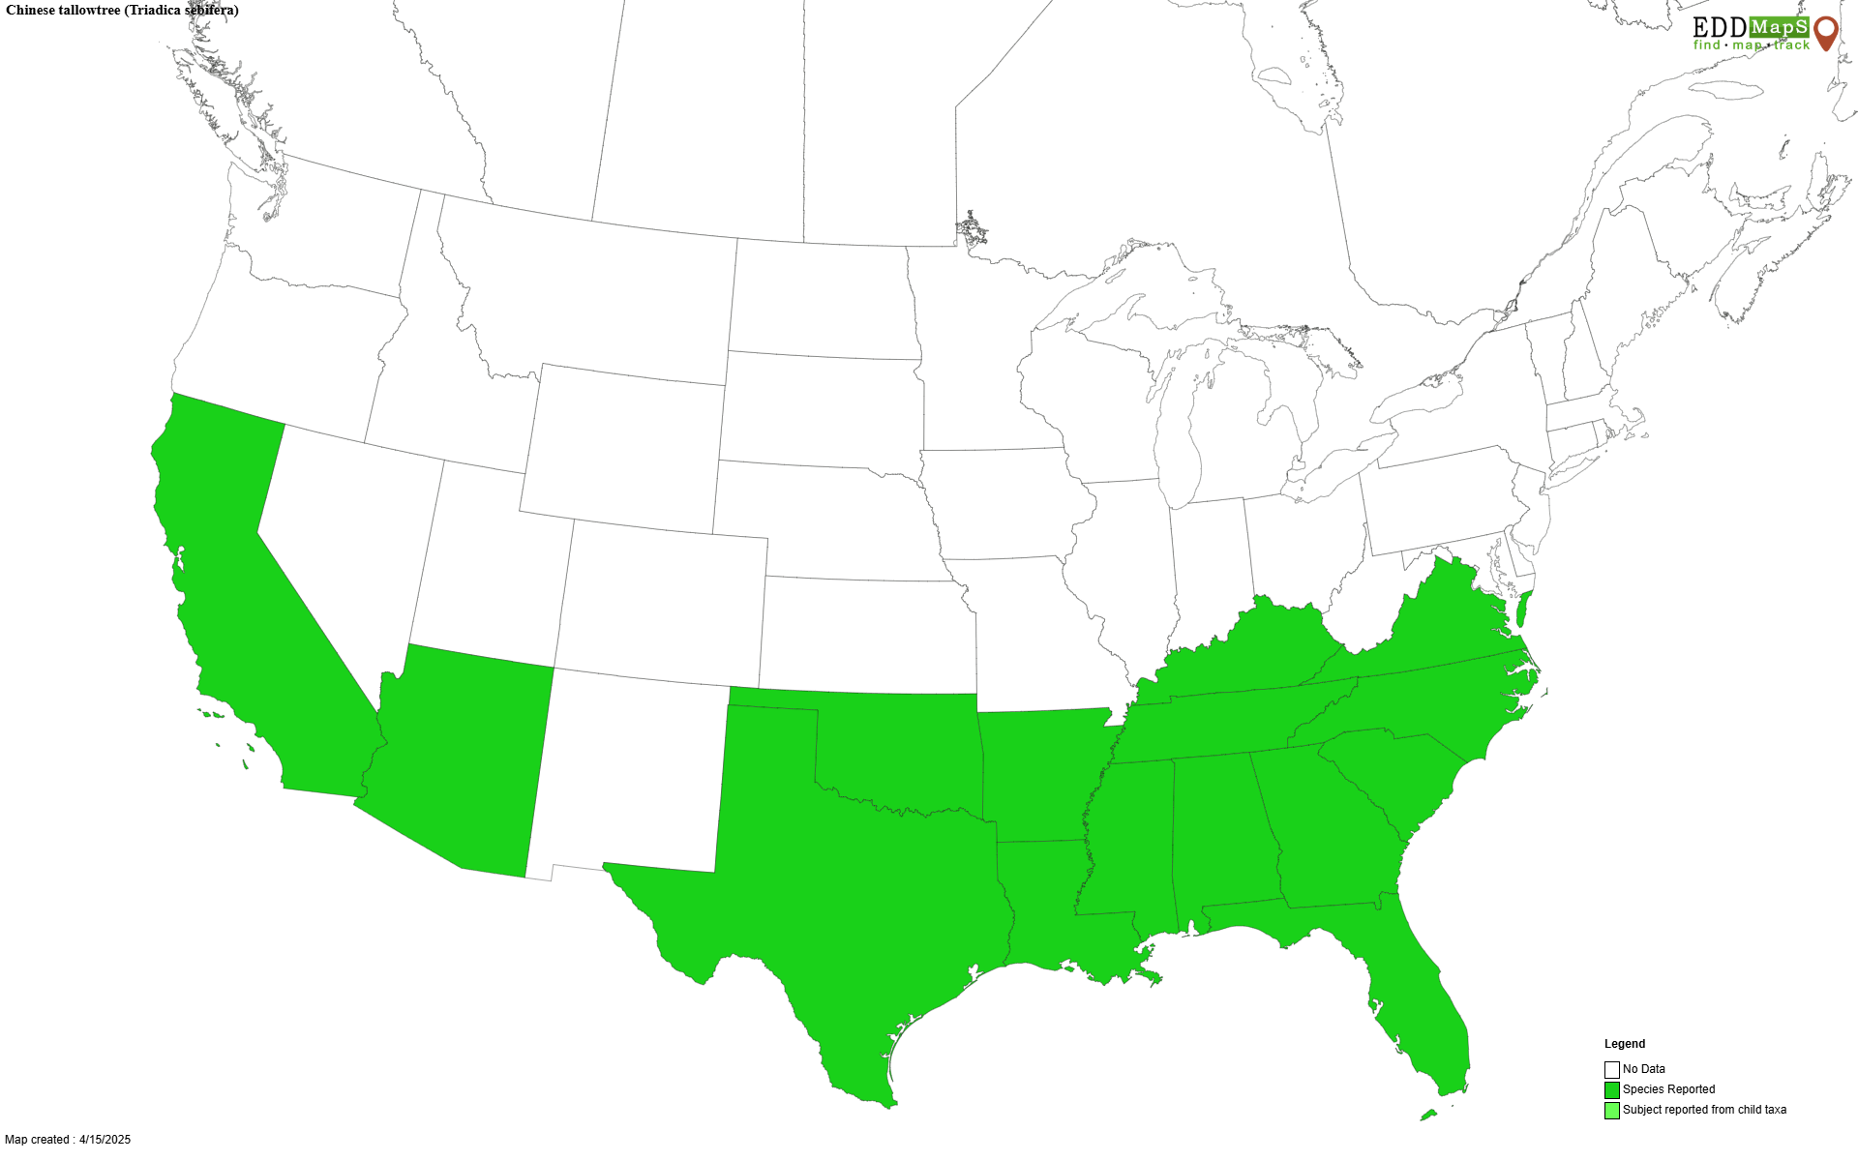
Chinese Tallow Tree Introduction
Native to parts of Asia including China and Japan.
Introduced to the US in the 1770s by Benjamin Franklin. Further promoted in the 1900s by the USDA to establish a soap industry.
Promoted as an ornamental shade tree, for honey production, and for bioenergy.
Mostly found throughout the southeastern US but a few trees can be found scattered throughout other states as far west as California.

Slide 3
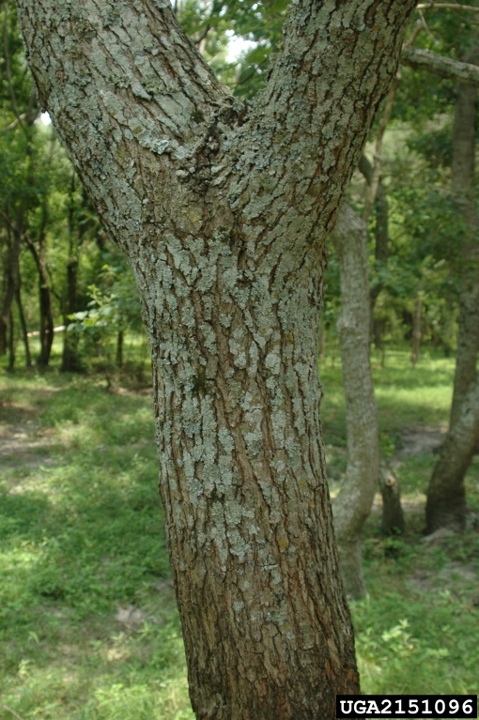
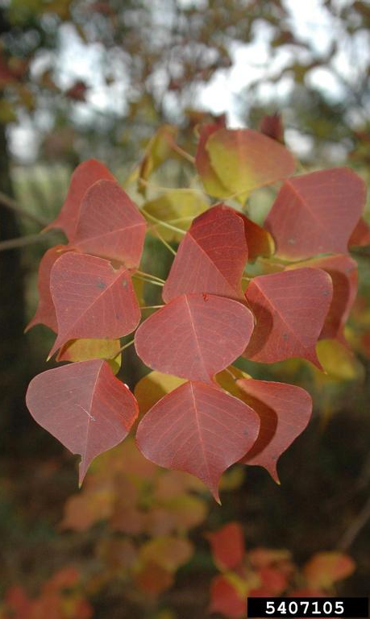
Chinese Tallow Tree Description
Height: 20-40 ft. on average but can reach heights of 70 ft.
Stem: gray color, relatively smooth but becomes furrowed with age.
Leaves: 1-3.5 inches long with similar width, alternately arranged with smooth edges, shape varies from broadly diamond shaped to ovate at the base and tapers to a point at the tip, known for their bright fall color ranging from bright yellow to reddish purple.
Chris Evans, University of Illinois, bugwood.org
Karan A. Rawlins, UGA, bugwood.org

Slide 4
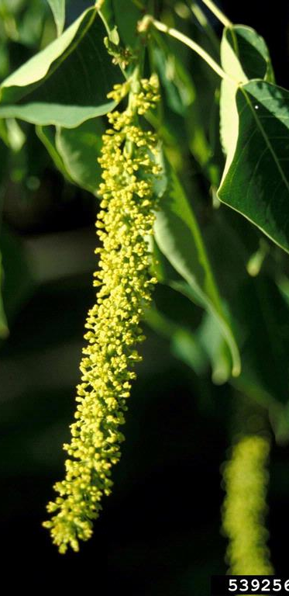
Chinese Tallow Tree Description
Flowers: yellowish green color and occur in clusters on long, dangling spikes known as catkins that are 2-8 inches long, both male and female flowers present, typically one catkin is produced per branch.
Fruits: 0.5-0.75 inches, round, three lobed capsule, greenish color that turns brown when mature and eventually splits open leaving three to four waxy, white seeds with a similar appearance to popcorn, found in clusters at the end of branches.
John M. Randall, TNC, bugwood.org
James H. Miller, USFS, bugwood.org

Slide 5
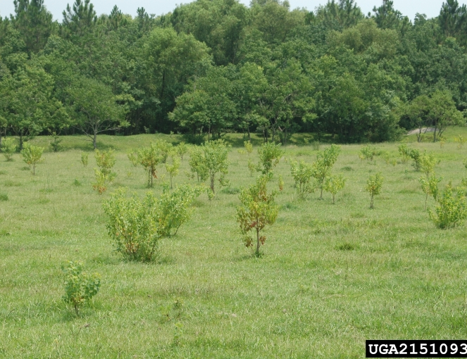
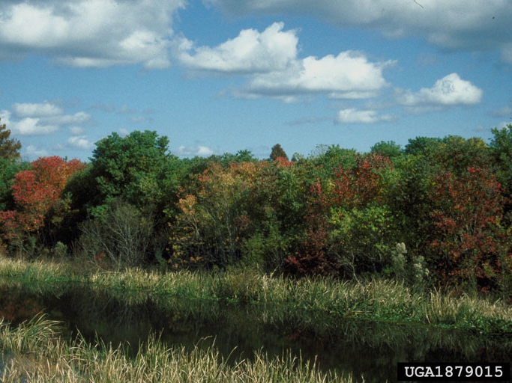
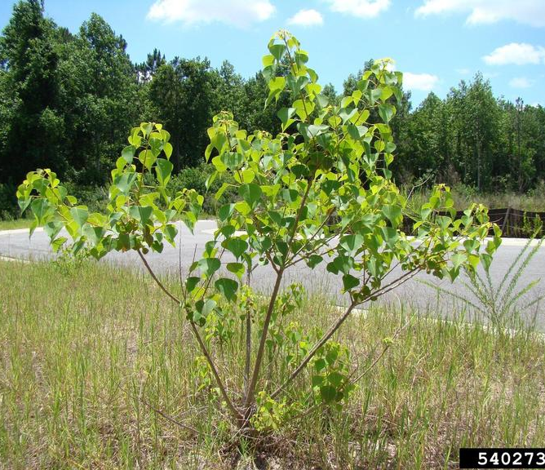
Chinese Tallow Tree Growth
Often planted as an ornamental tree in urban areas. Once spread into forested areas, it is a fast-growing tree that can form a monoculture.
Commonly found along roadways, in bottomlands, old fields, coastal prairies, and riparian areas.
Chris Evans, University of Illinois, bugwood.org
Cheryl McCormick, UF, bugwood.org
Rebekah D. Wallace, UGA, bugwood.org

Slide 6
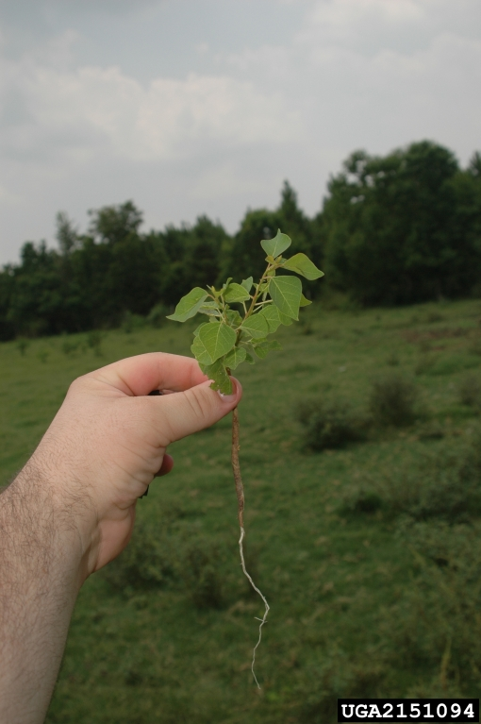
Chinese Tallow Tree What Makes it a Successful Invader?
Prolific fruit producer – 50,000 to 100,000 seeds can be produced by one tree, and they can remain viable in the soil for up to 5 years. Seeds are commonly spread by wildlife and water.
Adaptable – can tolerate a wide range of environmental conditions including a variety of soil conditions, periods of drought or flooding (has a significant taproot), exposure to salt water, and different light conditions.
Vegetative propagation – known as an aggressive sprouter that can sprout from roots and stumps.
Chris Evans, University of Illinois, bugwood.org

Slide 7
Chinese Tallow Tree Impact
Considered one of the most invasive trees in the southeastern US.
Outcompetes and crowds out native vegetation resulting in a closed canopy tallow tree forest (monoculture).
Difficult to remove once established – not all management options work for all areas.
Leaves, fruit, and sap are toxic to humans, pets, and cattle. Can cause nausea, vomiting, skin irritation, etc. Fallen leaves alter the soil chemistry by releasing high concentrations of tannins.

Slide 8
Chinese Tallow Tree Management
Mechanical control:
Hand pulling seedlings tends to be ineffective due to the significant tap root.
The use of heavy machinery can be effective at removing larger trees but runs into the same problem of leaving roots, which can lead to resprouting.
Since tallow tree resprouts from the stump, cutting without a follow-up herbicide treatment often leads to higher density stands.
Pairing with an herbicide stump treatment makes cutting tallow tree a more effective management strategy.

Slide 9
Chinese Tallow Tree Management
Chemical control:
Several herbicides may be used to effectively manage tallow tree, including imazapyr and triclopyr.
Chemical use can be challenging due to tallow tree frequently growing near water.
Chemical treatment often requires multiple applications.
Foliar broadcast treatments are most effective in late summer to early fall.
Cut-stump treatments are most effective in late fall.
Basal bark and hack and squirt treatments are most effective in the fall.

Slide 10
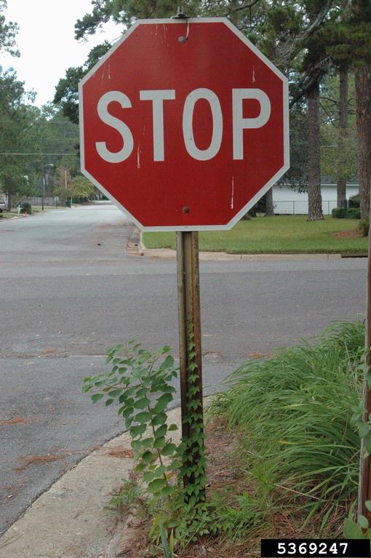
Chinese Tallow Tree Management
Stop the spread: do not plant tallow tree, prevent its spread to new areas by removing all Chinese tallow trees from your property, and be careful not to move plant materials that may sprout to other areas.
Prescribed fire: not very effective in managing tallow tree and in some cases, fire can promote growth by removing competing vegetation. May be effective as a part of an integrated pest management approach.
Biological control: grazing by cattle is not an option and goats do not prefer tallow tree. The USDA is working with two insects as biocontrol agents, but they have yet to be approved for release.
Joseph LaForest, UGA, bugwood.org

Slide 11
Chinese Tallow Tree Additional Resources
Southern Regional Extension Forestry
http://southernforesthealth.net/
University of Arkansas Cooperative Extension
https://www.uaex.uada.edu/environment-nature/ar-invasives/invasive-plants/chinese-tallow-tree.aspx
Alabama Cooperative Extension
https://www.aces.edu/blog/topics/forestry-wildlife/management-options-for-chinese-tallowtree/
* Created by Katy Crout Moretti & David Coyle (Clemson University); Reviewed by Lynne Womack (US Forest Service)

