Slide 1

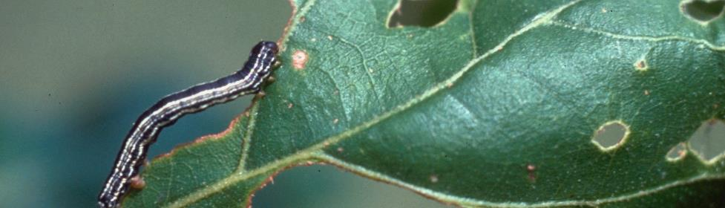
Fall cankerworm
Alsophila pometaria

Slide 2
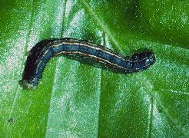
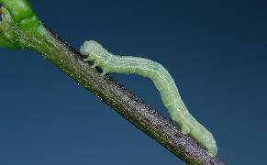
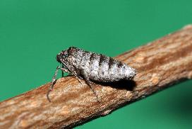
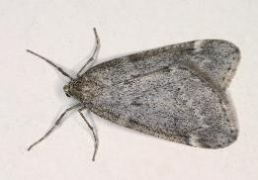
Fall cankerworm
Identifying characteristics
Larvae can be brown or green, with characteristic inchworm shape. Up to 2.5 cm in length.
Adults are ~1.5 cm long and have mottled gray-brown coloring.
  Winged males have a 2.4-3.5 cm wingspan.
  Adult females are wingless.
Larvae (green morph)
Larvae (brown morph)
Adult female
Adult male

Slide 3
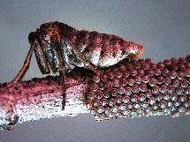
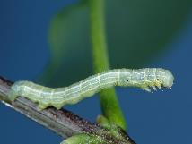
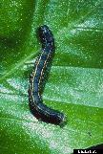
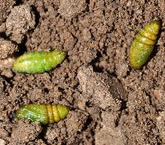
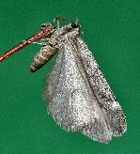
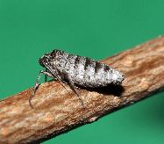
Fall cankerworm
Lifecycle
Eggs hatch in spring around bud break, larvae begin feeding on new leaves.
Females climb the nearest tree, mate, and lay egg masses on smaller branches.
Larvae drop from trees, burrow under soil surface and spin cocoons to pupate (late spring – early fall).
Adults emerge from the soils when temps drop to freezing in late fall/early winter.

Slide 4
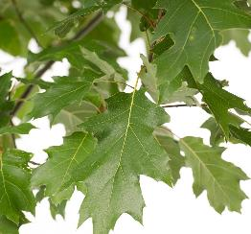
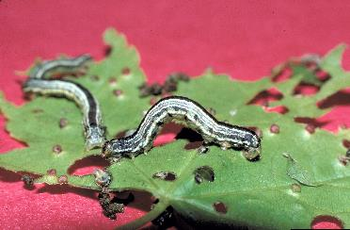
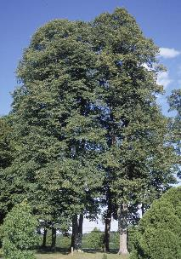
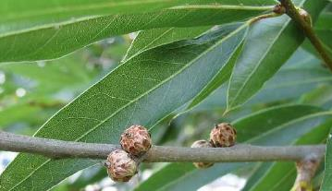
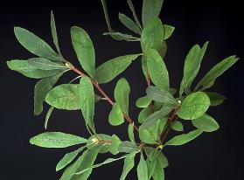
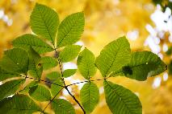
Fall cankerworm
Common hosts
Maple
Basswood
Oak
Hickory
Oak
Azalea
North American deciduous trees and smaller, woody shrubs.

Slide 5
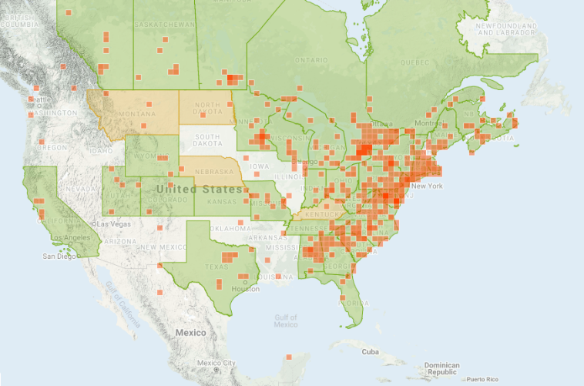
Fall cankerworm
Distribution
inaturalist.org

Slide 6
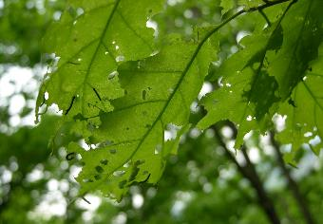
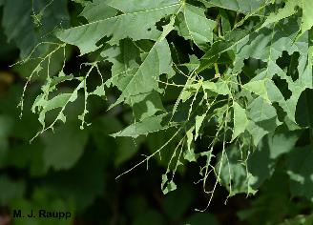
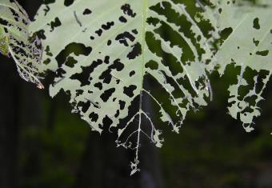
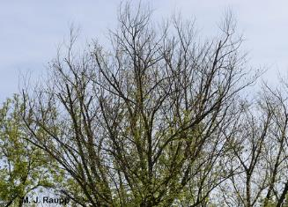
Fall cankerworm
What to look for
At bud break, larvae chew small holes, which become more irregular as they develop.
Eventually, larvae skeletonize new leaves by feeding between small veins.
Mature larvae consume entire leaf, leaving midrib and major veins.
Extensive feeding after years of defoliation can lead to branch dieback, reduced growth and death.

Slide 7
Fall cankerworm
What to look for
At bud break, larvae chew small holes, which become more irregular as they develop.
Eventually, larvae skeletonize new leaves by feeding between small veins.
Mature larvae consume entire leaf, leaving midrib and major veins.
Extensive feeding after years of defoliation can lead to branch dieback, reduced growth and death.

Slide 8
Fall cankerworm
What to look for
At bud break, larvae chew small holes, which become more irregular as they develop.
Eventually, larvae skeletonize new leaves by feeding between small veins.
Mature larvae consume entire leaf, leaving midrib and major veins.
Extensive feeding after years of defoliation can lead to branch dieback, reduced growth and death.

Slide 9
Fall cankerworm
What to look for
At bud break, larvae chew small holes, which become more irregular as they develop.
Eventually, larvae skeletonize new leaves by feeding between small veins.
Mature larvae consume entire leaf, leaving midrib and major veins.
Extensive feeding after years of defoliation can lead to branch dieback, reduced growth and death.

Slide 10
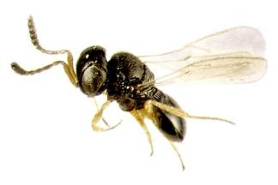
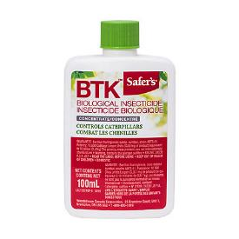
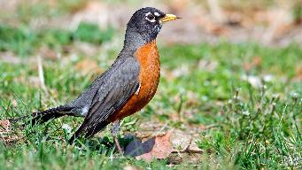
Fall cankerworm
Management
Natural Control: Predators including birds, spiders, small rodents and the egg parasitoid, Telenomus alsophilae help control fall cankerworm populations.
Chemical control: Control can be achieved by treating the affected host trees with a registered insecticide soon after the larvae first become active and after the leaves have sufficiently expanded for coverage by the spray.

Slide 11
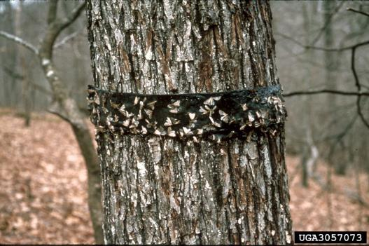
Fall cankerworm
Management
Mechanical Control: Landscape trees can be banded with sticky material to intercept adult females as they climb, preventing oviposition and therefore reducing larval abundance and defoliation.
Silvicultural Control: Reducing overall tree stress and promoting diverse urban canopies will help reduce potential damage from fall cankerworm.

Slide 12




Fall cankerworm
Additional resources
Southern Regional Extension Forestry
http://southernforesthealth.net/
USDA
https://www.fs.usda.gov/Internet/FSE_DOCUMENTS/stelprdb5426975.pdf
Entomological Society of America
https://academic.oup.com/jipm/article/12/1/23/6287317
EDDMaps: Reporting App for Smartphones
http://www.eddmaps.org/

