Slide 1



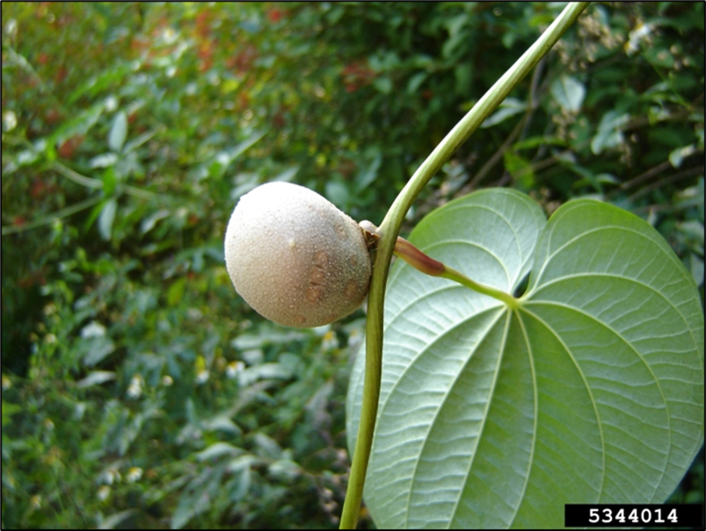
Air-Potato
Dioscorea bulbifera
Also known as air potato vine, air yam, and bitter yam
Non-native perennial vine in the Dioscoreaceae (yam) family
Karen Brown, UF, bugwood.org

Slide 2

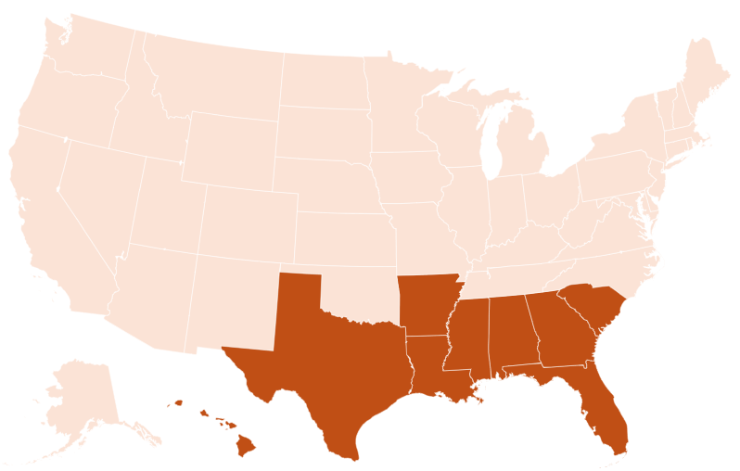
Air-Potato Introduction
Originates from parts of Asia and Africa
Introduced to Alabama in the late 1700s and Florida in 1905
Cultivated as an ornamental and possible food crop
As of 2024, found in several eastern states and Hawaii

Slide 3
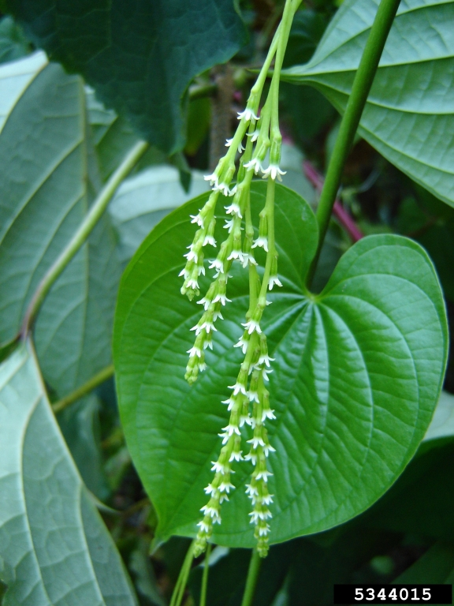
Air-Potato Description
Leaf: 2-10 inches long, heart shaped with elongated tips, glabrous (hairless), alternate arrangement, entire (smooth) margins, and prominent veins originating from the leaf base
Flowers: inconspicuous, grow from leaf axils in panicles 4 inches long; rarely seen in the US as vegetative reproduction is more common
Karen Brown, UF, bugwood.org

Slide 4
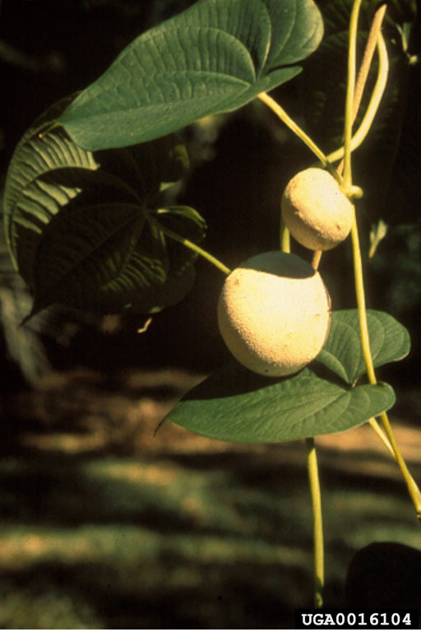
Air-Potato Description
Stem: slender vines, twine counter-clockwise
Bulbils: aerial potato-like tubers, up to 6 inches long, brown to gray color, may be smooth or have a warty texture, 1-4 created at each leaf axil
Fred Nation, bugwood.org

Slide 5
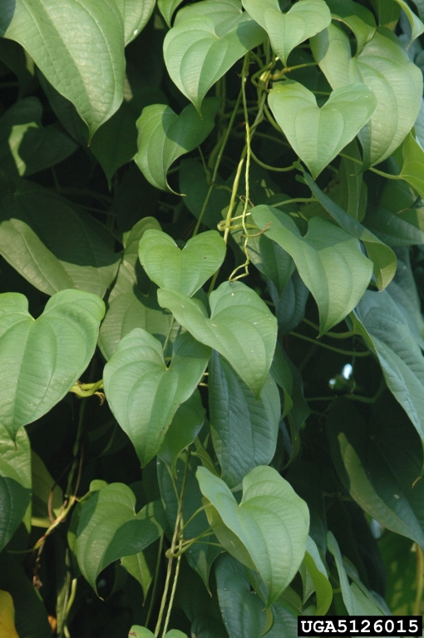
Air-Potato Look-Alikes
Dioscorea alata
Common name: winged, white, or greater yam
Difference: vine twines clockwise, opposite leaves, produces more elongated and fewer aerial tubers
Chris Evans, University of Illinois, bugwood.org

Slide 6
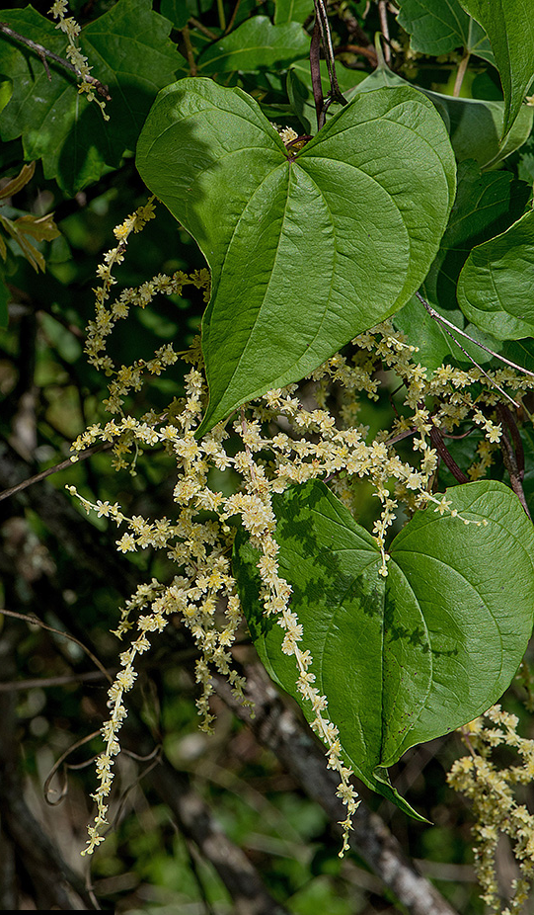
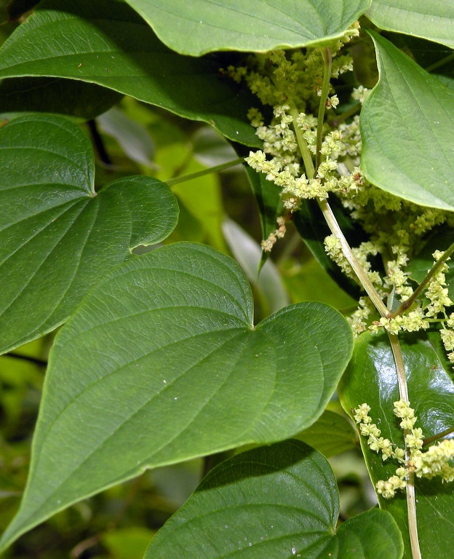
Air-Potato Look-Alikes
Dioscorea floridana (Florida yam) and Dioscorea villosa (Wild yam)
Native species to the southeastern US
Difference: smaller leaves on lower climbing vines, never produce aerial tubers
Roger Hammer, Florida Plant Atlas
Dough McGrady, NC State Extension

Slide 7
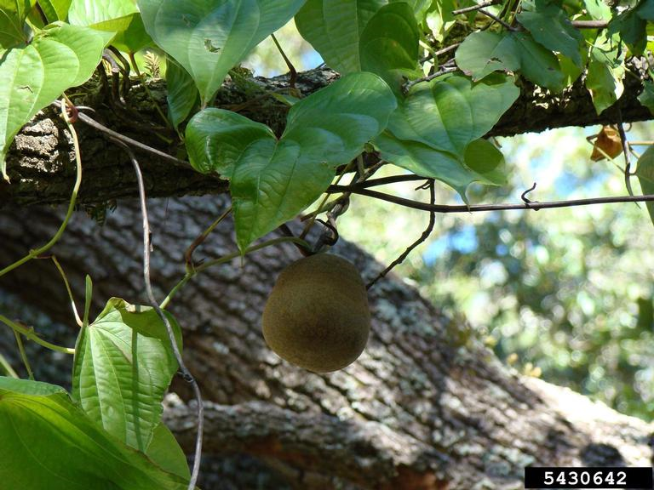
Air-Potato Growth
Dioecious – separate male and female plants
Only female D. bulbifera plants have been found in the US = sexual reproduction does not occur
Vegetative reproduction occurs through sprouting of bulbils to create clones
Bulbils drop from the vine and can go through a dormant period before sprouting at the beginning of the next growing season
Rebekah D. Wallace, UGA, bugwood.org

Slide 8
Air-Potato What Makes it a Successful Invader?
Quick growth rate – vines can grow approximately 8 inches per day and up to 65 feet in a growing season (7–9-month period)
Produce large numbers of propagules – each plant can produce over 300 bulbils per growing season
Asexual reproduction – no pollination needed, reproduce solely by bulbils and underground tubers

Slide 9
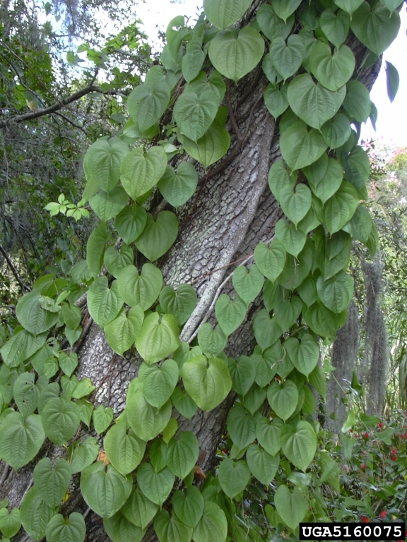
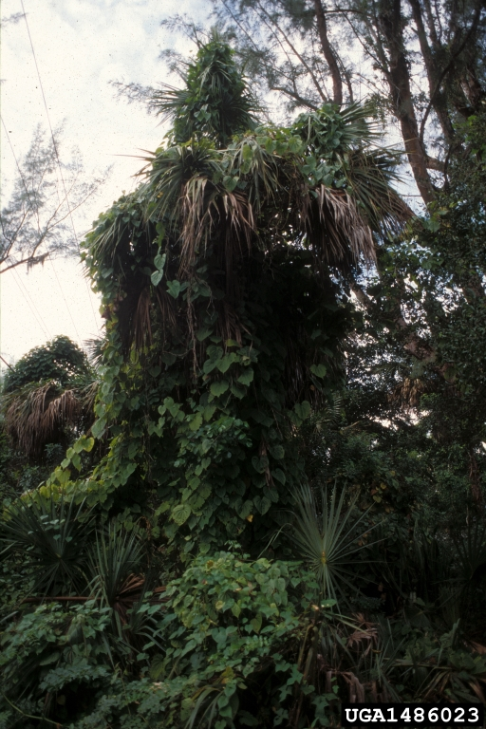
Air-Potato Impact
Vines of D. bulbifera can grow into dense masses blanketing everything beneath
Ecological impact = vines grow on and kill native vegetation
Forest and Kim Starr, bugwood.org
Dan Clark, bugwood.org

Slide 10
Air-Potato Management
Prevention – movement of contaminated debris, soil, equipment, etc. can start new populations of D. bulbifera.
Mechanical – remove vines and bulbils by placing in bags or burn to prevent further spread. Can be labor intensive, time consuming, and temporary if underground tubers are not also removed. Even a small section left behind can regrow.
Chemical – triclopyr and glyphosate can be used to manage D. bulbifera. But chemicals can be costly, must be reapplied, take several treatments to potentially kill underground tubers, and damage to non-targets plants are likely.

Slide 11
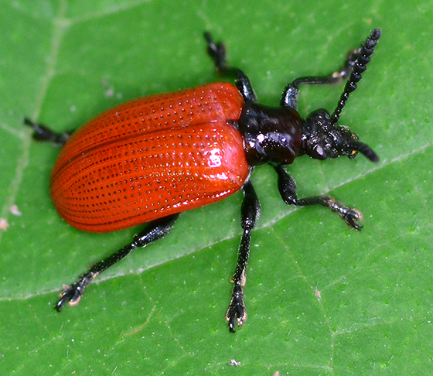
Air-Potato Management
Biological – A 10-year collaboration between several organizations found that the air-potato leaf beetle (Lilioceris cheni) feeds on air-potato leaves. Its release and establishment has led to a decrease in the spread of D. bulbifera and a reduction in vine biomass and bulbil production.
bugguide.net

Slide 12



Air-Potato Additional Resources
Southern Regional Extension Forestry
http://southernforesthealth.net/
USDA National Invasive Species Information Center
https://www.invasivespeciesinfo.gov/terrestrial/plants/air-potato#cit
Florida Department on Agriculture and Consumer Services
https://www.fdacs.gov/Agriculture-Industry/Pests-and-Diseases/Plant-Pests-and-Diseases/Noxious-Weeds/Dioscorea-bulbifera-Air-Potato
* Created by Katy Crout Moretti & David Coyle (Clemson University); Reviewed by Lynne Womack (US Forest Service)

