Slide 1



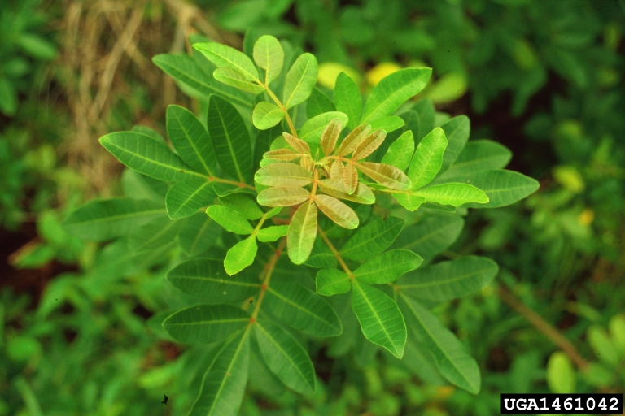
Brazilian Peppertree
Schinus terebinthifolius
Also known as Christmas berry, Florida holly, and broad leaf pepper tree
Invasive evergreen shrub or small tree in the Anacardiaceae family
Amy Ferriter, State of Idaho, bugwood.org

Slide 2
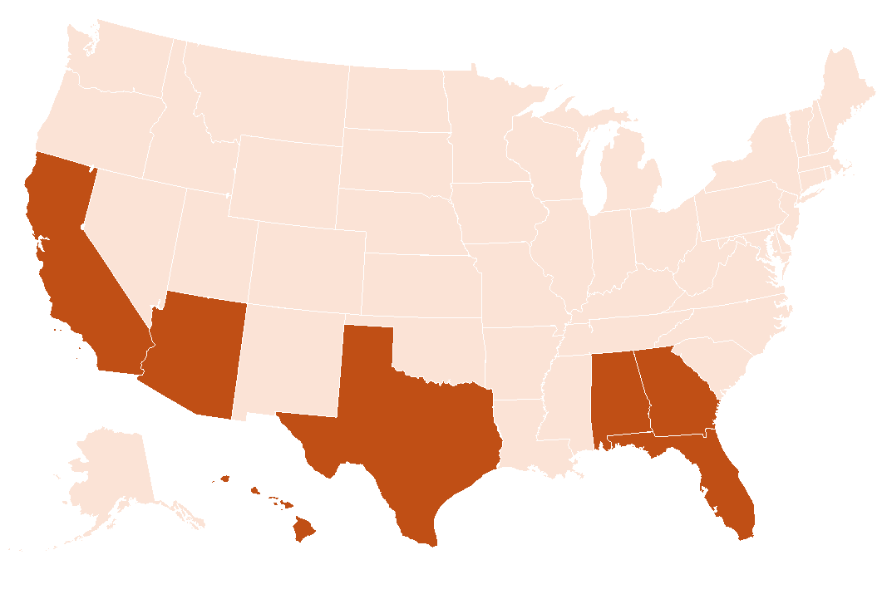
Brazilian Peppertree
Introduction
Native to South America
Introduced to Florida in the 1840s as an ornamental
Can be found in several southern states
Also invasive in other countries including Spain, Portugal, Australia, New Zealand, and South Africa
Recognized as a nuisance weed in the 1950s

Slide 3
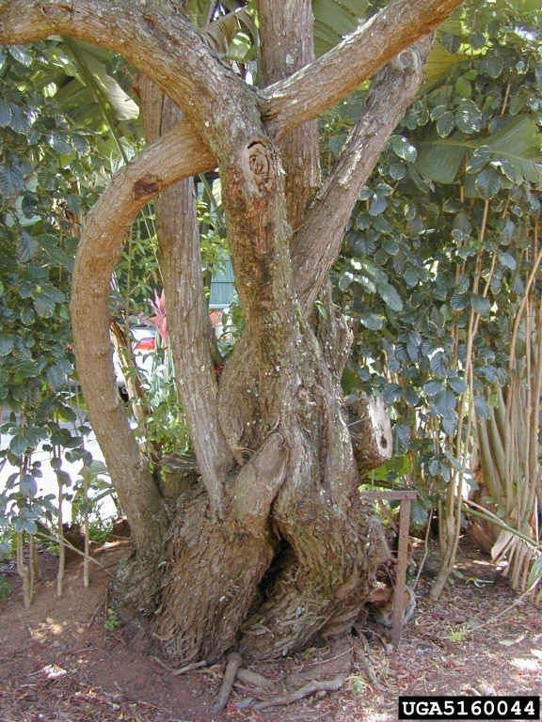
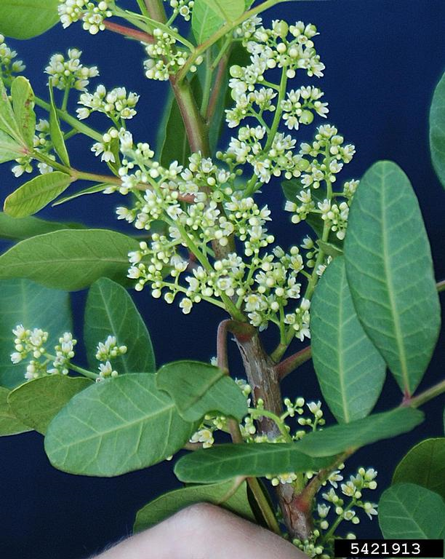
Brazilian Peppertree
Description
Height: 10-30 feet
Stems: gray, smooth or furrowed into narrow, flat ridges
Flowers: five greenish-white petals, in clusters
Forest and Kim Starr, bugwood.org
James H. Miller, USDA, bugwood.org

Slide 4
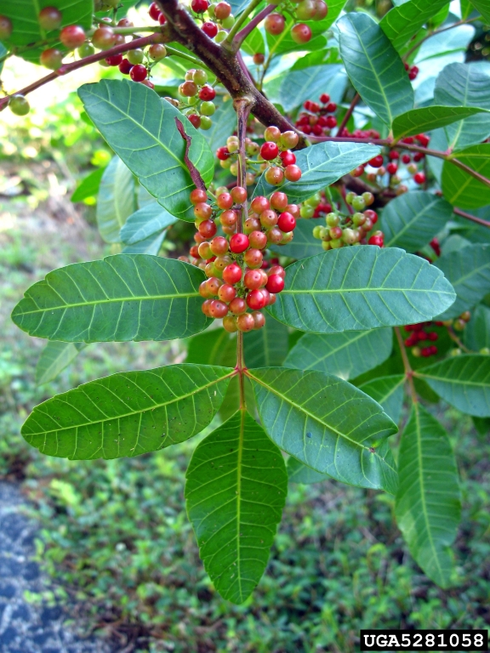
Brazilian Peppertree
Description
Leaves: shiny green, alternate, odd pinnately compound, 3-12 inches long with leaflets that are 1-2 inches long, very aromatic
Fruits: small drupes, begin as glossy green but mature to bright red, form in a dense cluster
Dan Clark, National Park Service, bugwood.org

Slide 5
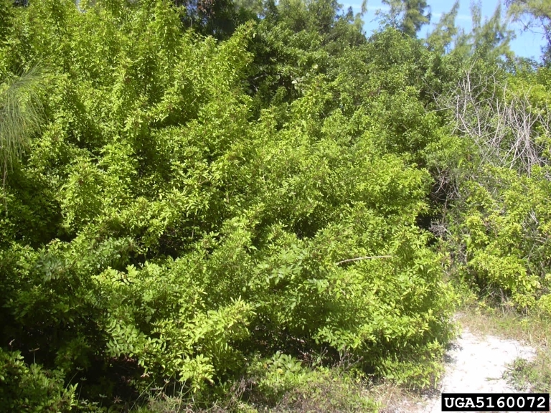
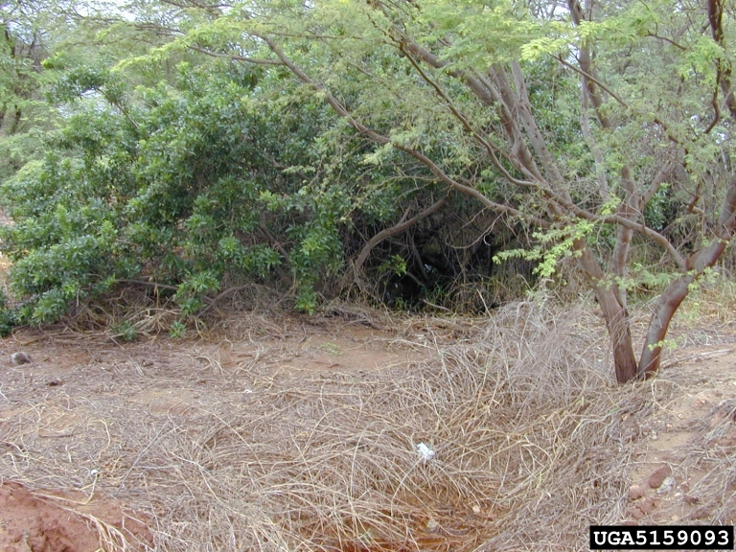
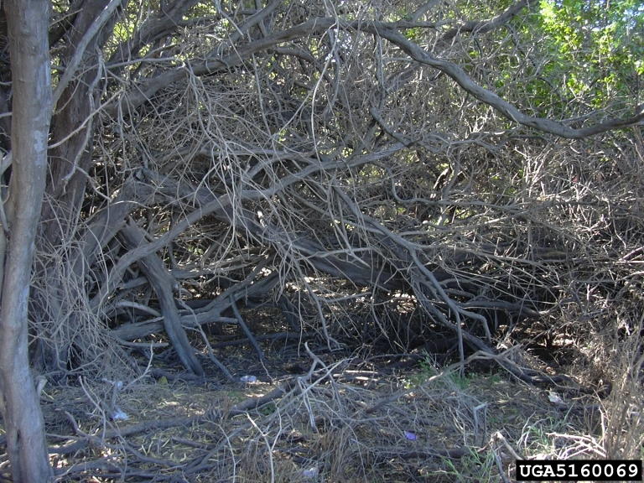
Brazilian Peppertree
Growth
Dioecious – separate male and female plants
Short trunk that gives way to long, intertwining branches
Produces dense thickets
Forest and Kim Starr, bugwood.org

Slide 6
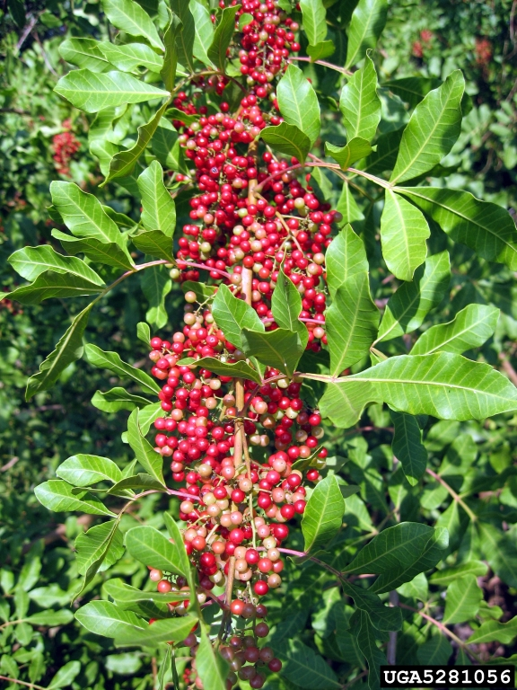
Brazilian Peppertree
What Makes it a Successful Invader?
Quick growth – matures within three years
Prolific seed producer – can produce over 8,000 fruits per plant allowing seeds to be spread over large distances by birds, small mammals, and water
Allelopathic – releases chemicals that inhibit the growth of other plant species in its vicinity
Thicket forming – shades out and displaces native vegetation
Dan Clark, National Park Service, bugwood.org

Slide 7
Brazilian Peppertree
Impact
Environmental – Considered one of the biggest threats to native biodiversity for its rapid and aggressive spread through coastal plains. Brazilian peppertree monocultures reduce the diversity of native plants and animals.
Health – belongs to the same family as poison ivy, poison oak, and poison sumac allowing for similar allergen responses for people that encounter the plant. Ingestion of the plant parts can also be toxic to humans, other mammals, and birds.

Slide 8
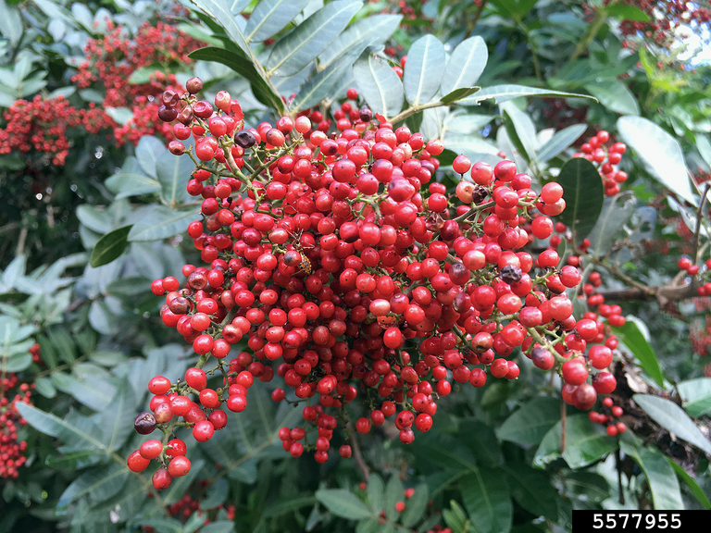
Brazilian Peppertree
Prevent the Spread
The importation, sale, and distribution has been prohibited in several states to prevent further introductions
Small pieces of the plant roots and seeds should not be moved to prevent accidental spread to new areas – check equipment and machinery
Shaun Winterton, USDA APHIS, bugwood.org

Slide 9
Brazilian Peppertree
Management: Mechanical Control
Physically removing individual plants by cutting and pulling up roots or using heavy machinery in addition to chemical control
Specifically target the seed producing, female trees
Flooding – seedlings are vulnerable to prolonged periods of submergence
Burning – areas with frequent fire regimes have less Brazilian peppertree but this management tactic is not recommended – can cause a severe respiratory reaction due to the plant’s toxins
Cons: expensive, labor intensive, and must be repeated to avoid Brazilian peppertree from regrowing

Slide 10
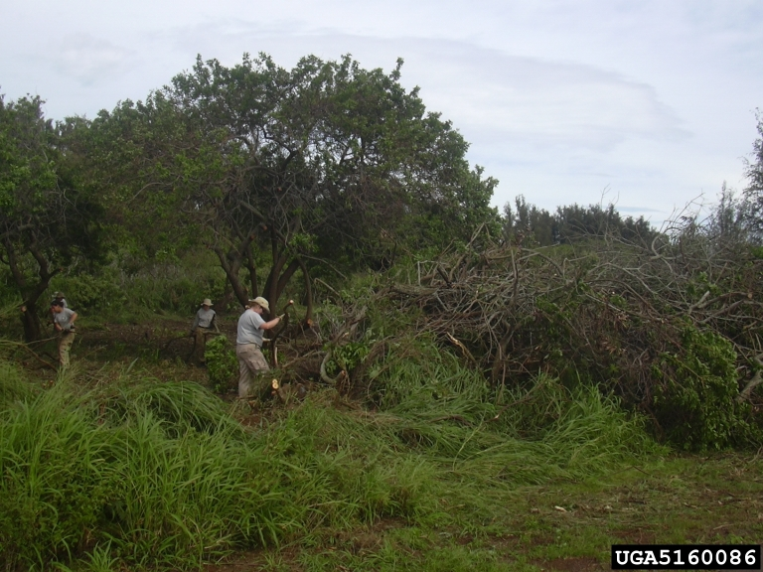
Brazilian Peppertree
Management: Chemical Control
Often used in addition to mechanical control
Glyphosate and triclopyr herbicides applied to stumps immediately after cutting
Basal bark and foliar treatments can be done on smaller stems
Cons: expensive, chemicals can damage non-target species, especially in sensitive aquatic ecosystems. Must be repeated to prevent regrowth
Always follow the label when using herbicides and wear appropriate PPE!
Forest and Kim Starr, bugwood.org

Slide 11
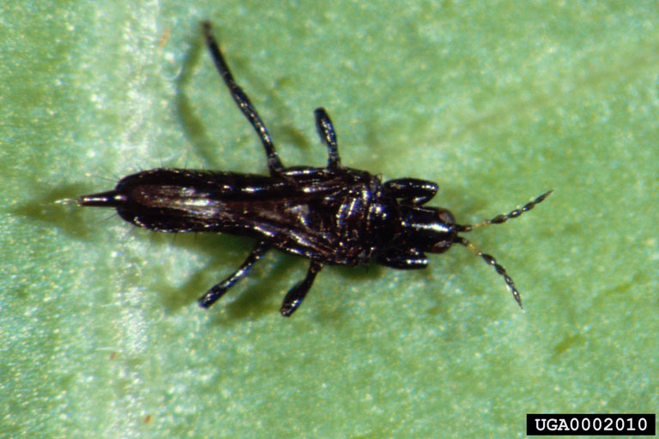
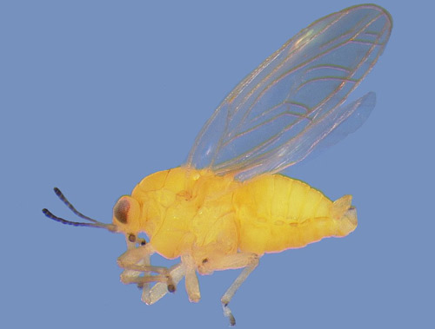
Brazilian Peppertree
Management: Biological Control
Some insects were identified that can help control Brazilian peppertree:
Brazilian peppertree thrips (Pseudophilothrips ichini) - native to Brazil, larval and adult feeding via sucking mouthparts can reduce plant growth and limit fruit production, but part of its lifecycle occurs in the soil and may be impeded by flooding
Yellow Brazilian peppertree leaf galler (Calophya latiforceps) – native to Brazil, highly host specific, nymphal feeding on host leaves and injection of toxic saliva causes decreased photosynthesis and reduced plant growth
James P. Cuda, UF, bugwood.org
Rodrigo Diaz, LSU AgCenter

Slide 12
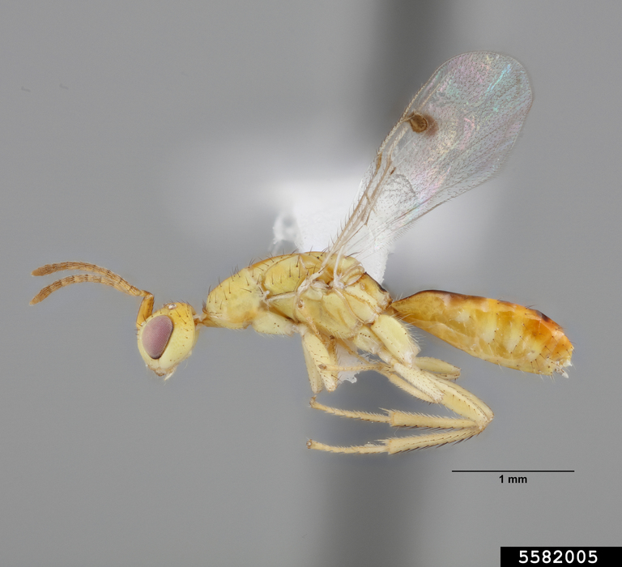
Brazilian Peppertree
Management: Biological Control
Brazilian peppertree seed chalcid (Megastigmus transvaalensis) – a plant feeding wasp originally from South Africa that lays its eggs and completes most of its lifecycle within peppertree drupes
Biocontrol can help reduce plant populations and is considered an important component of an integrated pest management plan

Slide 13



Brazilian Peppertree
Additional Resources
Southern Regional Extension Forestry
http://southernforesthealth.net/
Brazilian Peppertree Integrated Management Guide
https://bugwoodcloud.org/CDN/fleppc/publications/BrazillianPeppertree_Final_Oct19.pdf
Florida Fish and Wildlife Conservation Commission
https://myfwc.com/wildlifehabitats/habitat/invasive-plants/weed-alerts/brazillian-pepper/
* Created by Katy Crout Moretti & David Coyle (Clemson University); Reviewed by Lynne Womack (US Forest Service)

