Slide 1



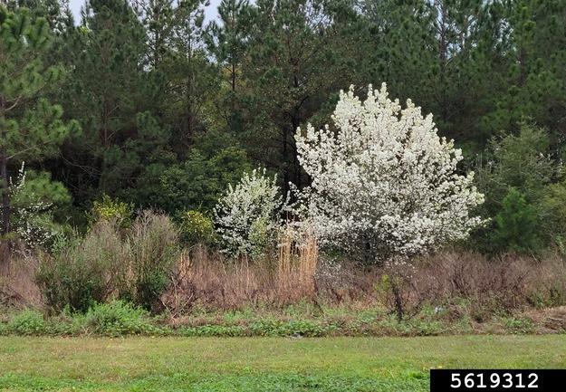
Callery Pear
Pyrus calleryana
Invasive, deciduous, flowering tree in the Rosaceae (rose) family
Known for its many cultivars
Rebekah D. Wallace, UGA, bugwood.org

Slide 2
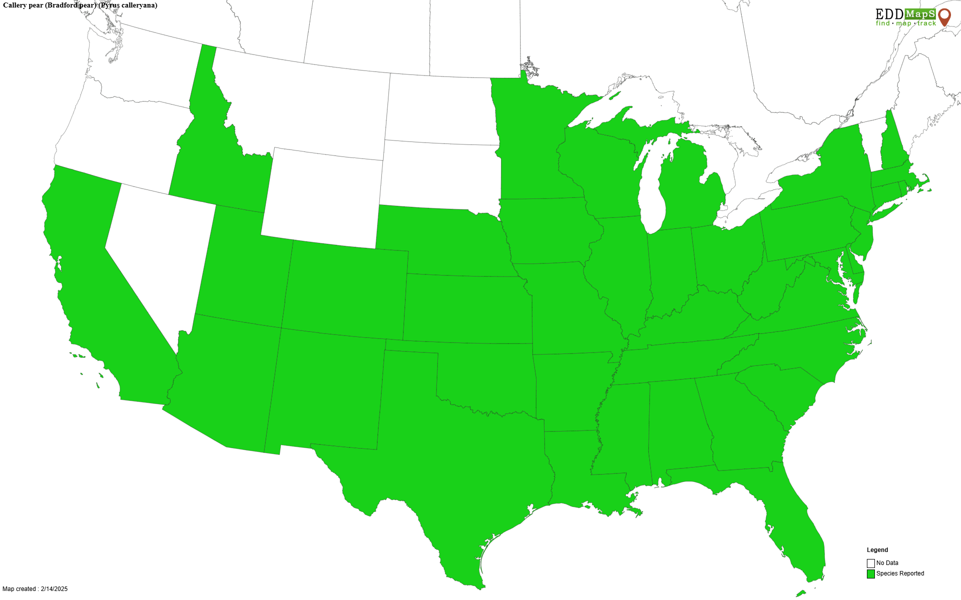
Callery Pear Introduction
Native to parts of East Asia – China, Japan, Korea, Taiwan, and Vietnam
Introduced to the US in the early 1900s for use in breeding fire blight resistance into common pears
Later became popular as an ornamental street tree
Mostly found throughout the southeastern US – New Jersey to Illinois, south to Texas – but has been reported in other states as well

Slide 3
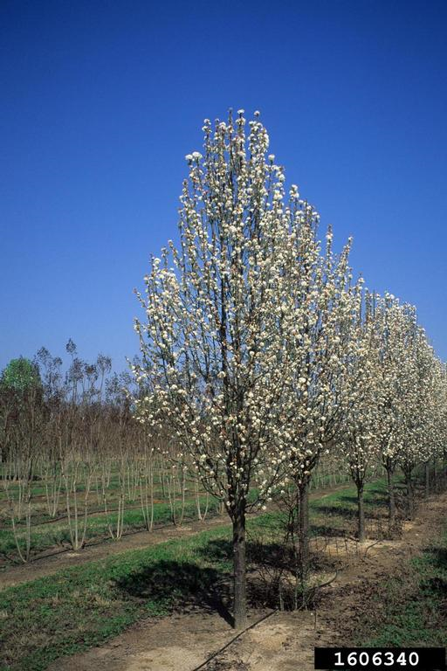
Callery Pear Cultivars = Pears Gone Wild
In the 1950s several cultivars became popular in the ornamental industry – Bradford being the most well known
Cultivars were originally sterile and thornless, but cross pollination with other cultivars creates fruit with viable seeds
Fruit eaten and spread by wildlife
Plants that grow from these seeds = the aggressive and thorny, thicket forming Callery pears
John Ruter, UGA, bugwood.org

Slide 4
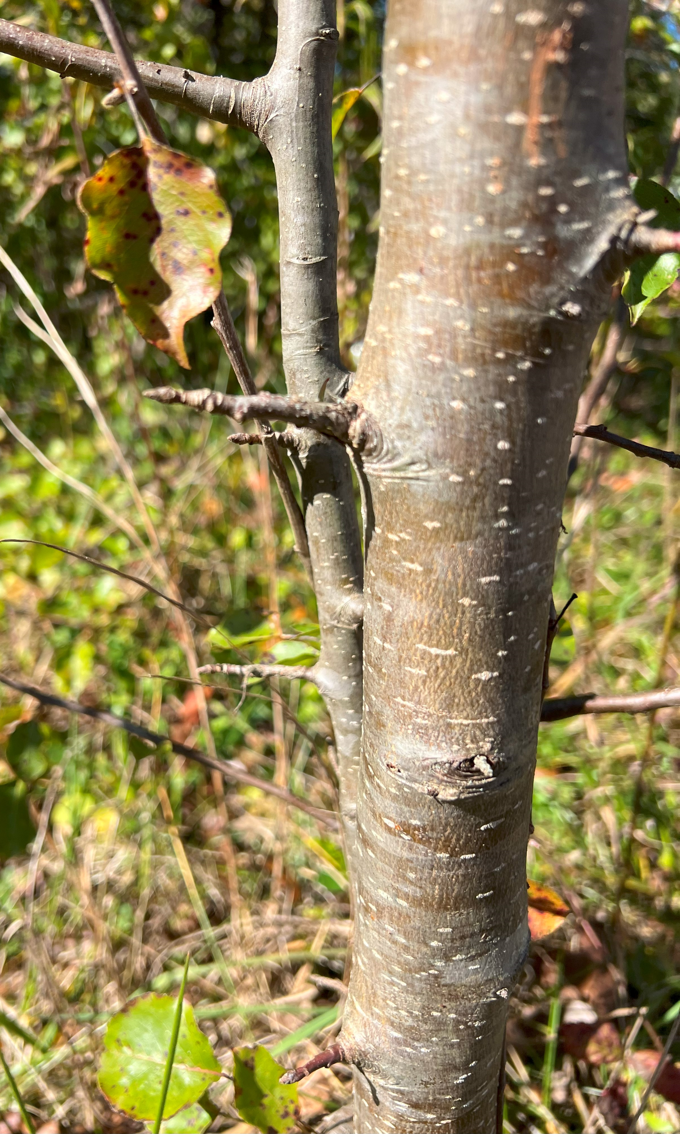
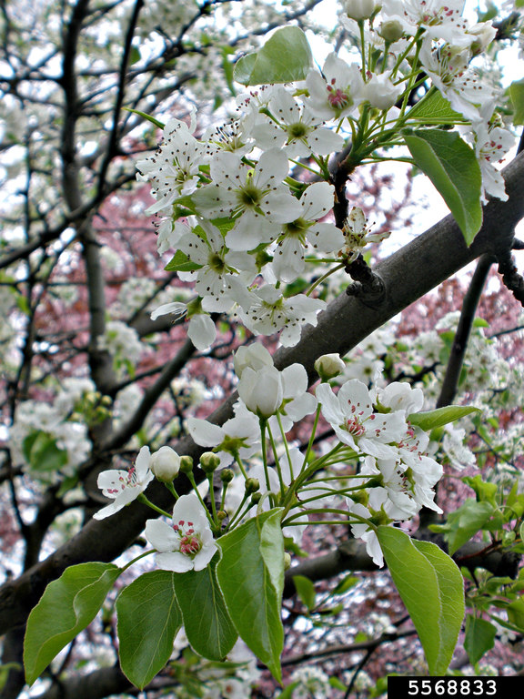
Callery Pear Description
Height: typically, 30-50 feet
Stem: grayish-brown color, smooth on newer limbs but fissured on larger limbs and trunk, thorns/spines up to 3 inches long common on limbs
Flowers: white, five petals each, clustered in a bundle, appear in late winter to early spring with a very distinct odor
Thorn/spine
Katy Moretti, Clemson University
Ansel Oommen, bugwood.org

Slide 5
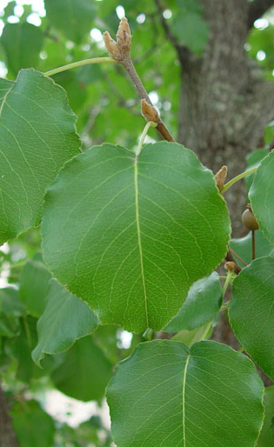
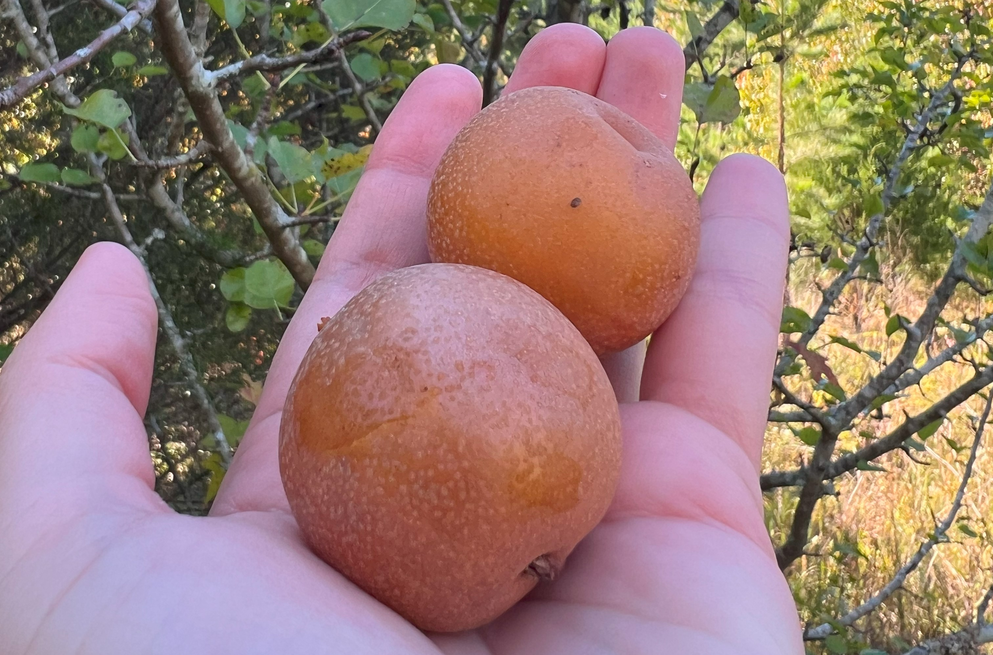
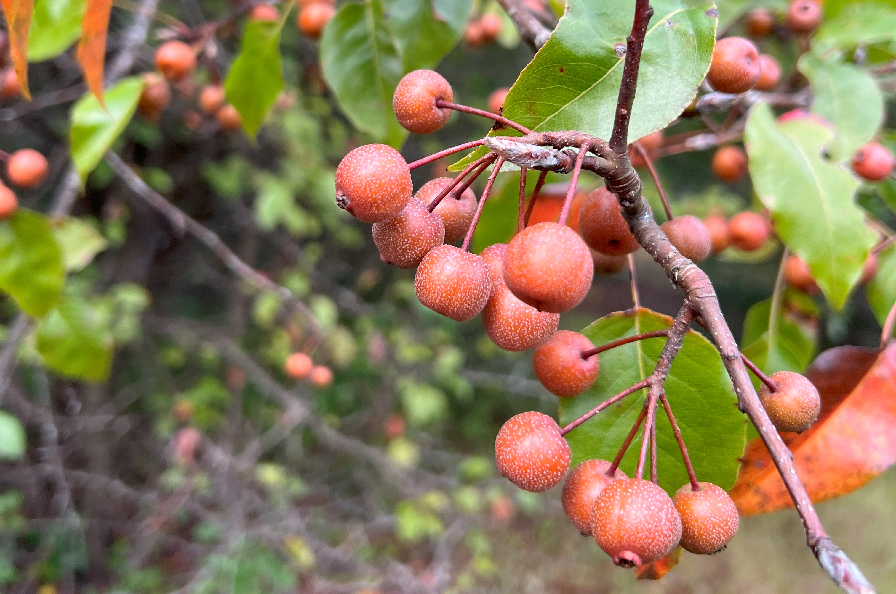
Callery Pear Description
Leaves: 1.5-3 inches long, simple, alternate, tear-drop shape with round-toothed margins, shiny waxy appearance, dark green in spring and summer, red to maroon in fall
Fruits: vary in size, round with long stems, begin as a green color but turn reddish-brow, flecked with pale dots, clustered similar to flowers, mature in fall
Chuck Bargeron, UGA, bugwood.org
Katy Moretti, Clemson University

Slide 6
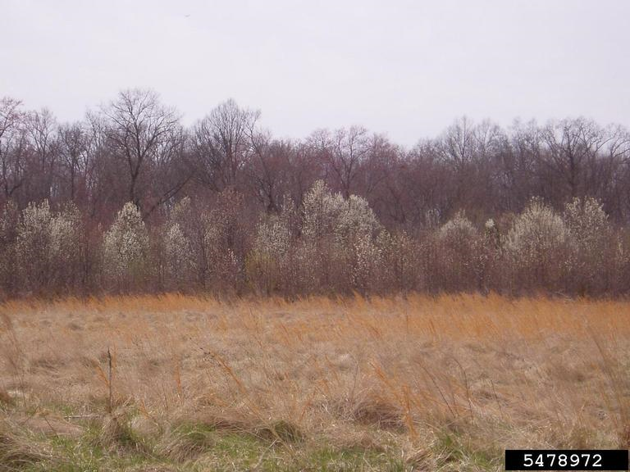
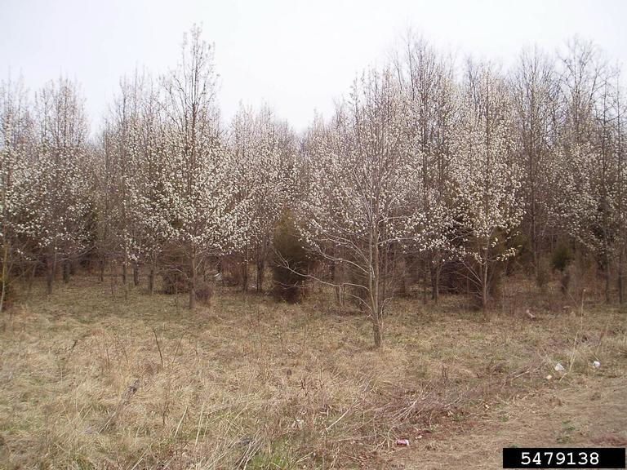
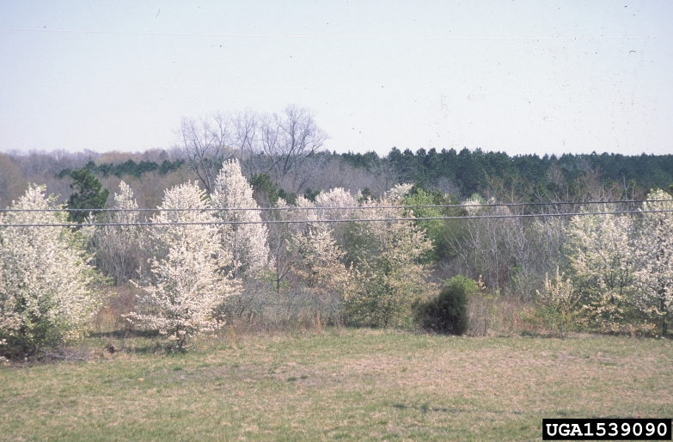
Callery Pear Growth
Thicket forming
Self-incompatible = cannot pollinate itself, requires cross pollination from genetically different cultivars
Leslie J. Mehrhoff, UC, bugwood.org
James H. Miller, USDA, bugwood.org

Slide 7
Callery Pear What Makes it a Successful Invader?
Vegetative propagation – no need for pollination, root sprouts produce clones of host plant
Thicket forming – shades out and displaces competitors
Thorns – difficult to remove mechanically and limits predation by grazing mammals
Prolific fruit producer – fruit consumed then seeds spread by wildlife, 1-10 seeds per fruit on average

Slide 8
Callery Pear Impact
Aggressive invader that quickly takes over an area (fields, roadsides, forest understory, etc.)
Outcompetes and displaces native vegetation
Few insects feed on Callery pear = food desert for birds that rely on native insects for food
Extremely difficult to remove once established

Slide 9


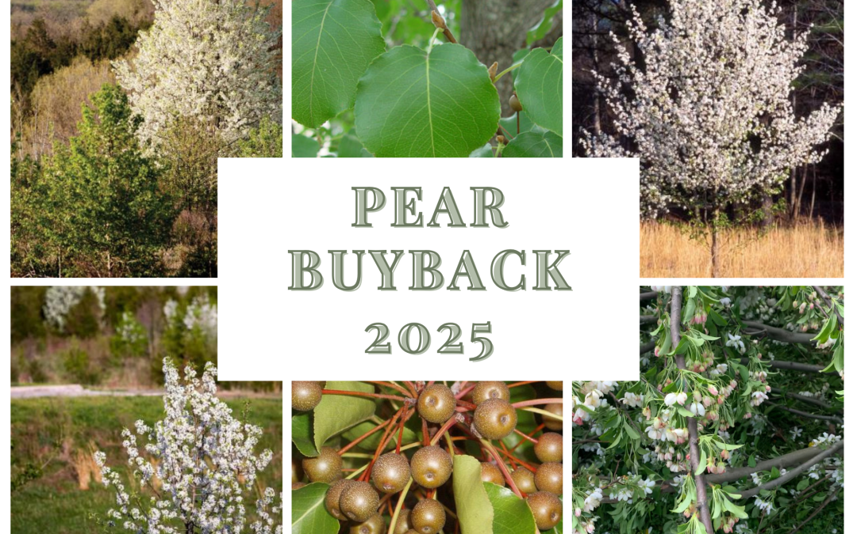
Callery Pear Prevent the Spread
Landowners can help prevent the spread by removing Callery pear cultivars from their yards
State agencies have created programs to incentivize landowners to remove Callery pear cultivars in exchange for a native replacement tree
Several states have banned the sale of Callery pear cultivars including South Carolina, Ohio, and Pennsylvania

Slide 10
Callery Pear Management
Mechanical – thorns pop tractor tires making mechanical control over large areas difficult. Seedlings can be pulled as long as all of the roots are also removed. Prescribed fire allows for resprouting. Cutting down larger trees can be effective when stumps are further treated with chemicals to prevent regrowth
Chemical – herbicides like glyphosate, imazapyr, and triclopyr are effective at killing Callery pear by applying to stumps shortly after being cut

Slide 11




Callery Pear Additional Resources
Southern Regional Extension Forestry
http://southernforesthealth.net/
Clemson Extension
https://hgic.clemson.edu/bradford-and-callery-pear/
Alabama Cooperative Extension System
https://www.aces.edu/blog/topics/forestry-wildlife/callery-pear-history-identification-and-control/
Penn State Extension
https://extension.psu.edu/callery-pear
* Created by Katy Crout Moretti & David Coyle (Clemson University); Reviewed by Emilee Poole (US Forest Service)

