Slide 1



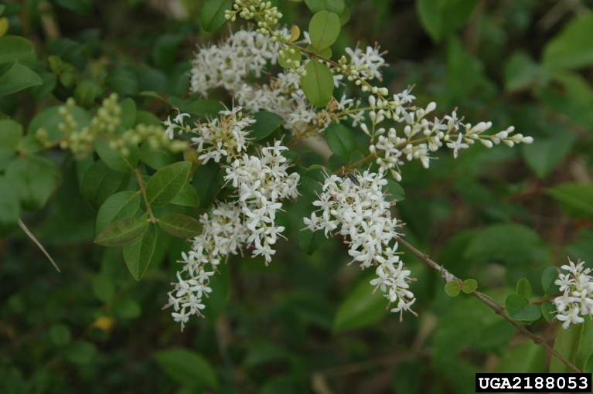
Chinese Privet
Ligustrum sinense
Invasive, semi-evergreen to evergreen shrub or small tree in the Oleaceae (olive) family
Chris Evans, University of Illinois, bugwood.org

Slide 2
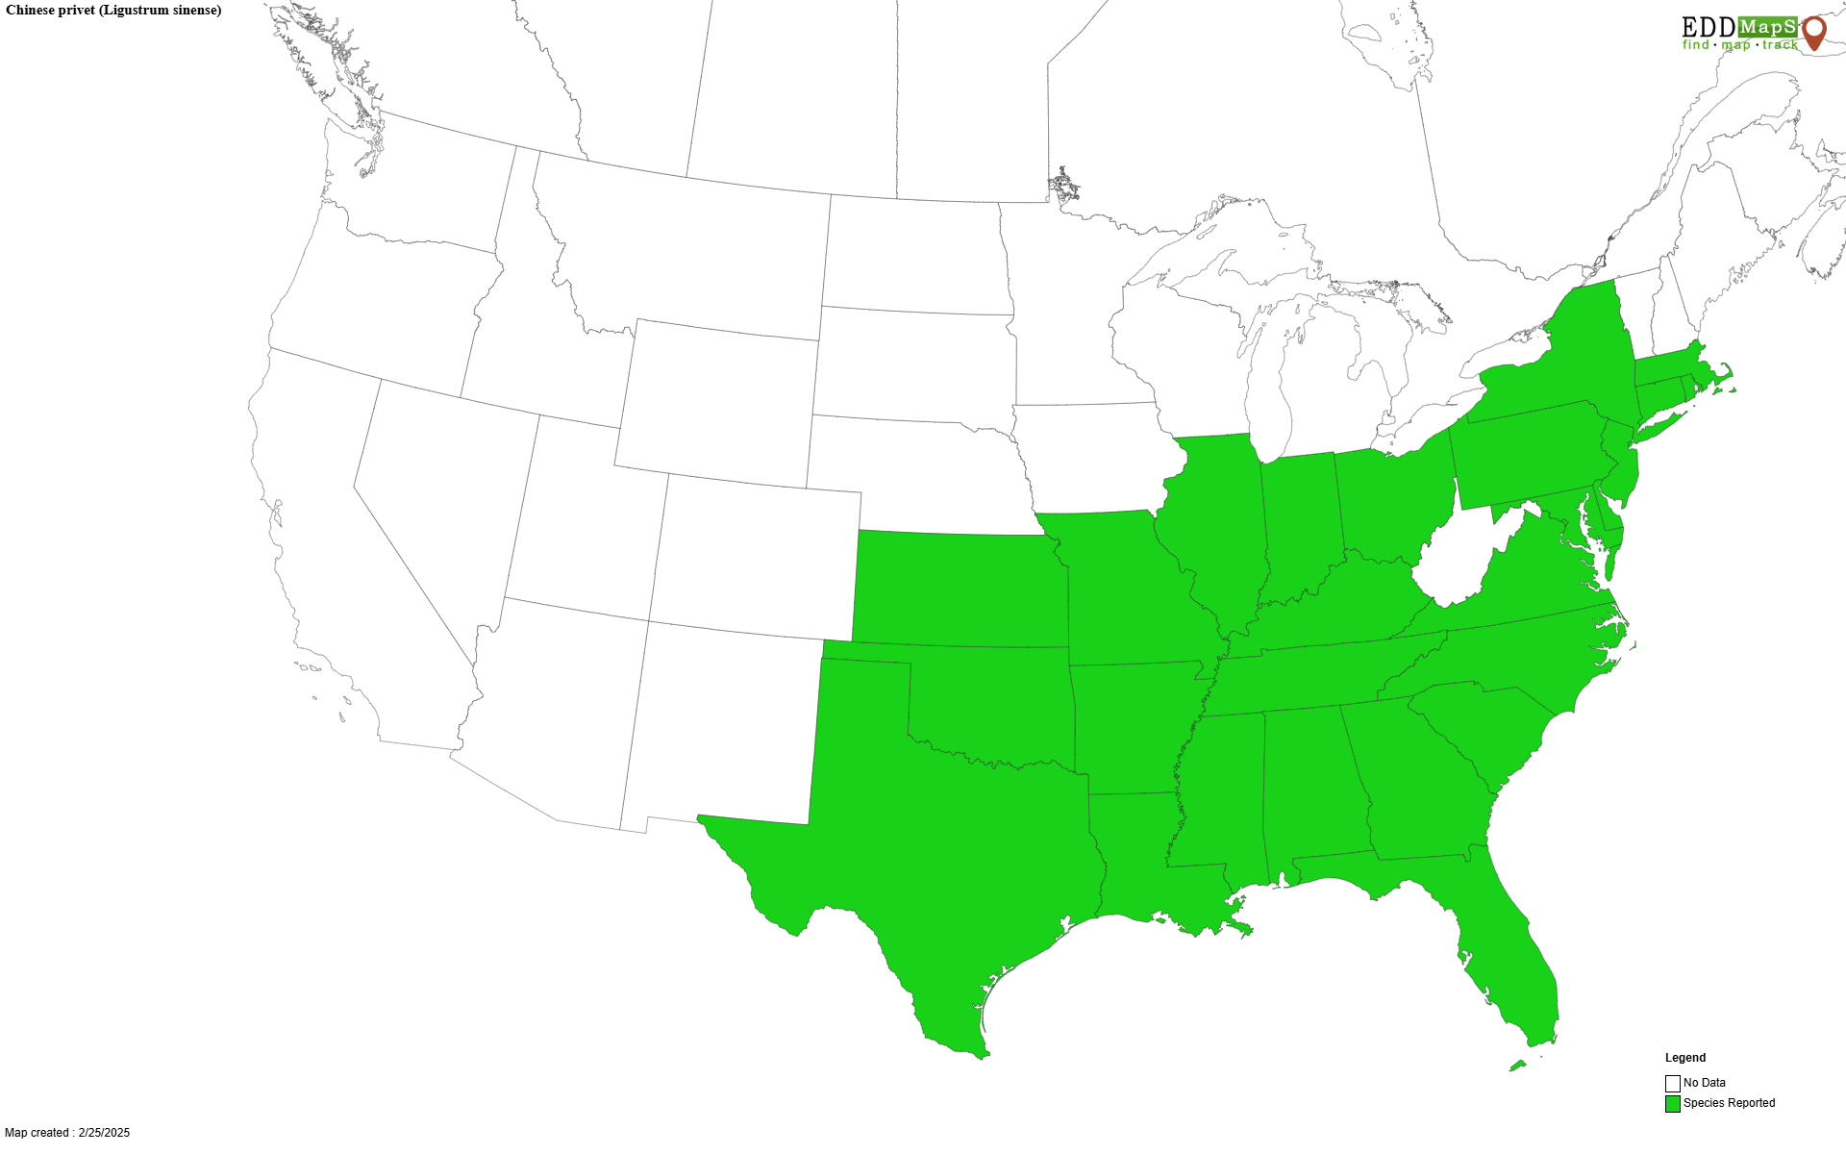
Chinese Privet
Introduction
Native to parts of Asia – China, Vietnam, and Laos
Introduced to the US in 1852 as an ornamental and commonly used as a hedgerow
Escaped cultivation and can now be found in several states
Predominately found from the Southeast west to Texas and although not as common, it can be found in the Northeast

Slide 3
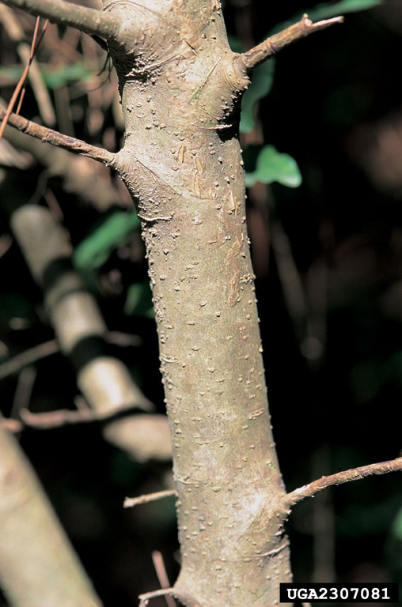
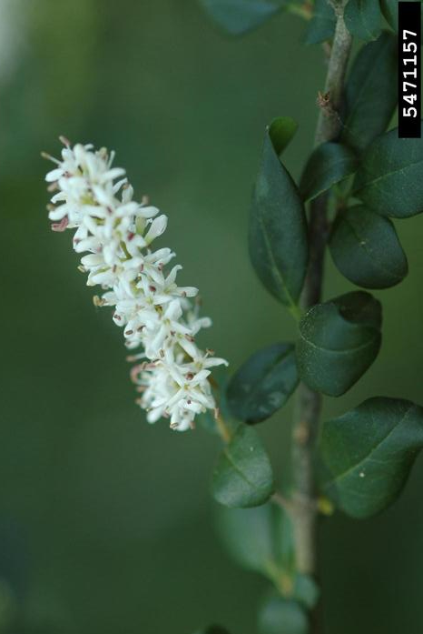
Chinese Privet
Description
Height: typically, 5-12 feet, up to 30 feet possible
Stem: light grey to brown, young twigs can be hairy, thin and smooth with scattered small dots (lenticels), multi-stemmed, long branches that droop downwards
Flowers: white to cream color, less than an inch in size, develop in panicles at the branch tips
James H. Miller, USDA, bugwood.org
Karan A. Rawlins, UGA, bugwood.org

Slide 4
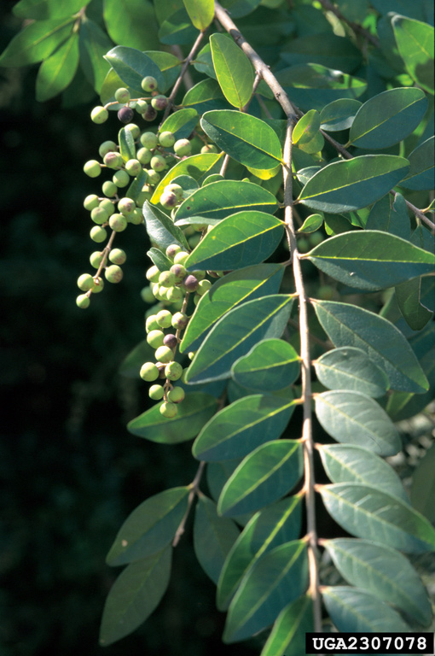
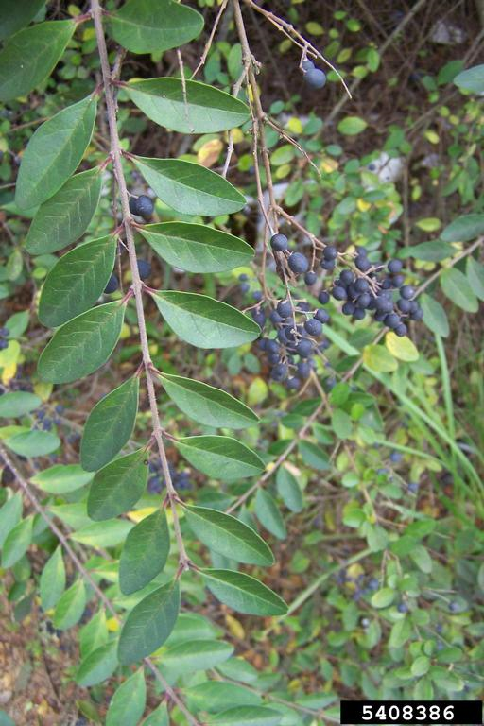
Chinese Privet
Description
Leaves: opposite, 1-2 inches with an oblong shape, can be hairy on the underside
Fruits: drupes, less than 0.5 inches diameter, clustered, begins green, ripens to a dark purple or black color
James H. Miller and Ted Bodner, bugwood.org
Karan A. Rawlins, UGA, bugwood.org

Slide 5
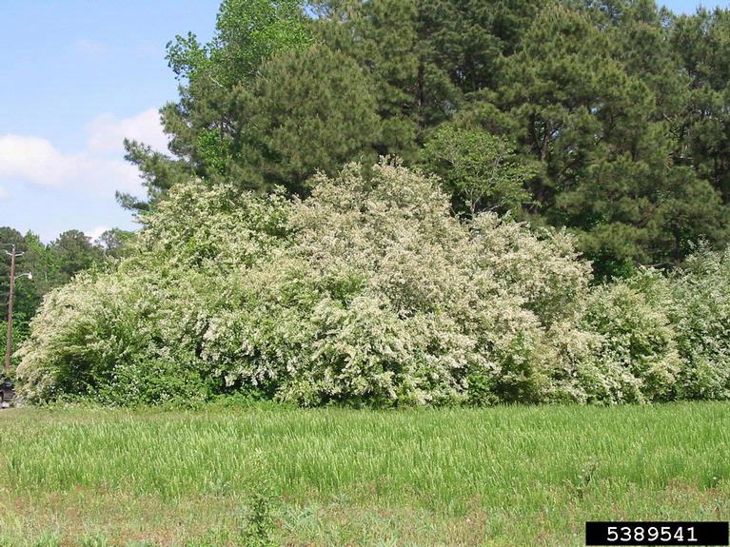
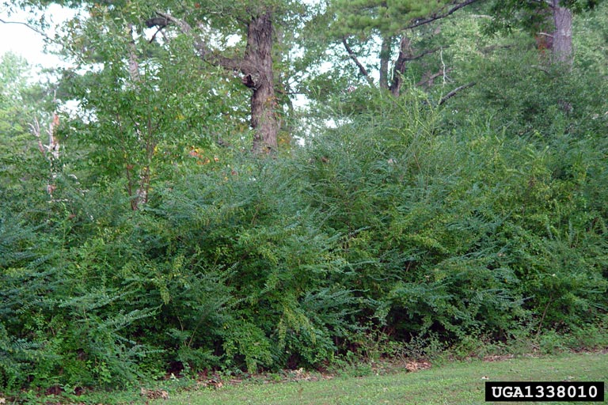
Chinese Privet
Growth
Forms dense thickets and shallow but extensive root systems
Nancy Loewenstein, Auburn University, bugwood.org
Chris Evans, University of Illinois, bugwood.org

Slide 6
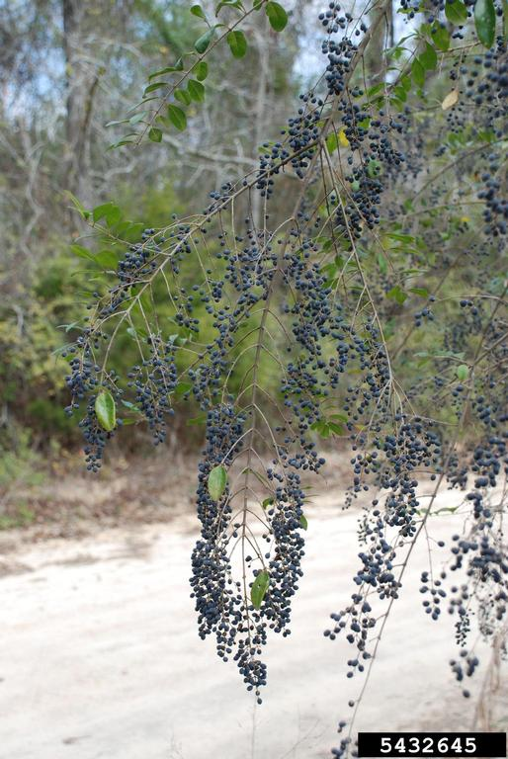
Chinese Privet
What Makes it a Successful Invader?
Prolific seed producer – fruit consumed and spread by wildlife
Vegetative propagation – spreads via root suckers
Adaptable - tolerates a wide range of soil and light conditions
Nancy Loewenstein, Auburn University, bugwood.org

Slide 7
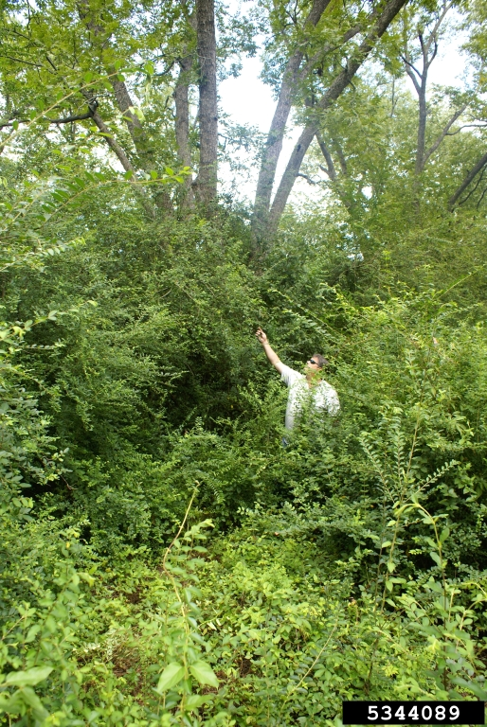
Chinese Privet
Impact
Aggressive invader that quickly takes over an area (fields, roadsides, forest understory, etc.)
Outcompetes and displaces native vegetation = decreasing biodiversity
Fruit and leaves are toxic to humans – causes nausea, headache, abdominal pain, vomiting, weakness, etc.
David Moorhead, UGA, bugwood.org

Slide 8
Chinese Privet
Management
Prevent the spread – check equipment for pieces of Chinese privet (fruits, stems, roots, etc.) before moving to new areas to reduce chances of spreading the plant to new areas.
Mechanical – physically removing Chinese privet by hand pulling is a good option for seedlings and saplings, but the whole plant must be removed including the roots to prevent regrowth. Cutting the stem can be used for larger plants but must be used in combination with herbicides to prevent regrowth. Brush mulching and mowing can be used to quickly remove dense stands, but privet will often return without the addition of chemical control.

Slide 9
Chinese Privet
Management
Chemical – foliar, cut stump, and basal bark herbicide treatments can be used to control privet. Glyphosate and other similar herbicides are effective against Chinese privet but can get expensive if treating large areas. Always follow the label and use appropriate PPE when handling herbicides.
Chinese privet can be difficult to eradiate once it becomes established due to its seedbank and the ability to sprout from pieces left underground. Using multiple control methods over several years is the most effective approach to reduce privet numbers.

Slide 10



Chinese Privet
Additional Resources
Southern Regional Extension Forestry
http://southernforesthealth.net/
USDA Plant Guide
https://plants.usda.gov/DocumentLibrary/plantguide/pdf/pg_lisi.pdf
Alabama Cooperative Extension
https://www.aces.edu/blog/topics/forestry-wildlife/control-options-for-chinese-privet/
* Created by Katy Crout Moretti & David Coyle (Clemson University); Reviewed by Scott Horn (US Forest Service)

