Slide 1

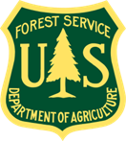

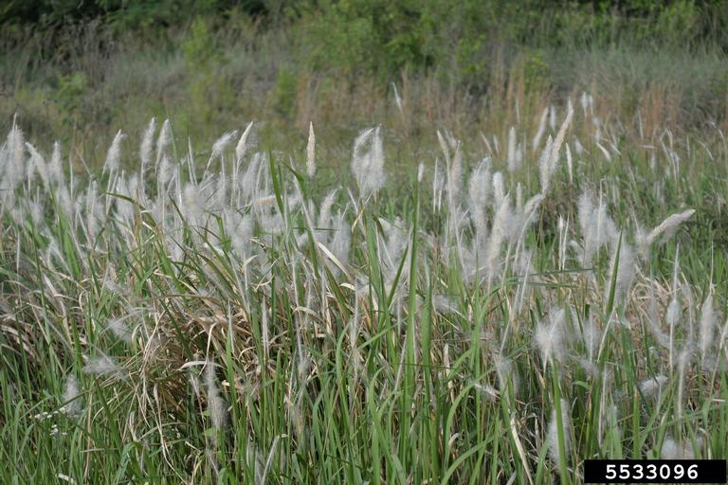
Cogongrass
Imperata cylindrica
Invasive, colony-forming perennial grass
Also known as Japanese bloodgrass, Red Baron grass, or speargrass
Karan A. Rawlins, UGA, bugwood.org

Slide 2
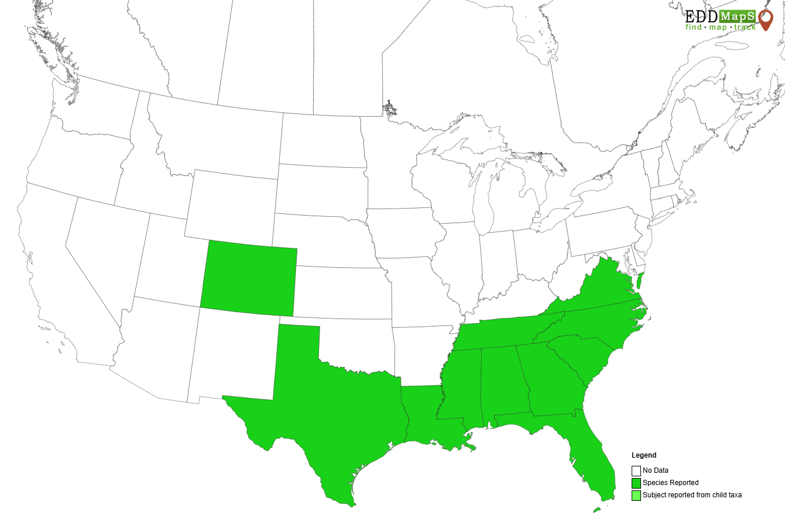
Cogongrass Introduction
Originates from parts of southeast Asia
Considered one of the top 10 worst weeds in the world
Accidentally introduced to the US in the early 1900s as seeds in packing materials from Japan
Later introduced to a few southeastern states as a potential forage crop and soil stabilizer
Has since spread predominately across the southeast but some spots have been found as far west as Colorado

Slide 3
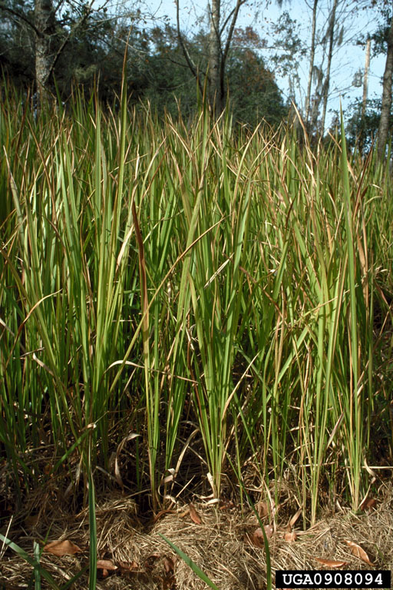
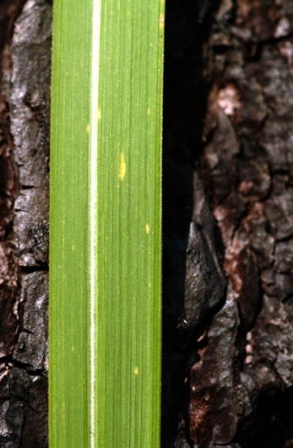
Cogongrass Description
Height: averages 3-4 feet, max up to 6 feet
Blades/leaves: yellow to green color with prominent off-centered, whiteish midvein, flat and finely serrated margins, about 1 inch wide, blades typically stand upright but some may droop, can turn to reddish brown color in fall and winter
Jeffrey Lotz, FL Department of Ag, bugwood.org
Mark Atwater, bugwood.org

Slide 4
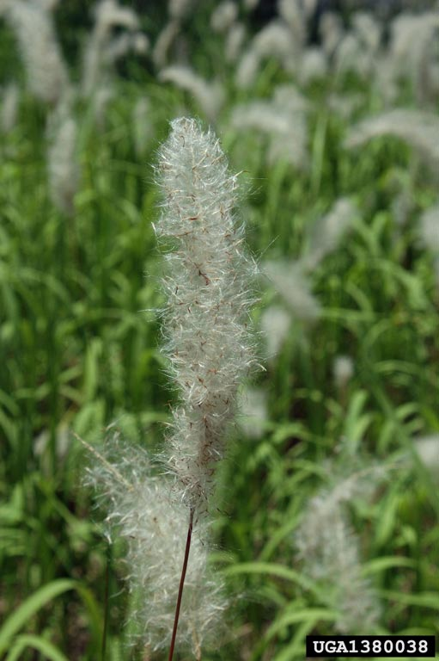
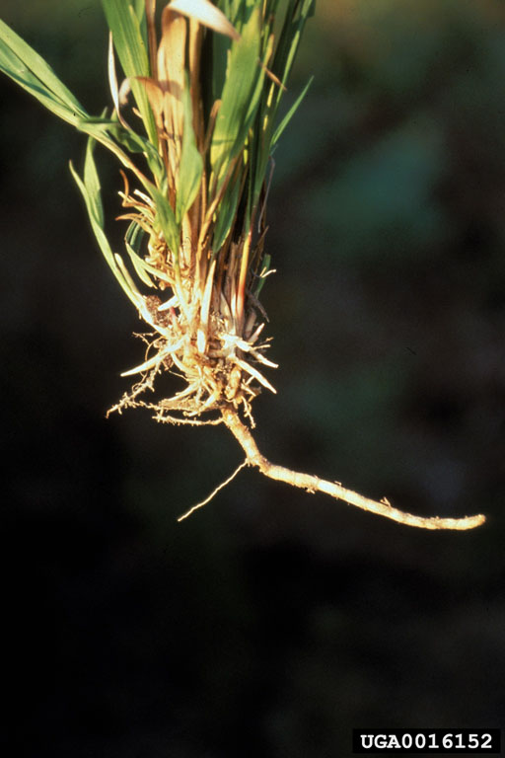
Cogongrass Description
Flower/ seed head: cylindrical shape, 2-8 inches long, silvery white color, fluffy, plume-like appearance and can contain up to 3,000 seeds
Rhizomes: form dense mats with many sharp points and many segments, covered in flaky scales but bright white color under the scales
Plant base: no apparent stem, blades appear to arise directly from the ground
Chris Evans, University of Illinois, bugwood.org
James Miller, USDA, bugwood.org

Slide 5
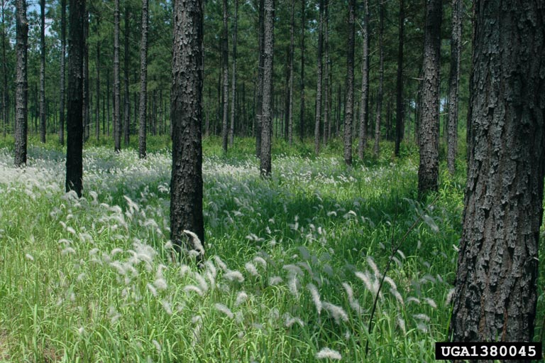
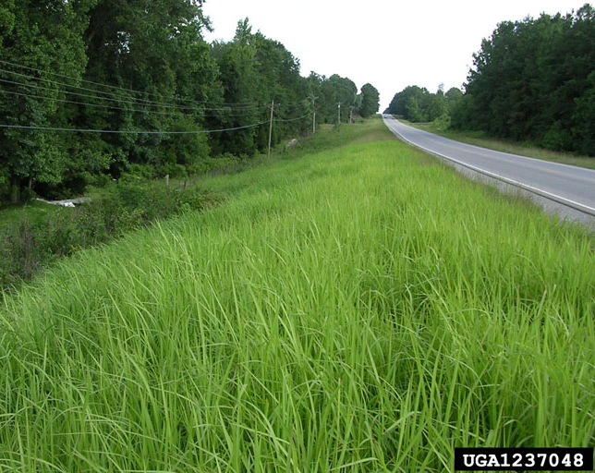
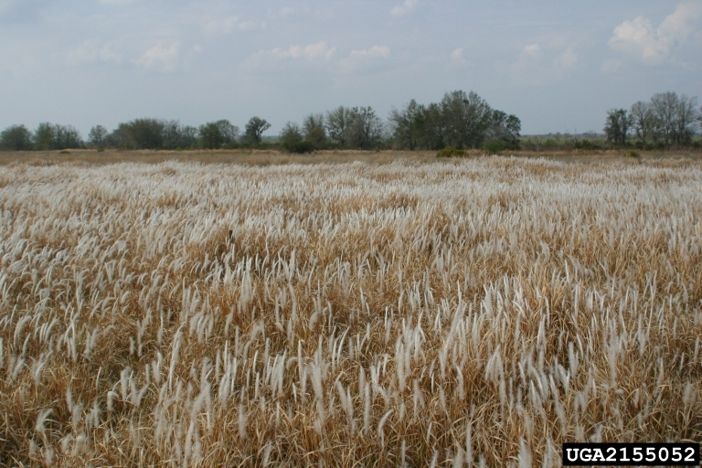
Cogongrass Growth
Infestations typically occur in dense, sometimes circular patches
Chris Evans, University of Illinois, bugwood.org
Wilson Faircloth, USDA, bugwood.org
John Byrd, MSU, bugwood.org

Slide 6
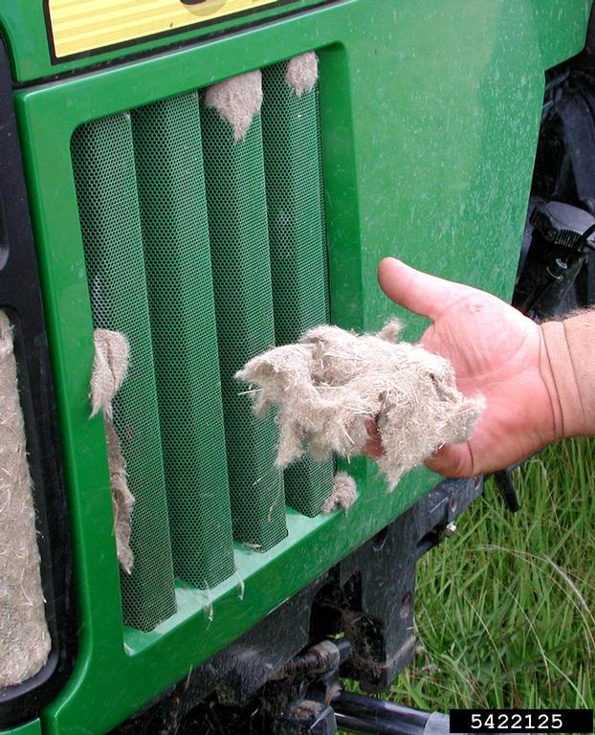
Cogongrass What Makes it a Successful Invader?
Prolific seed producer – plants can produce up to 3,000 seeds per season and seeds can easily be moved by contaminated equipment or the wind for several miles.
Sexual reproduction – creates genetic variability.
Fire adapted – thrives where fire is a regular occurrence.
Adaptable – tolerant of a wide variety of soil types and drought conditions.
Wilson Faircloth, USDA, bugwood.org

Slide 7
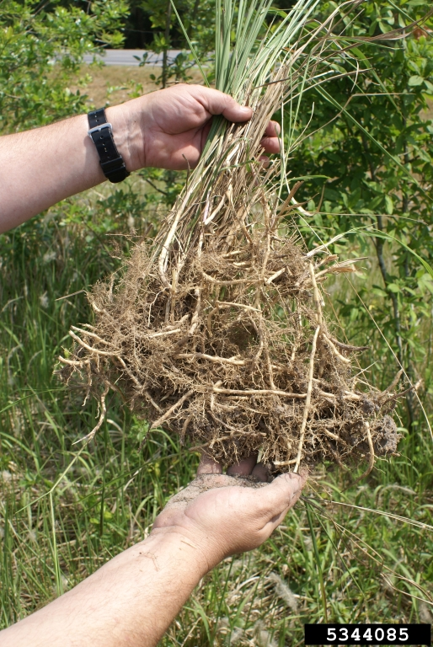
Cogongrass What Makes it a Successful Invader?
Vegetative propagation – small pieces of rhizomes can be unintentionally moved to new areas via machinery, allowing new populations to establish. Several infestations of cogongrass can be linked to contaminated equipment used for site prep, power line installation, contaminated fill dirt, etc.
Extensive root system – rhizomes can make up at least 60% of the total biomass and can grow to depths of 4 feet into the soil.
Chuck Bargeron, UGA, bugwood.org

Slide 8
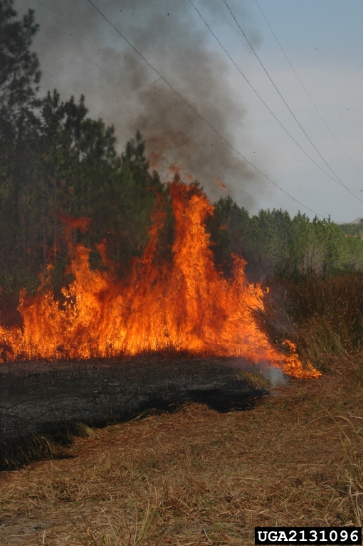
Cogongrass Impact
Aggressively invades a range of sites including roadsides, open forests, fields, etc.
Outcompetes and displaces native vegetation, disrupting ecosystems, reducing wildlife habitat, and decreasing tree growth and establishment success.
Alters fire regimes and intensity = provides sufficient fuel for fires causing fires to burn hot enough to eliminate competing native species.
Chris Evans, University of Illinois, bugwood.org

Slide 9
Cogongrass Management
Prevention – slow the spread of cogongrass by avoiding soil disturbance in infested areas, check for seeds and rhizomes to prevent spreading to new locations via hitchhiking, do not purchase or plant cogongrass.
Mechanical – mowing should not be done when seed heads are present, but when done should be followed by chemical control. Hand pulling and animal grazing is not recommended due to sharp leaf edges and the difficulty of removing the entire rhizome. Repeated deep tilling can be effective but must be done frequently to exhaust energy reserves of the rhizomes. Fire is not recommended due to cogongrass increasing fire intensity and ability to survive fire, but an herbicide can be applied after fire to try and limit regrowth.

Slide 10
Cogongrass Management
Chemical – glyphosate and imazapyr are the most effective herbicides for cogongrass management but require multiple treatments for control. Always follow the label and wear appropriate PPE.
Cogongrass can be difficult to eradicate once it becomes established due to its extensive rhizome network. Using multiple control methods over an extended period of time has worked best to reduce numbers.

Slide 11
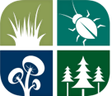


Cogongrass Additional Resources
Southern Regional Extension Forestry
http://southernforesthealth.net/
Florida Department of Agriculture and Consumer Services
https://www.fdacs.gov/Forest-Wildfire/Our-Forests/Forest-Health/Invasive-Non-Native-Plants/Cogon-Grass
Alabama Cooperative Extension
https://www.aces.edu/blog/topics/forestry-wildlife/cogongrass-management-faq/
* Created by Katy Crout Moretti & David Coyle (Clemson University); Reviewed by Lynne Womack (US Forest Service)

