Slide 1

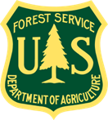

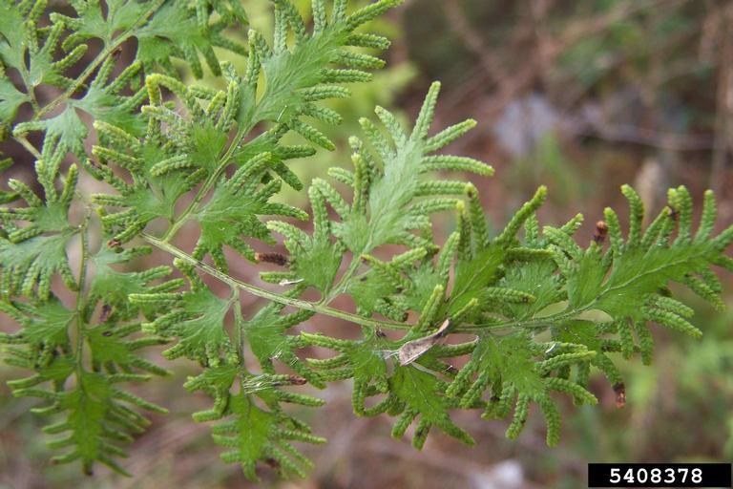
Japanese Climbing Fern
Lygodium japonicum
Invasive, perennial vine in the Schizaeaceae family
Karan A. Rawlings, UGA, bugwood.org

Slide 2
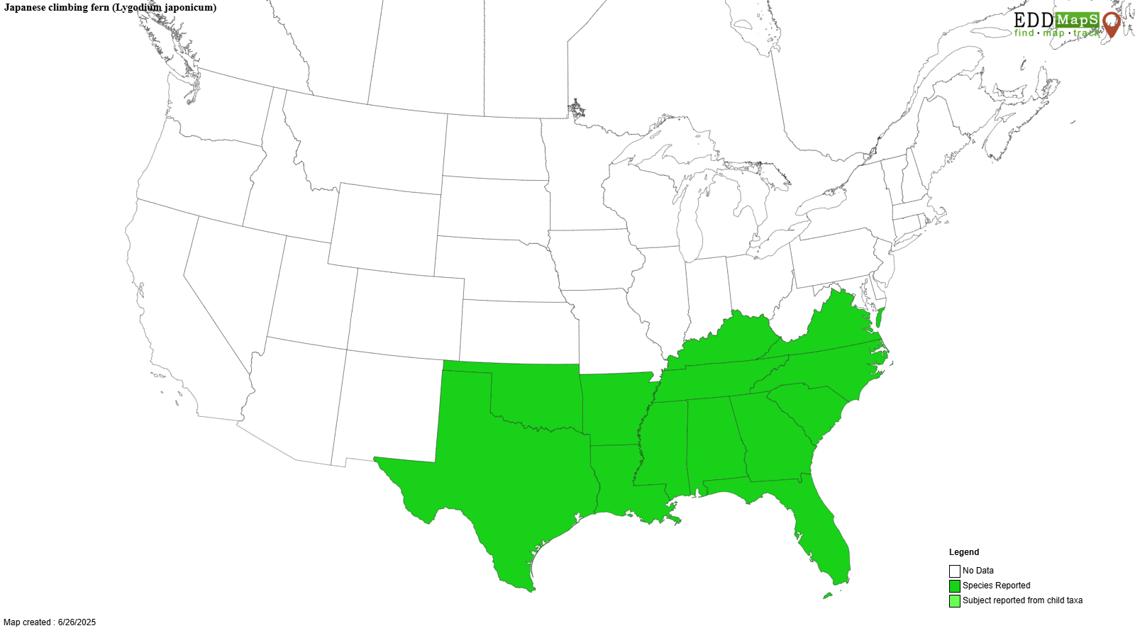
Japanese Climbing Fern
Introduction
Originates from eastern Asia and Australia
Introduced in the early 1900s as an ornamental
Escaped cultivation and has since been found in several southeastern states

Slide 3
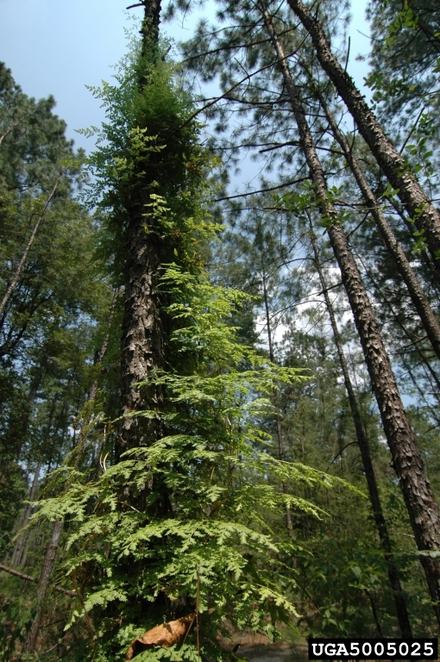
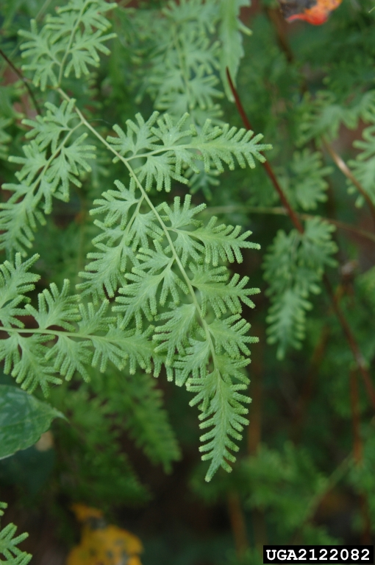
Japanese Climbing Fern
Description
Height: up to 90 feet
Leaves: fern-like appearance arranged on branches off the rachis, triangular shape but can vary, finely lobed, 3-6 inches long, 2-3 inches wide, usually light green color, hairs on the underside
Ronald Billings, Texas A&M, bugwood.org
Chris Evans, University of Illinois, bugwood.org

Slide 4
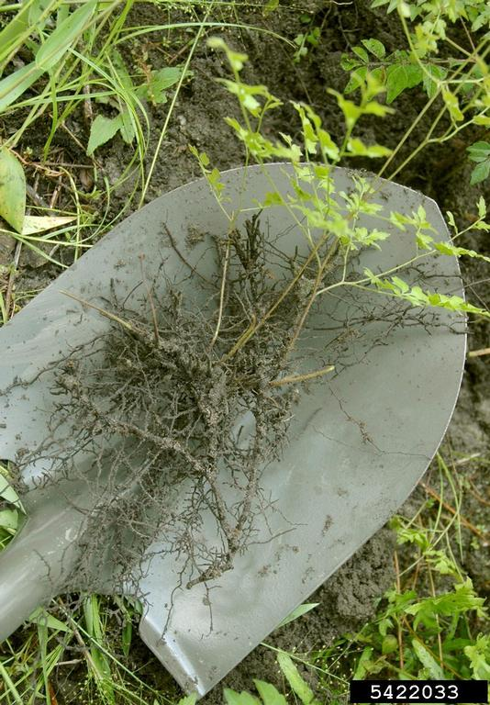
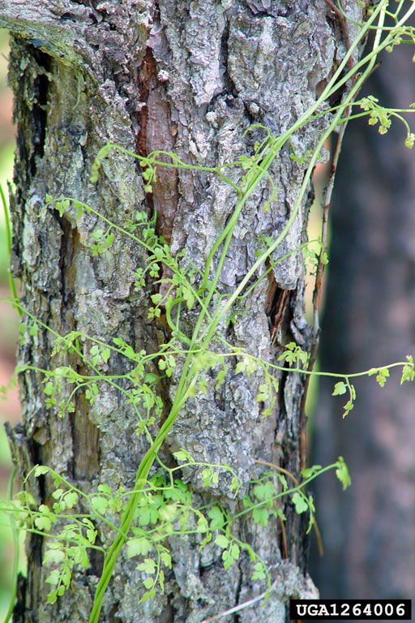
Japanese Climbing Fern
Description
Stem: (rachis) = long, wiry, twining, vine-like fronds that range in color from green to reddish tan to black, difficult to break, runners can form layered mats on the ground surface
Spores: found on the underside of leaves in double rows
Corrie Pieterson, University of Florida, bugwood.org
Chris Evans, University of Illinois, bugwood.org

Slide 5
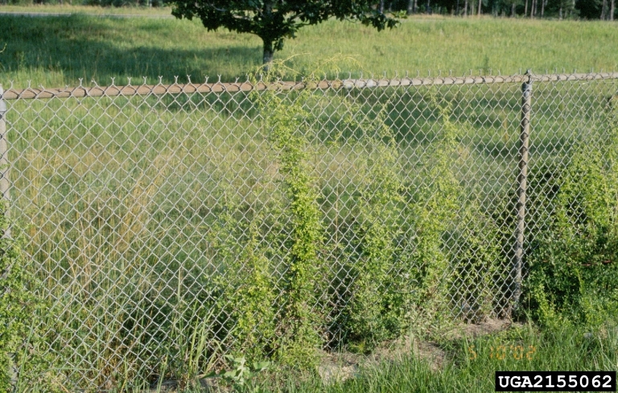
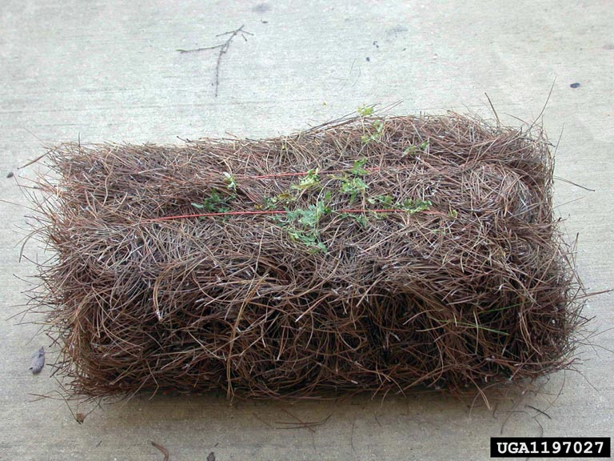
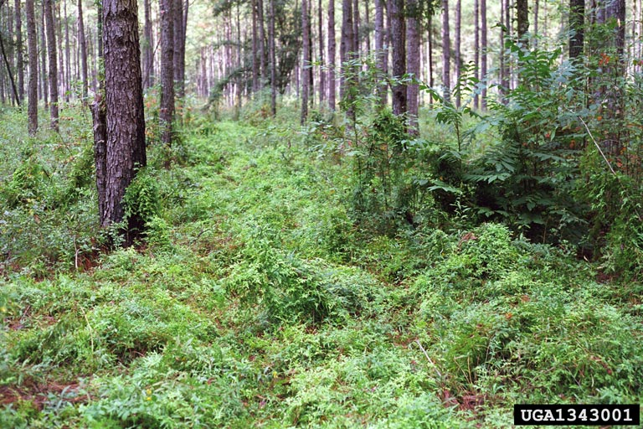
Japanese Climbing Fern
Growth
Commonly found growing on roadsides, forests, urban green spaces, etc.
Grows over trees, shrubs, and the ground - old/dead vines often provide support for new growth the following spring.
Can remain evergreen in warmer climates.
John D. Byrd, bugwood.org
Dennis Teague, bugwood.org
Wayne Willamson, bugwood.org

Slide 6
Japanese Climbing Fern
What Makes it a Successful Invader?
Adaptable – tolerant of a wide variety of light and moisture conditions, soil types, and disturbance.
Prolific spore producer – can produce up to 38,000 spores per square inch.
Dispersal – wide range of dispersal methods including on pine straw, clothing, equipment, animals, etc. Easily spread via wind.
Vegetative propagation – rhizomes spread through the soil to create new plants without the need for spores. Can also be spread to new areas unintentionally via equipment, vehicles, etc. to create new populations.

Slide 7
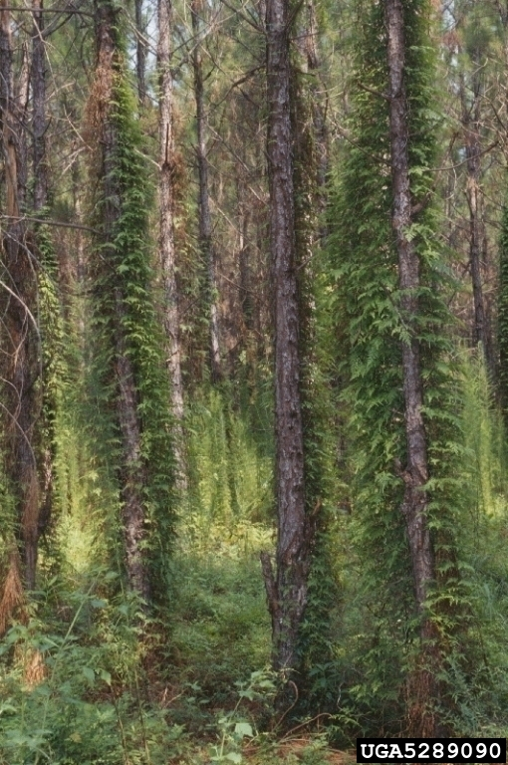
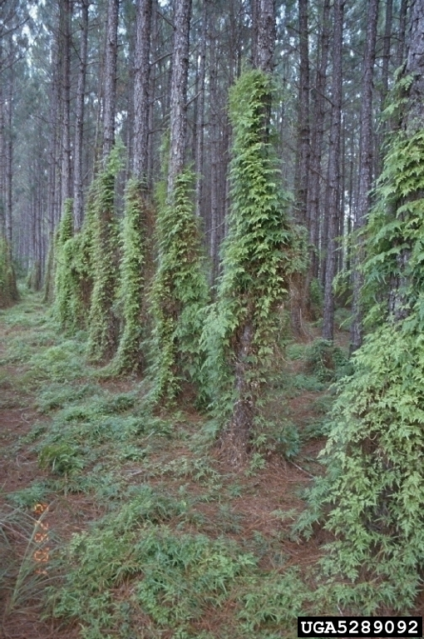
Japanese Climbing Fern
Impact
Climbs over shrubs and into treetops to create dense canopies that shade out and cause mortality in underlying vegetation.
Can grow as thick ground cover that prevents seed germination or seedling recruitment of native species.
Loss of native plant species can have larger ecosystem impacts on native insect, animal, and bird communities.
Florida DPI, Florida Department of Ag and Consumer Services, bugwood.org

Slide 8
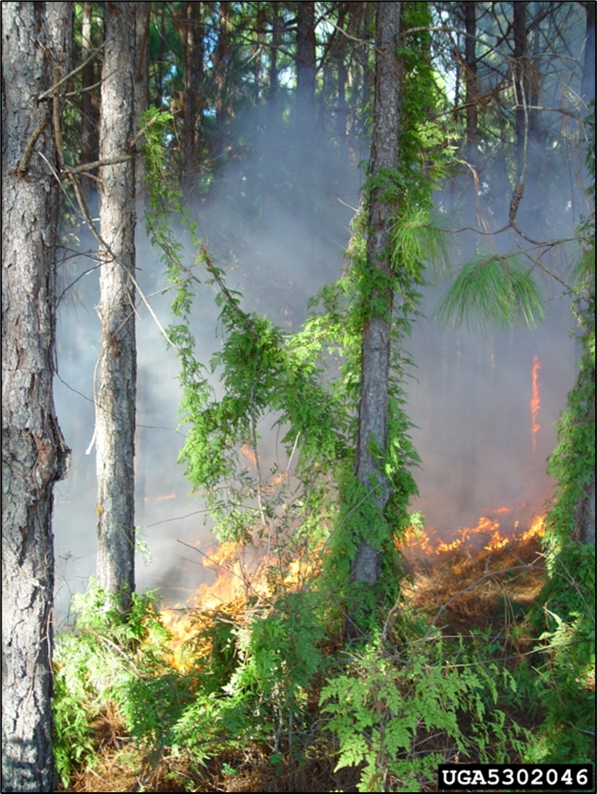
Japanese Climbing Fern
Impact
Increases fire risk – vines grow up trees creating a fuel ladder that allows fire to spread into tree canopies.
Can create more damaging fires due to the amount of fuel load produced (old/dead vines from previous year).
Concern to pine plantations where fire is often used as a management tool.
Chuck Bargeron, UGA, bugwood.org

Slide 9
Japanese Climbing Fern
Management
Prevention – slow the spread of Japanese climbing fern to new areas by checking for rhizomes on equipment, boots, etc. before moving from an infested area.
Mechanical – hand pulling is often not practical due to the difficulty of removing the entire rhizome from the ground. Repeated mowing or cutting may be successful over an extended period for small infestations but is time consuming. Mowing and cutting can be more successful when used with chemical management strategies.

Slide 10
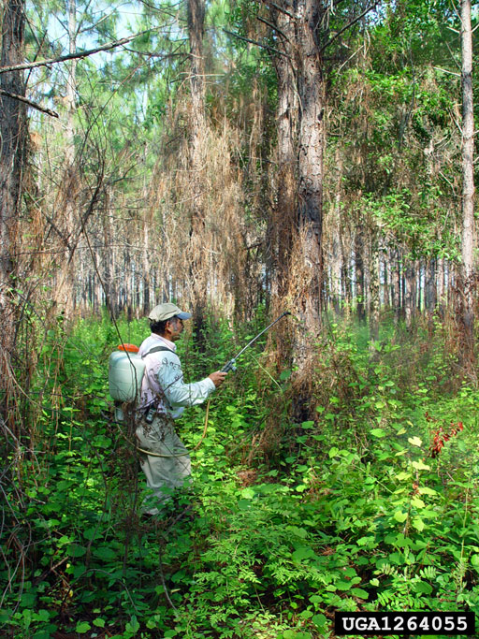
Japanese Climbing Fern
Management
Chemical – several herbicides can be used to successfully manage JCF including glyphosate and metsulfuron methyl used alone or in combination. Chemical control can pose challenges since herbicides may also kill the plant growing beneath JCF, so care should be taken to pull the vines away from the desirable plant before application. Follow up treatment is often needed to make sure the herbicide reaches the rhizomes.
Always follow the label and wear appropriate PPE when working with chemicals.
Chris Evans, University of Illinois, bugwood.org

Slide 11
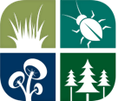


Japanese Climbing Fern
Additional Resources
Southern Regional Extension Forestry
http://southernforesthealth.net/
Alabama Cooperative Extension
https://www.aces.edu/blog/topics/forestry-wildlife/japanese-climbing-fern-identification-control/
University of Florida IFAS Extension
https://edis.ifas.ufl.edu/publication/FR280
* Created by Katy Crout Moretti & David Coyle (Clemson University); Lynne Womack (US Forest Service)

