Slide 1



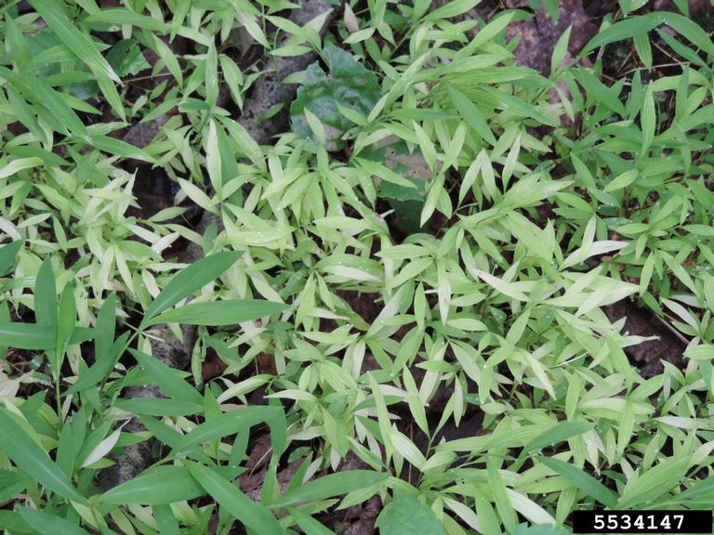
Japanese Stiltgrass
Microstegium vimineum
Invasive, annual grass in the Poaceae family
Also known as Nepalese browntop, Japanese grass, Mary’s grass, and more
Richard Gardner, bugwood.org

Slide 2
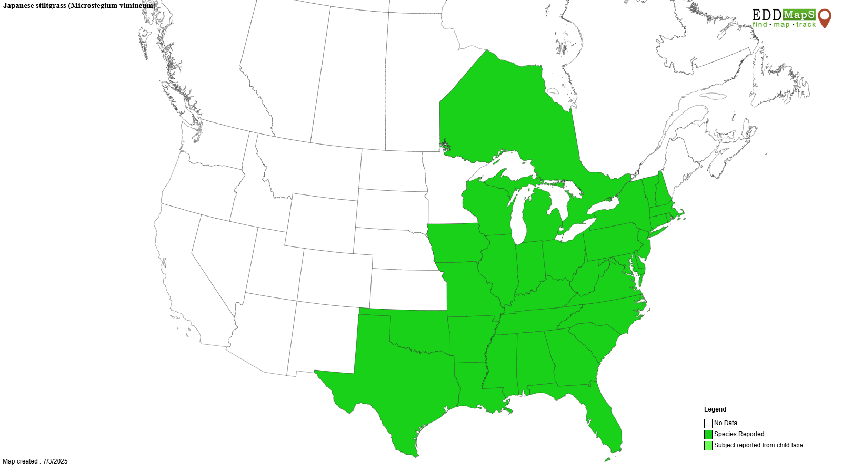
Japanese Stiltgrass
Introduction
Originates from parts of Asia
Introduced around the 1920s – most likely as packing materials
Has since spread through most of eastern North America

Slide 3
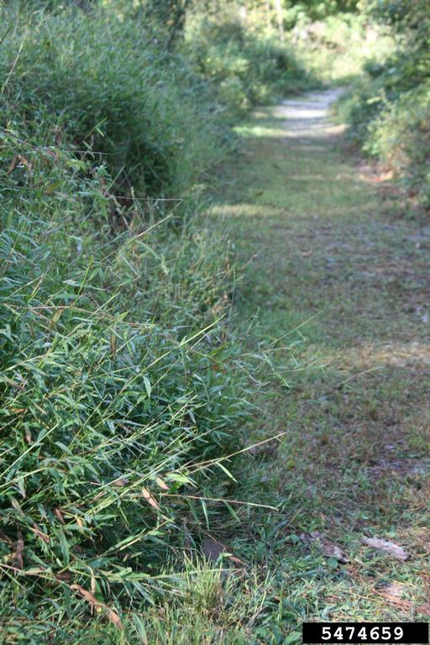
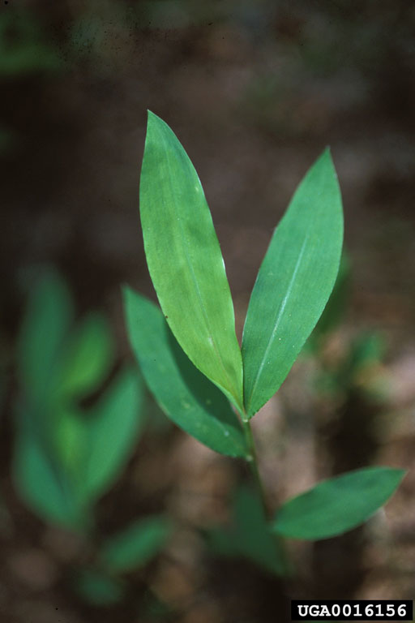
Japanese Stiltgrass
Description
Height: typically ½ -3 feet, up to 6 feet possible
Blades/ leaves: pale green color, slightly pubescent, pointed on both ends with smooth edges, and a silvery off-centered midrib, 2-4 inches long, ½ inch wide, alternate and well spaced along stem
Chris Evans, University of Illinois, bugwood.org
James H. Miller, USDA, bugwood.org

Slide 4
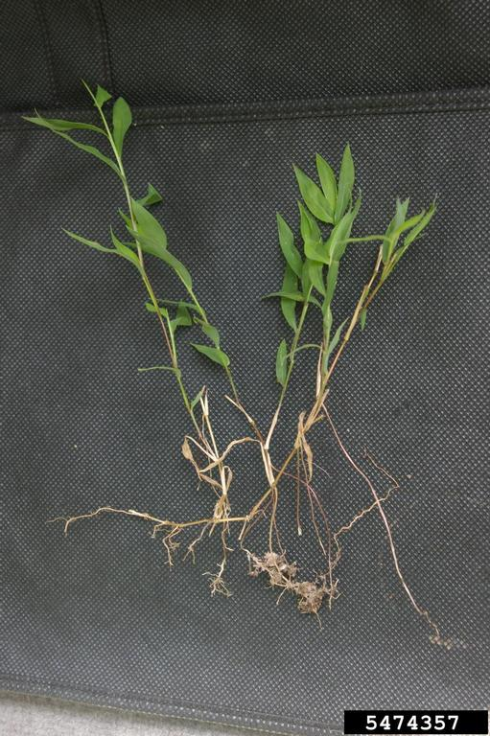
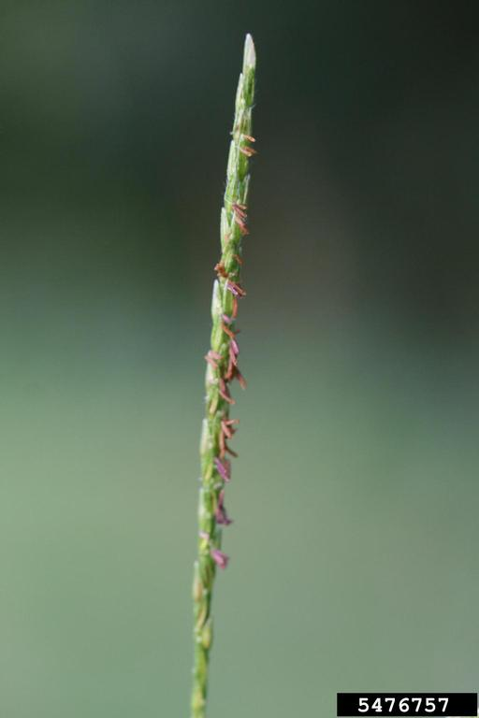
Japanese Stiltgrass
Description
Stem: Thin, smooth, multiple stems often present, longer stems typically droop and can root at the nodes, green in spring and summer, purple to brown color in the fall, and tannish color in winter
Flower/ seed head: small, delicate, closed flowers occur in short branchlets lower on the stem, may have 1-3 spikes
Roots: usually shallow and fibrous
Nancy Loewenstein, Auburn University, bugwood.org
Chris Evans, University of Illinois, bugwood.org

Slide 5
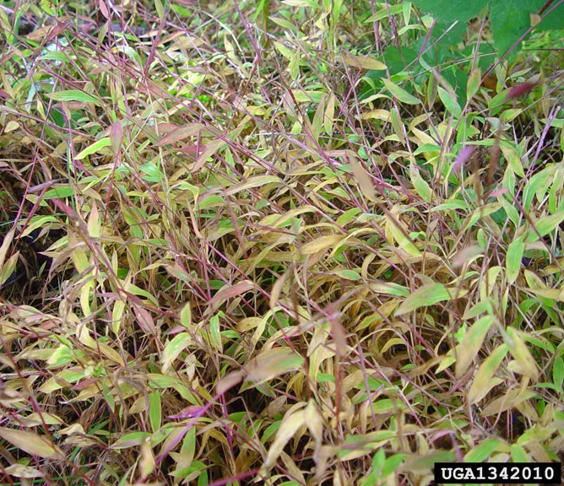
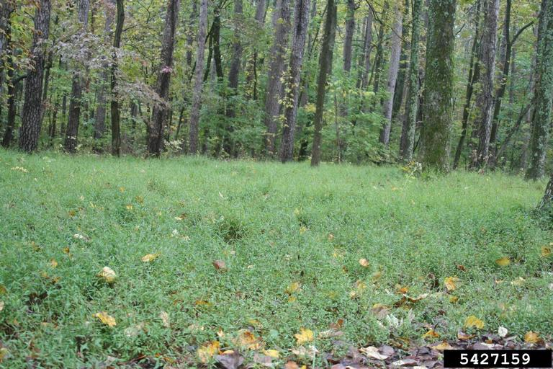
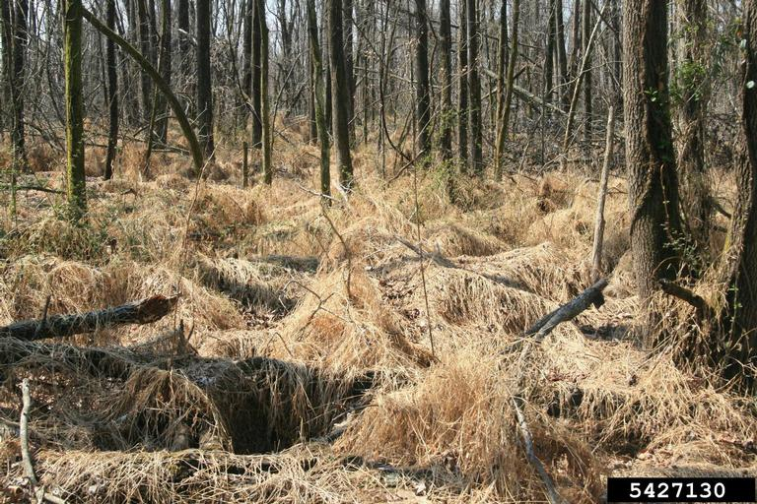
Japanese Stiltgrass
Growth
Often grow in dense, sprawling, mat-like infestations commonly found in shady, moist, disturbed sites but can tolerate different light and moisture conditions
Chris Evans, University of Illinois, bugwood.org

Slide 6
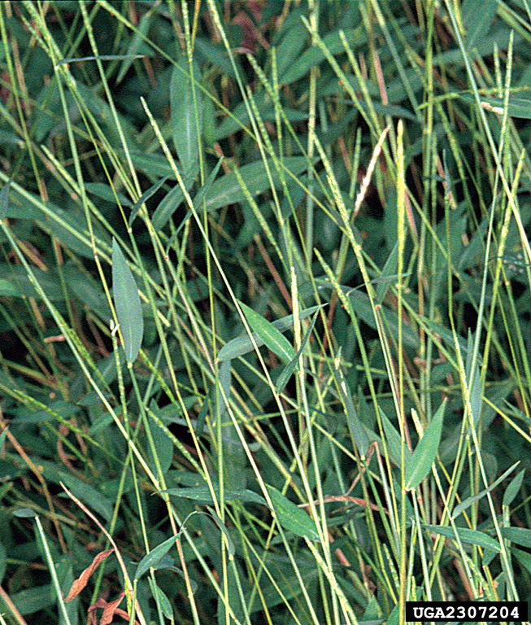
Japanese Stiltgrass
What Makes it a Successful Invader?
Prolific seed producer – each plant can produce 100 to 1,000 seeds that remain viable for up to three years and are easily spread by wildlife, wind, human movement, etc.
Vegetative propagation – sprouts new shoots from stems that touch the ground
Self fertilization – some flowers are cleistogamous
James H Miller & Ted Bodner, bugwood.org

Slide 7
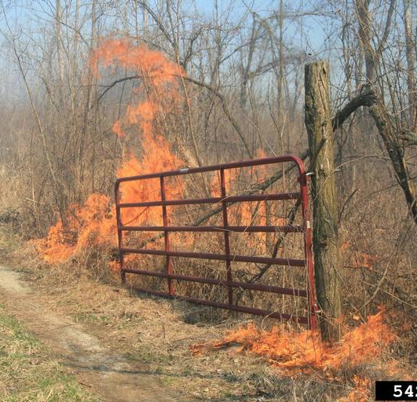
Japanese Stiltgrass
Impact
Aggressive invader that can be found invading forested floodplains, ditches, roadsides, fields, forest edges, etc.
Outcompetes and displaces native vegetation, disrupting ecosystems, reducing wildlife habitat, and decreasing tree growth and establishment success.
Left unchecked, can overtake native vegetation in as little as 3-5 years.
Winter thatch can be fuel for fires.
Chris Evans, University of Illinois, bugwood.org

Slide 8
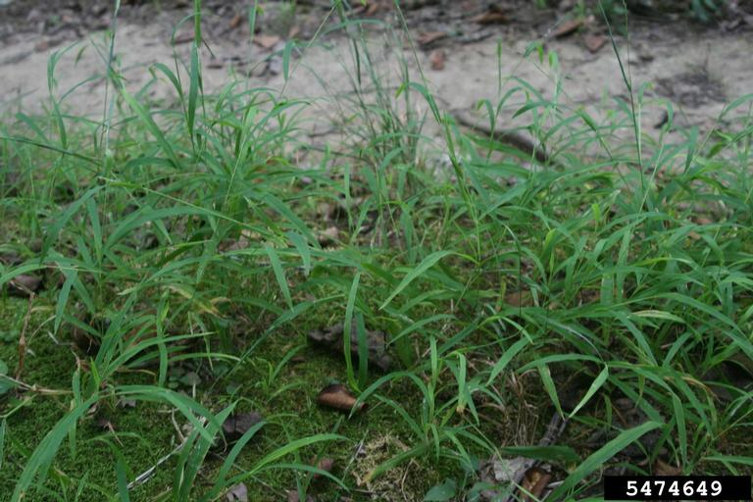
Japanese Stiltgrass
Look-Alikes
Leersia virginica
Common names: Virginia cutgrass, whitegrass
Difference: leaves thinner, longer, and lacks an obvious midrib stripe, seedheads are flat, compressed, more open and spreading
Chris Evans, University of Illinois, bugwood.org

Slide 9
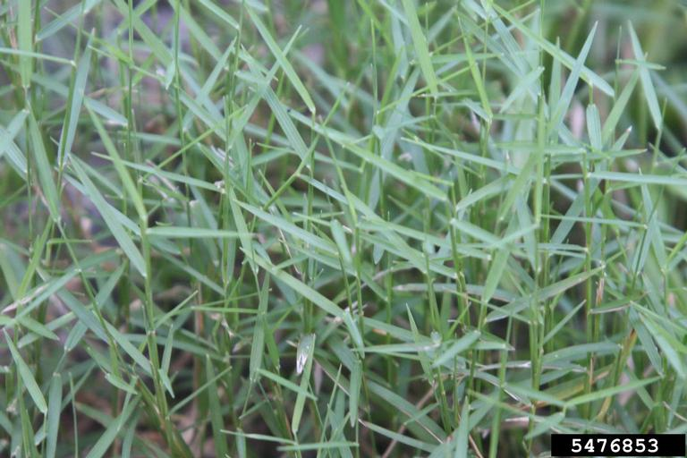
Japanese Stiltgrass
Look-Alikes
Muhlenbergia schreberi
Common name: nimblewill
Difference: leaves are very narrow with a sharp point, stalky stems, branching seed heads, lacking unique silvery line along the midrib
Chris Evans, University of Illinois, bugwood.org

Slide 10
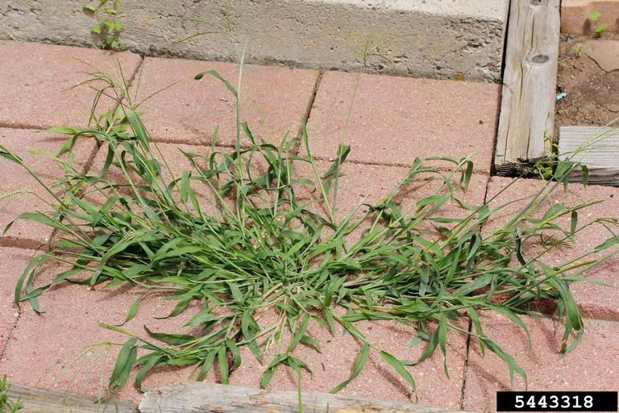
Japanese Stiltgrass
Look-Alikes
Digitaria spp.
Common name: crabgrass
Difference: stem appears flattened, leaves often longer and pointed at tip, lacking unique silvery midrib, stalky stems, branching seed heads
Joseph Berger, bugwood.org

Slide 11
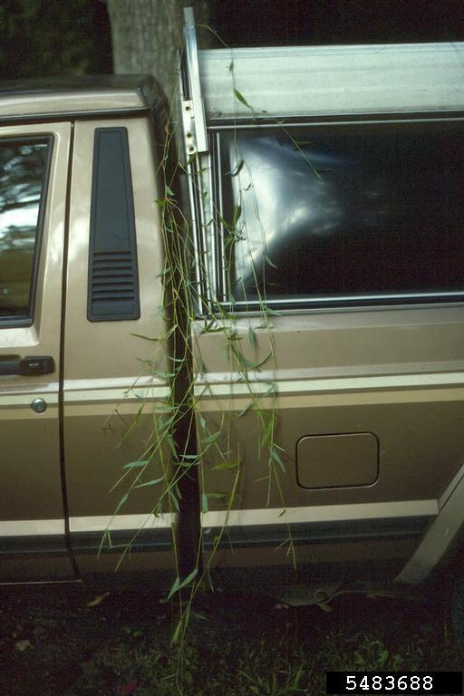
Japanese Stiltgrass
Management
Prevention – slow the spread of Japanese stiltgrass by checking equipment for seeds and other plant parts that could start new infestations.
Chemical – multiple herbicides can be effective against Japanese stiltgrass including dithiopyr, indaziflam, glyphosate, clethodim, etc. Always follow the label and wear appropriate PPE.
Leslie J Mehrhoff, bugwood.org

Slide 12
Japanese Stiltgrass
Management
Mechanical – hand pulling is possible for small infestations due to their shallow root systems but should be completed before flowers are visible to prevent seeds from maturing and spreading. Mowing can be effective for larger infestations. Both techniques need to be repeated numerous times to deplete plant resources and seed banks.

Slide 13



Japanese Stiltgrass
Additional Resources
Southern Regional Extension Forestry
http://southernforesthealth.net/
Alabama Cooperative Extension
https://www.aces.edu/blog/topics/forestry-wildlife/field-guide-to-the-identification-of-japanese-stiltgrass/
NC State Extension
https://content.ces.ncsu.edu/japanese-stiltgrass-identification-and-management
* Created by Katy Crout Moretti & David Coyle (Clemson University); Reviewed by Lynne Womack (US Forest Service)

