Slide 1



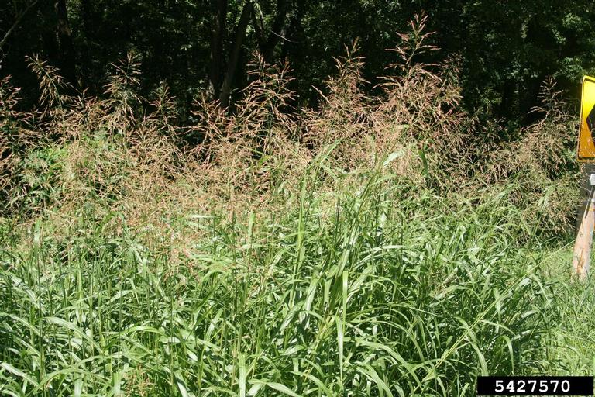
Johnson grass
Sorghum halepense
Invasive, perennial grass in the Poaceae family
Known as one of the most persistent and troublesome weeds in the southern US
Chris Evans, University of Illinois, bugwood.org

Slide 2
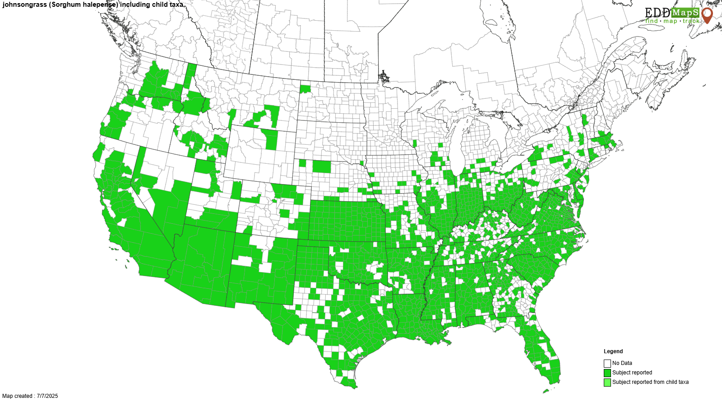
Johnson grass
Introduction
Native to the Mediterranean region
Introduced in the early 1800s as a forage species
Has since spread and become naturalized throughout much of the US and the world

Slide 3
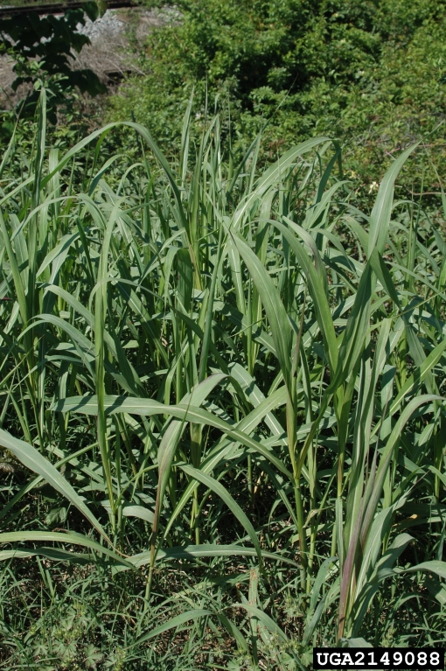
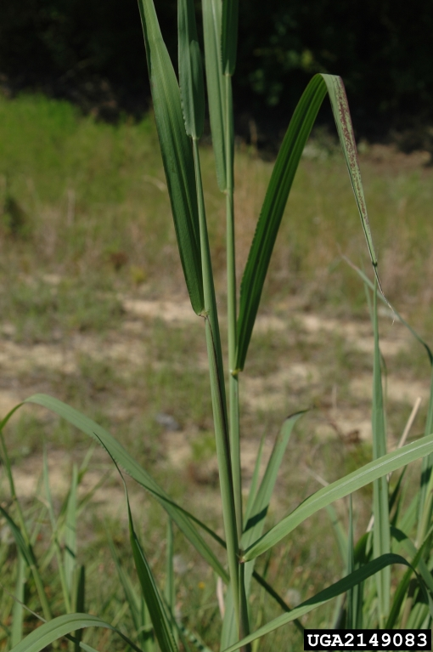
Johnson grass
Description
Height: 4-8 feet
Blades/leaves: about 1-1.5 inches wide and 8-24 inches long (can be up to 35 inches long), rough underside, sharp to the touch, prominent white midrib
Stem: stout, unbranched, hairy nodes present along stem
Chris Evans, University of Illinois, bugwood.org
Chris Evans, University of Illinois, bugwood.org

Slide 4
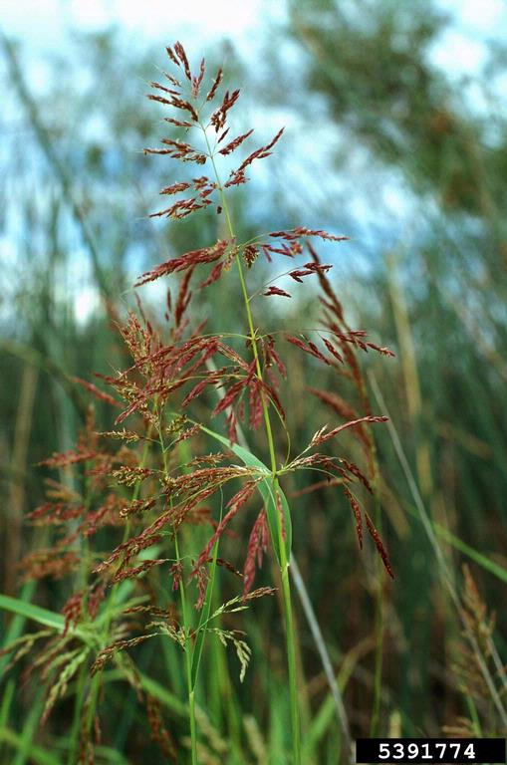
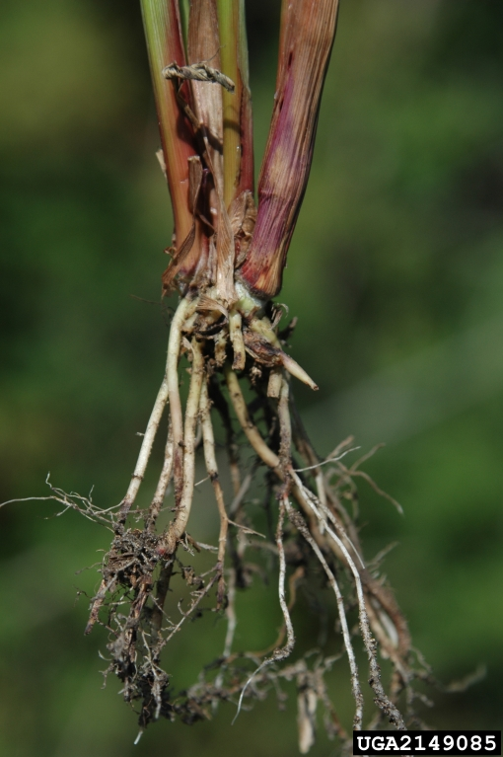
Johnson grass
Description
Flowers: panicle inflorescence that is purplish in color and containing red-purple flowers, large and can be more than a foot tall, loosely branched
Seed head: seed head has an open, angular panicle, reddish-brown to red-black color, 4-20 inches long
Roots/rhizome: fleshy, white, aggressively creeping rhizome system
Barry Rice, bugwood.org
Chris Evans, University of Illinois, bugwood.org

Slide 5
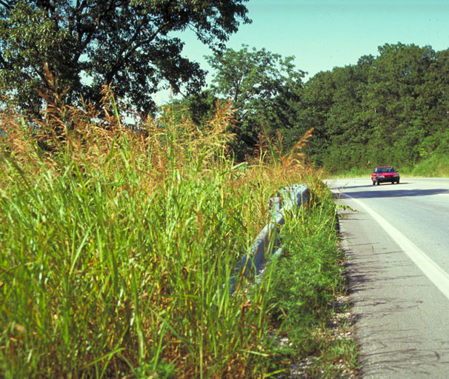
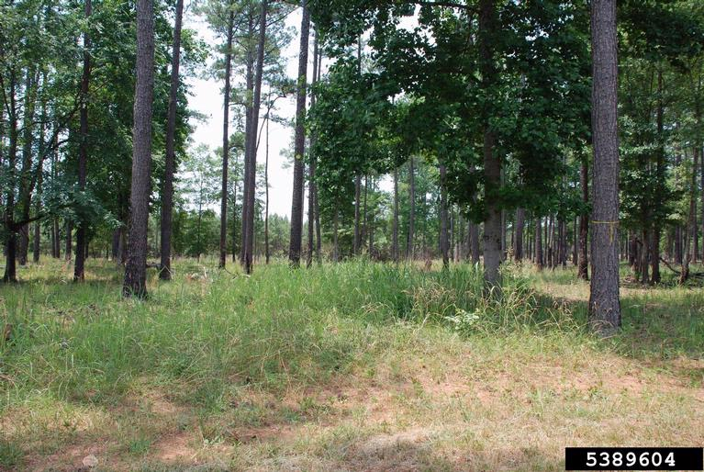
Johnson grass
Growth
Often grows in large, dense patches due to its large, creeping rhizomatous root system
Commonly found growing along roadsides, fields, forests, ditches, wetlands, etc.
Bonnie Harper-Lore, bugwood.org
Chris Evans, University of Illinois, bugwood.org
Nancy Loewenstein, Auburn University, bugwood.org

Slide 6
Johnson grass
What Makes it a Successful Invader?
Vegetative propagation – can produce 200-300 feet of new growth per year, new shoots arise from rhizome system allowing it to easily spread
Adaptable – can grow in varying light conditions and in dry to moist soils, although it is not tolerant of flooding
Seed producer – can also spread via seeds, easily distributed via wildlife, humans, etc., seeds remain viable for 6 years

Slide 7
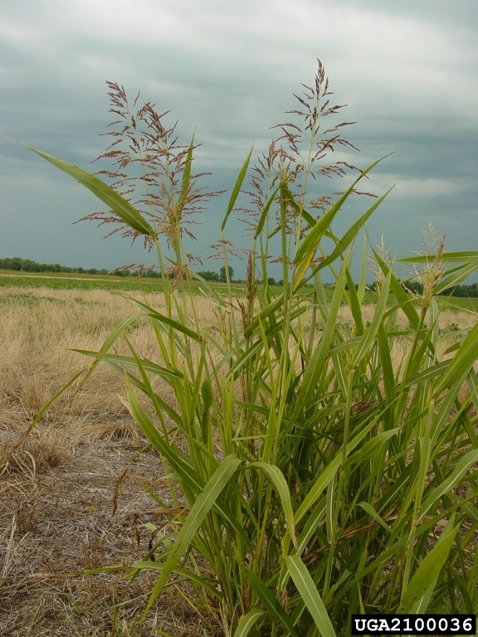
Johnson grass
Impact
Aggressively spreads and invades a wide range of sites
Outcompetes and displaces native vegetation, disrupting ecosystems, reducing wildlife habitat, and decreasing tree growth and establishment success
Nearly impossible to completely remove once established
Charles T Bryson, USDA, bugwood.org

Slide 8
Johnson grass
Management
Prevention – slow the spread of Johnson grass by avoiding soil disturbance in infested areas and check equipment for seeds and plant parts that could start new infestations.
Chemical – many herbicides are effective at reducing Johnson grass growth, including glyphosate, clethodim, and sulfosulfuron. Always follow the label and wear appropriate PPE when working with chemicals.

Slide 9
Johnson grass
Management
Mechanical – difficult to remove via hand pulling due to extensive underground system – all rhizomes would have to be removed to prevent regrowth. Repeated mowing can reduce growth and reduce seed production. Mechanical methods alone do not generally eradicate this grass but can be successful when used with chemical control for an integrated management approach.

Slide 10



Johnson grass
Additional Resources
Southern Regional Extension Forestry
http://southernforesthealth.net/
UF IFAS Extension
https://edis.ifas.ufl.edu/publication/EP620
Illinois Extension
https://extension.illinois.edu/invasives/invasive-johnsongrass
* Created by Katy Crout Moretti & David Coyle (Clemson University); Reviewed by Lynne Womack (US Forest Service)

