Slide 1



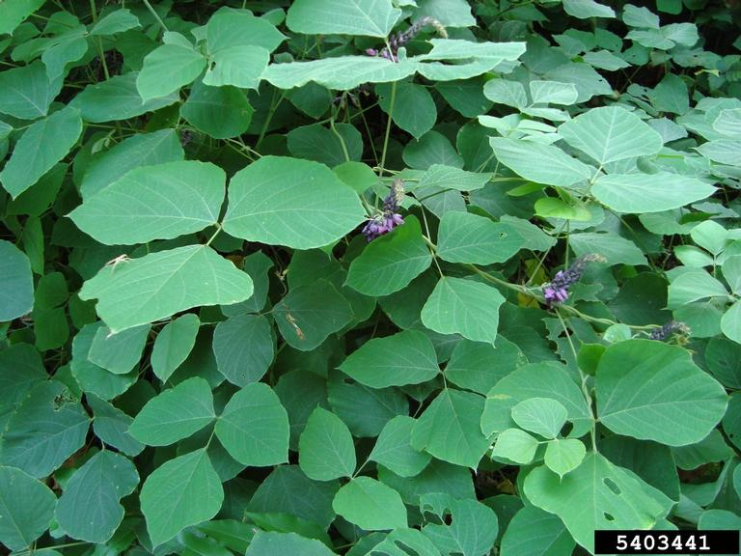
Kudzu
Pueraria montana var. lobata
Invasive, perennial vine in the Fabaceae family
Known by many as the vine that ‘ate’ the South
Karen Brown, UF, bugwood.org

Slide 2
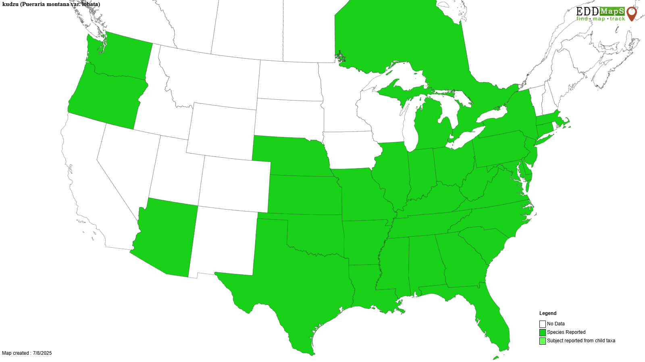
Kudzu
Introduction
Native to areas of Asia including China, Taiwan, Japan, and India
First brought to the US in the 1800s in different exhibitions and as an ornamental vine
In the 1930s the US government promoted kudzu as erosion control and plants were given out across the South
By the 1950s kudzu had spread rapidly and was removed from the USDA list of permissible cover plants

Slide 3
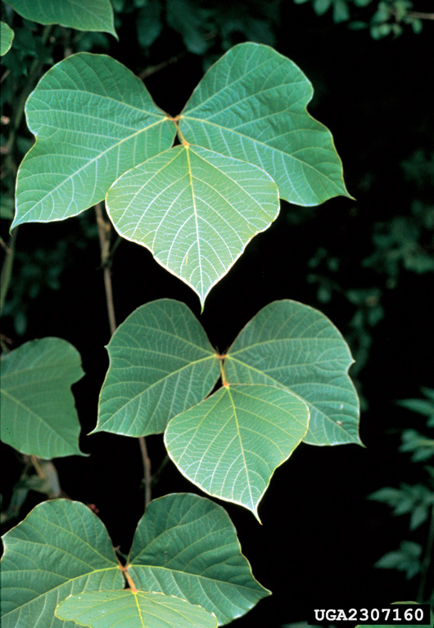
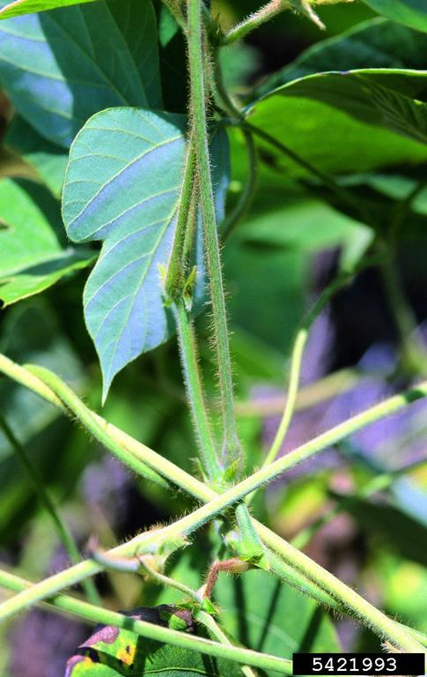
Kudzu
Description
Leaves: dark green color, alternate, broadly ovate, compound with three leaflets, up to 8 inches long, hairy on the underside and margins, smooth or lobed margin
Stem: young stems are hairy and yellow green in color, harden to a grey woody stem as they mature, grow up to 10 inches in diameter
James H Miller, USDA, bugwood.org
James H Miller, USDA, bugwood.org

Slide 4
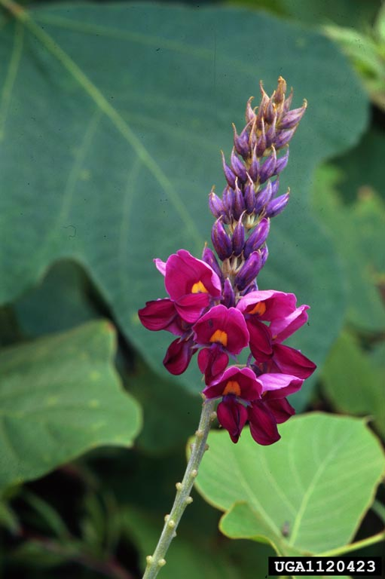
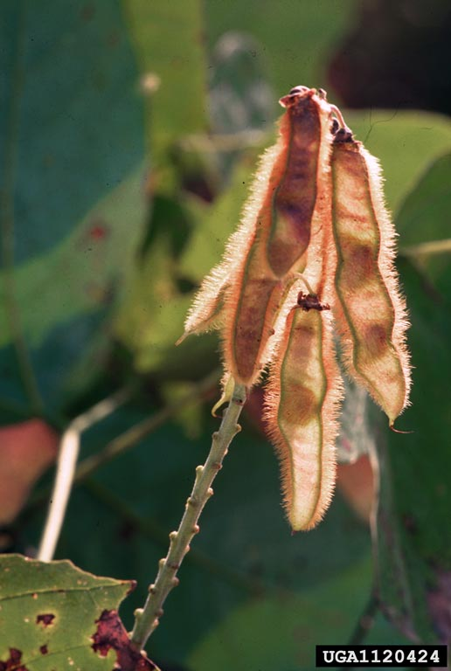
Kudzu
Description
Flowers: clustered, appear on spikes that are up to 8 inches long, purple color, fragrant
Fruit: legume, green color that turn brown as they mature hairy, flat, 3 inches long and half inch wide, can contain 3-10 seeds
Roots: starchy, tuberous, can reach up to 12 feet deep, can weigh 200-300 pounds
James H Miller, USDA, bugwood.org
James H Miller, USDA, bugwood.org

Slide 5
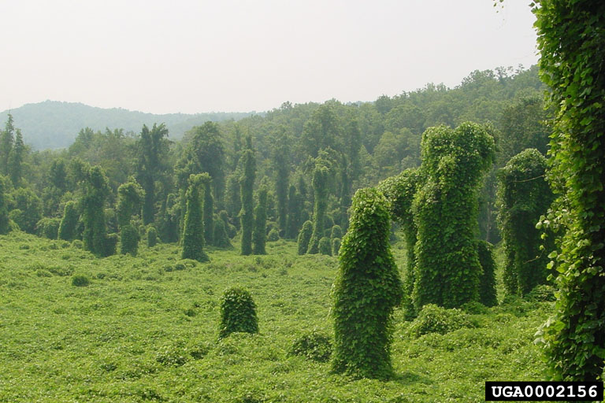
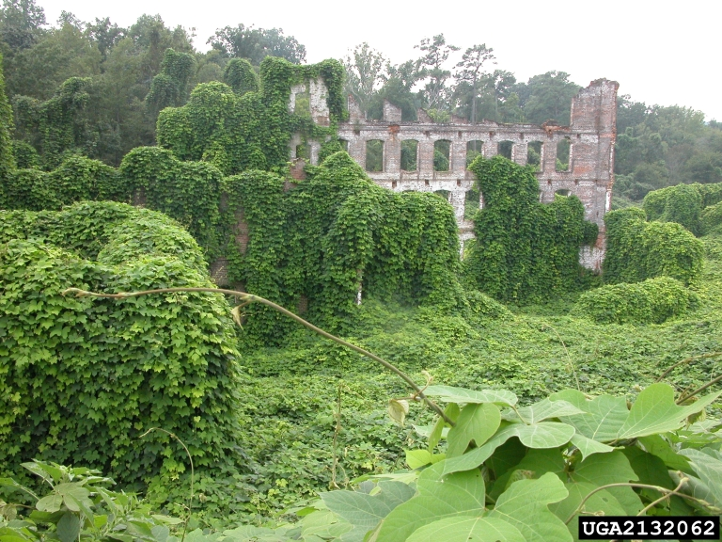
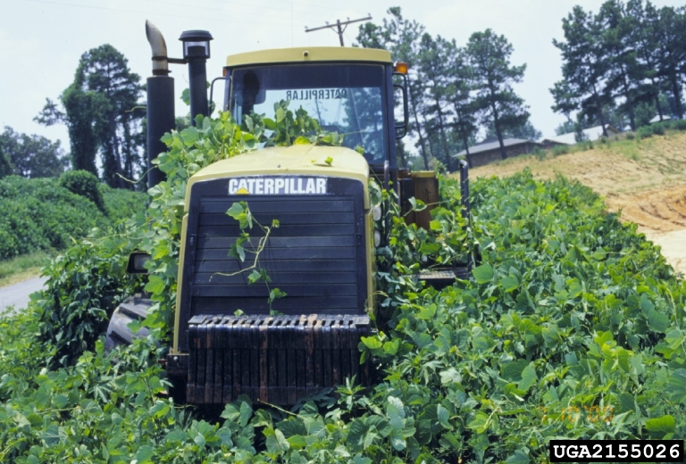
Kudzu
Growth
Twining vine that creates dense monocultures – mature stands can contain tens of thousands of plants per acre and can create mats up to 8 feet thick
Takes over old fields, roadsides, abandoned buildings, forest edges, etc.
Kerry Britton, USDA, bugwood.org
Johnny Randall, NC Botanical Garden, bugwood.org
John D Byrd, MSU, bugwood.org

Slide 6
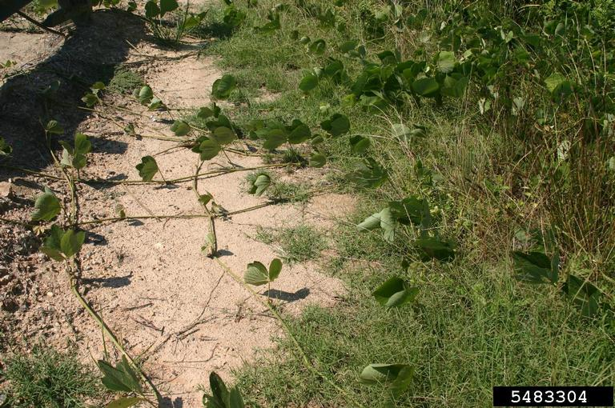
Kudzu
What Makes it a Successful Invader?
Quick growth rate – can grow up to 60 feet in a single season and up to 1 foot per day
Extensive root system – can grow up to 12 feet deep allowing better access to resources and making it more difficult to remove
Vegetative propagation – vines growing along the ground can root at nodes to form new plants
Leslie J Mehrhoff, bugwood.org

Slide 7
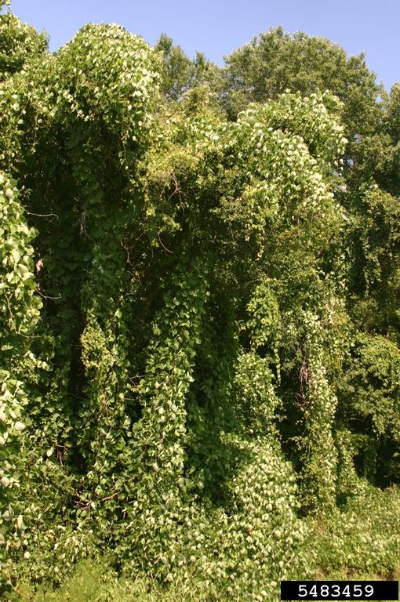
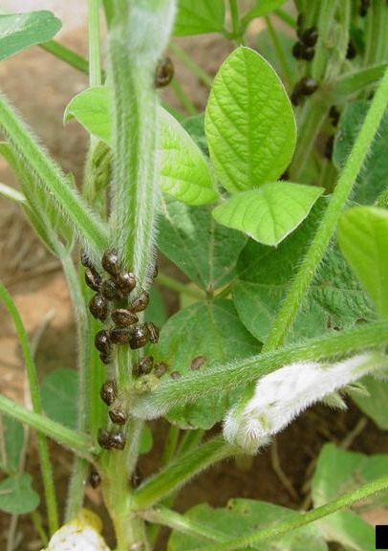
Kudzu
Impact
Kudzu bug on soybeans
Often shades out and smothers native plants which disrupts ecosystems by displacing native vegetation, reducing wildlife habitat, hinders tree growth and even causes tree mortality.
Serves as a host for many agricultural pests and diseases.
Leslie J Mehrhoff, bugwood.org
Phillip Roberts, UGA bugwood.org

Slide 8

Kudzu
Management
Prevention – before leaving infested areas inspect clothing, equipment, vehicles, etc. for any plant parts that could start new populations to help slow the spread.
Mechanical – heavy grazing and cutting close to the ground can help to exhaust root reserves but must be repeated over several years and are not as effective on old, well-established infestations.
Jil Swearingen, USDI, bugwood.org

Slide 9
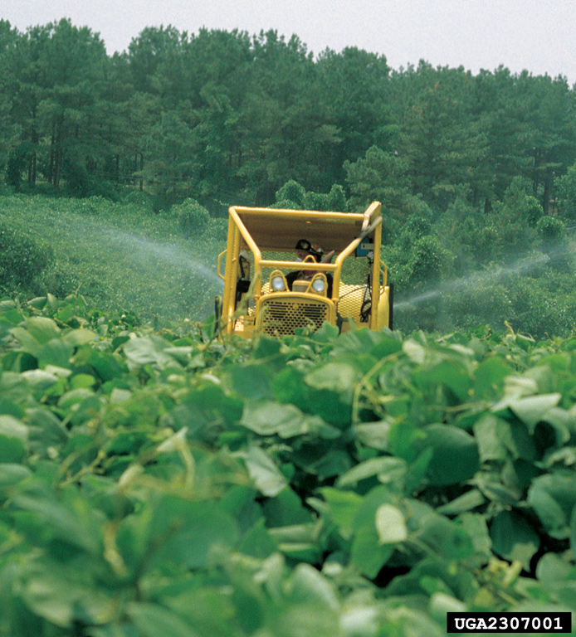
Kudzu
Management
Chemical – several herbicides can help manage kudzu when used as foliar sprays including clopyralid, aminopyralid, triclopyr, and glyphosate, but must be repeated on established populations. Always follow the label and wear appropriate PPE.
Fire – cand be used as an initial treatment to clear old growth before using mechanical or chemical techniques to target the new growth that returns.
James H Miller, USDA, bugwood.org

Slide 10



Kudzu
Additional Resources
Southern Regional Extension Forestry
http://southernforesthealth.net/
Alabama Cooperative Extension
https://www.aces.edu/blog/topics/forestry-wildlife/the-history-and-use-of-kudzu-in-the-southeastern-united-states/
University of Illinois Extension
https://extension.illinois.edu/invasives/kudzu
* Created by Katy Crout Moretti & David Coyle (Clemson University); Reviewed by Lynne Womack (US Forest Service)

