Slide 1



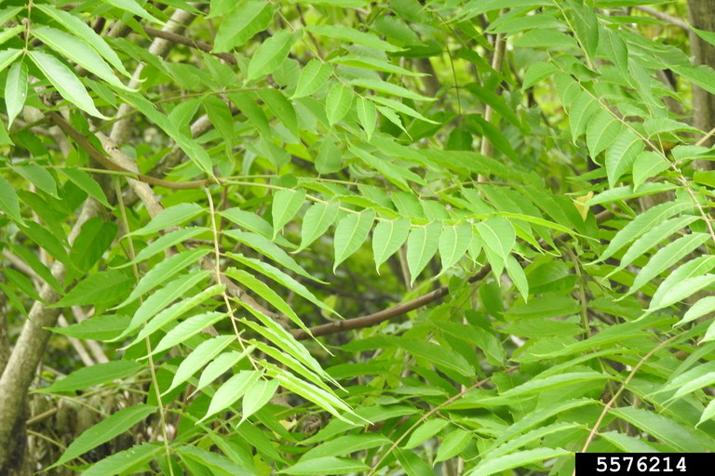
Tree of Heaven
Ailanthus altissima
Invasive, deciduous tree in the Simaroubaceae family
Also known as Chinese sumac and paradise tree
Richard Gardner, bugwood.org

Slide 2
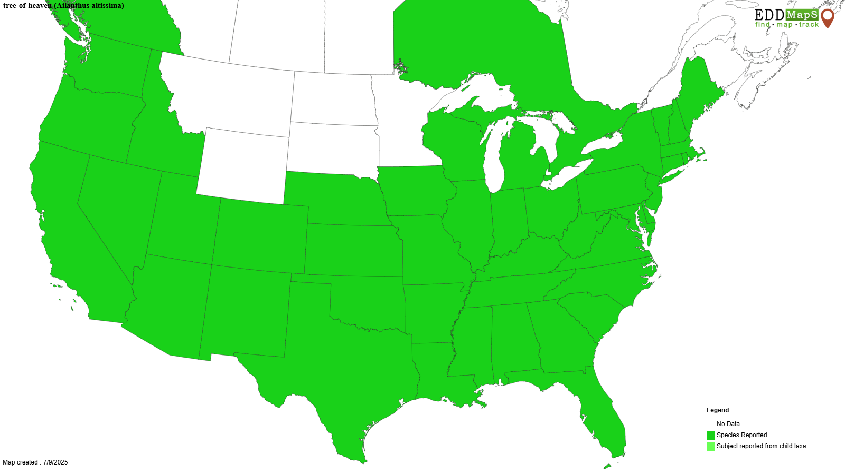
Tree of Heaven
Introduction
Native to parts of China and Taiwan
Introduced to the US in the mid to late 1700s as an ornamental species
Was once widely planted across several states
Has since spread to most states across the US

Slide 3
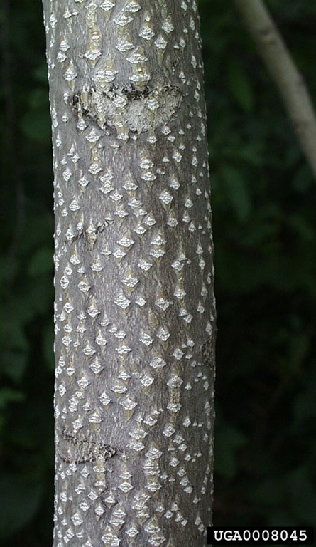
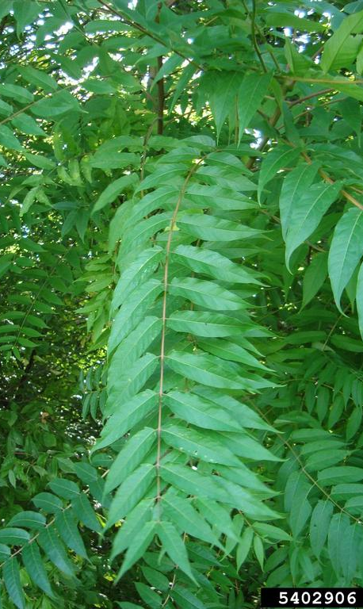
Tree of Heaven
Description
Height: up to 80 feet
Stem: 6 feet in diameter, smooth bark with lenticels, light gray brown color, develops fissures with maturity, heart shaped scar left on branch after leaves fall, twigs have a spongy brown center
Leaves: pinnately compound, 1-4 feet in length, around 10-40 lance shaped leaflets present, smooth edges, raised protruding bumps/glands at base
Paul Wray, Iowa State University, bugwood.org
Annemarie Smith, ODNR, bugwood.org

Slide 4
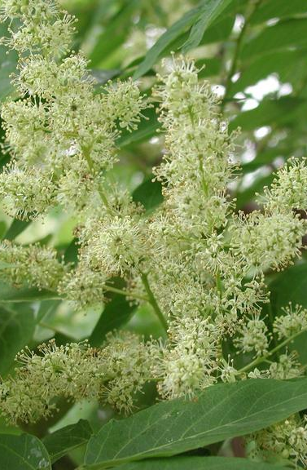
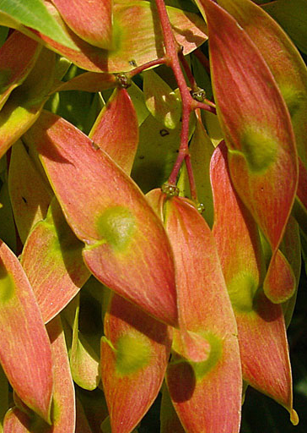
Tree of Heaven
Description
Flowers: large clusters of small yellow flowers that develop above the foliage
Fruits: produced on female plants in clusters, tan to reddish color, single flat twisted wing with one rounded seed in the middle, 1-2 inches in length
Smell: parts of this tree including the leaves have a distinct smell compared to burnt peanut butter
Leslie J Mehrhoff, bugwood.org
Chuck Bargeron, UGA, bugwood.org

Slide 5
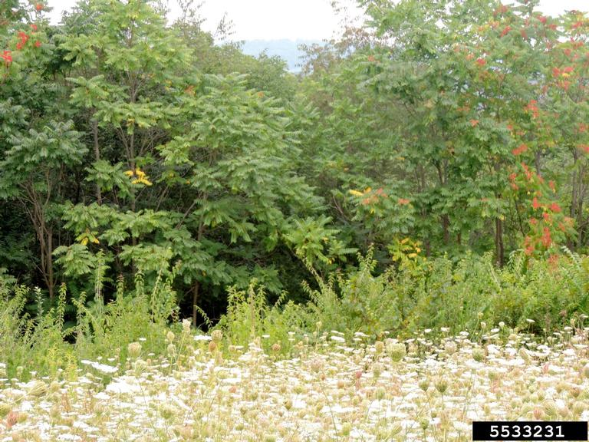
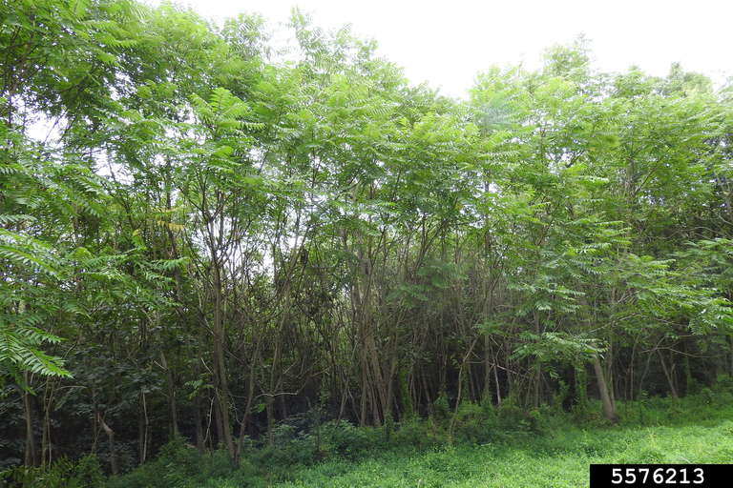
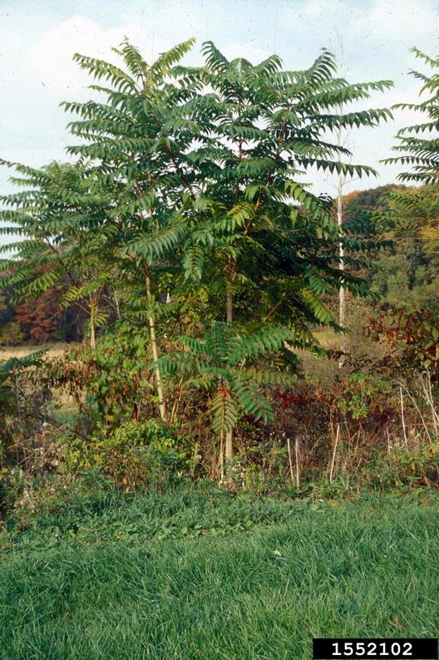
Tree of Heaven
Growth
Forms dense, clonal thickets
Rapidly invades forest edges, fields, roadsides, etc.
Richard Gardner, bugwood.org
Catherine Herms, bugwood.org

Slide 6
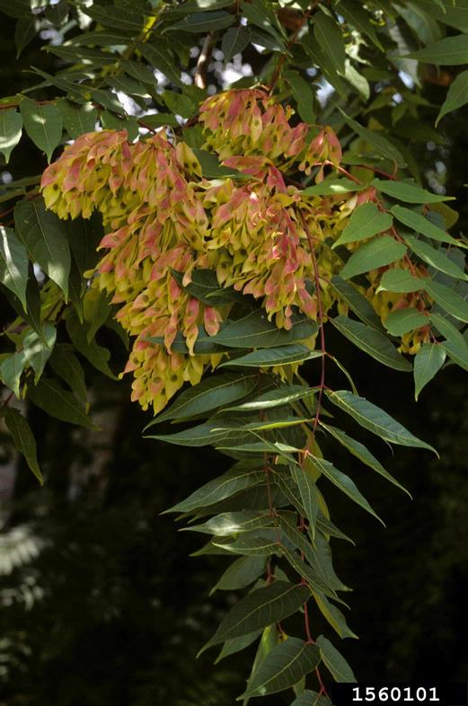
Tree of Heaven
What Makes it a Successful Invader?
Prolific seed producer – a single mature tree can produce 350,000 seeds per year with a high germination rate, can disperse via wind, water, or wildlife
Adaptable – can grow in shallow soils with a variety of soil types
Fast growth – known for its rapid growth that made it a popular ornamental street tree, sprouts can grow 3 feet in a single season
Ohio State Weed Lab, bugwood.org

Slide 7
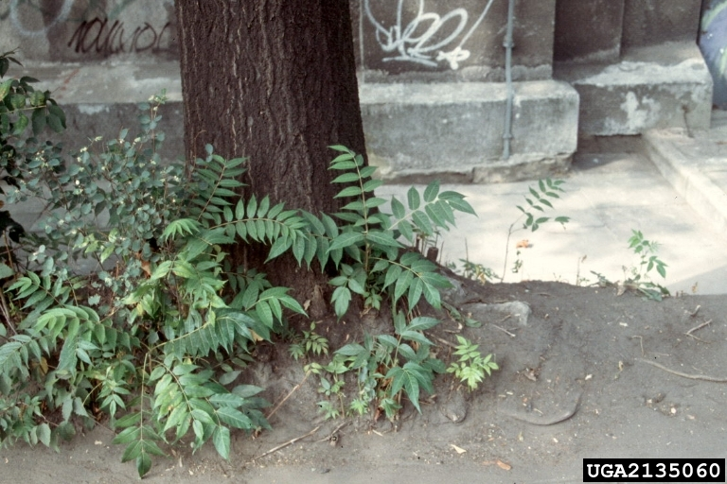
Tree of Heaven
What Makes it a Successful Invader?
Vegetative reproduction – spread via root sprouts/ suckers that can appear 50 feet or more from the parent tree
Allelopathic – produces chemicals that limit or prevent the growth of other plant species in its vicinity
Barbara Tokarska-Guzik, bugwood.org

Slide 8
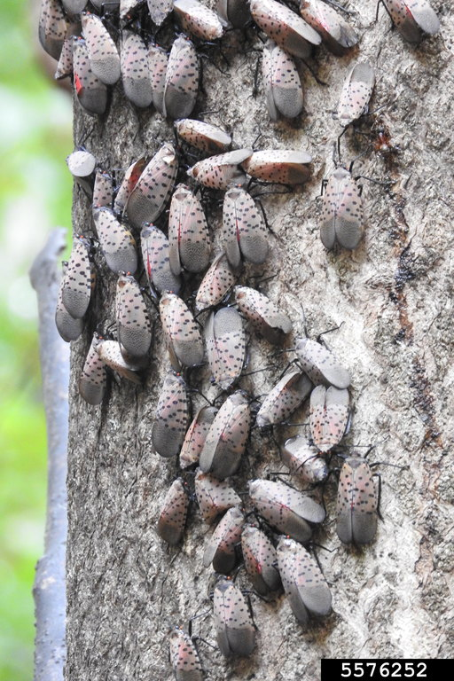
Tree of Heaven
Host Tree
Host plant for spotted lanternfly, SLF (Lycorma delicatula) – an invasive insect in forests and horticultural and agricultural crops
SLF can feed on over 100 plant species, but its preferred host is tree of heaven
SLF nymphs and adult have higher survival rates when tree of heaven is present, and adult females produce more eggs
Tree of heaven can be used to monitor for SLF populations
Richard Gardner, bugwood.org

Slide 9
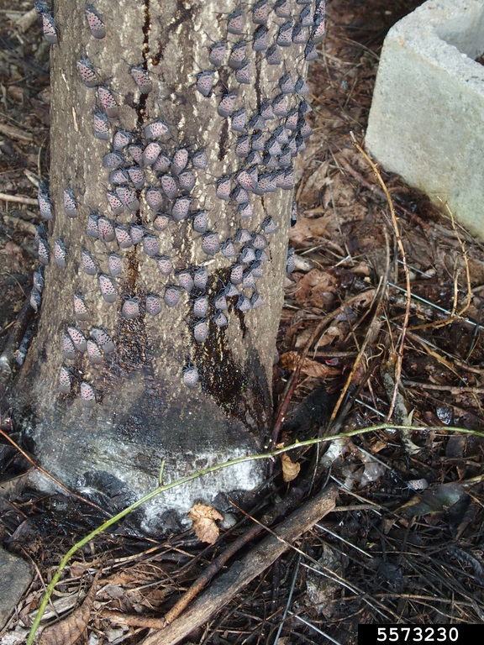
Tree of Heaven
Impact
Outcompetes and displaces native vegetation which leads to disrupting ecosystems, reducing wildlife habitat, and decreasing tree growth and establishment success
In urban areas where SLF is present, their feeding on tree of heaven can lead to honeydew – that attracts stinging insects – and black sooty mold that can coat any objects beneath the trees
Male trees produce copious amounts of pollen affecting people with seasonal allergies
Emelie Swackhamer, Penn State University, bugwood.org

Slide 10
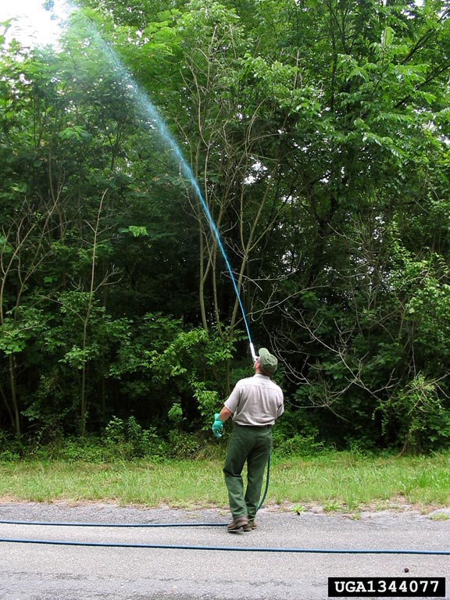
Tree of Heaven
Management
Prevention – slow the spread by checking equipment, shoes, etc. for root segments that could start new infestations.
Chemical – several herbicides can be used for control including glyphosate, imazapyr, dicamba, methyl, triclopyr, and metsulfuron. Always follow the label and wear the appropriate PPE when handling chemicals.
GSMNP, USDI National Park Service, bugwood.org

Slide 11
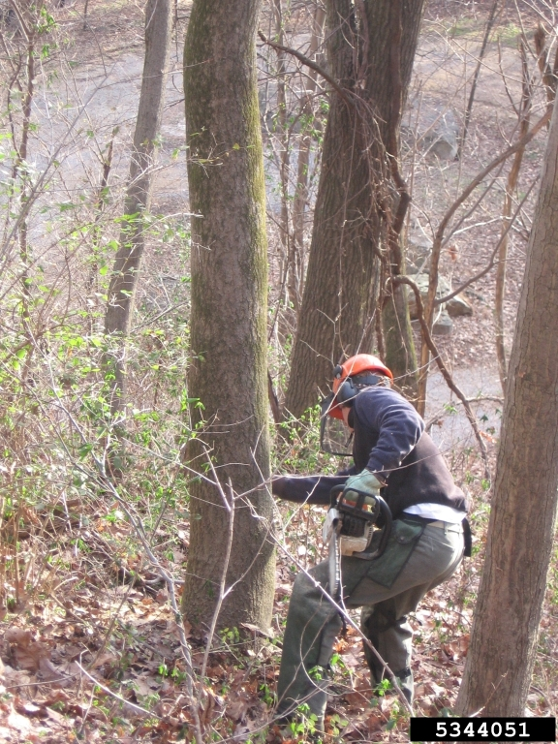
Tree of Heaven
Management
Mechanical – hand pulling can be effective for young seedlings if the entire root system is removed. Its extensive root system and ability to resprout make it difficult to control by mowing or cutting without continued treatment or the addition of chemical treatment for an integrated management approach.
Nancy Dagley, USDI National Park Service, bugwood.org

Slide 12



Tree of Heaven
Additional Resources
Southern Regional Extension Forestry
http://southernforesthealth.net/
NC State Extension
https://content.ces.ncsu.edu/tree-of-heaven-ailanthus
Michigan State Extension
https://www.canr.msu.edu/resources/a-tale-of-two-invaders-tree-of-heaven-and-spotted-lanternfly
* Created by Katy Crout Moretti & David Coyle (Clemson University); Reviewed by Lynne Womack (US Forest Service)

